Slide 1
Opioid Misuse Prevention Program (OMPP)
By: Kendall Wood
Program Coordinator
Email: Kendall.E.Wood@medstar.net
Phone: 240-434-7659

Slide 2
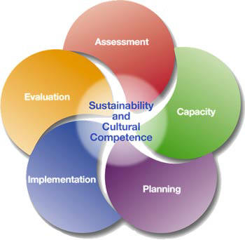
What is OMPP?
The Opioid Misuse Prevention Program
Initiative designed to reduce opioid misuse, reduce opioid overdoses, and reduce opioid-related fatalities
State-funded multi-year project
Uses the SPF Model
Notes:
The SPF Model was also used for the activities of the Community Alcohol Coalition.

Slide 3
Needs Assessment
Approved on 8/31/15
Findings
  Insight on community perceptions related to opioid misuse
  Lack of awareness and consequences of opioid misuse
  Perceived main sources of supply and distribution as:
    Over-prescription by physicians
    Friends and family members
  Perceived main users of opioid (including heroin) were identified as 18-25 year olds and 26-44 year olds.
Notes:
ASSESSMENT-This step involves the collection of data to identify and prioritize problems within a geographic area, as well as an assessment of resources and readiness within the community to address needs and gaps.
*Remind the group how the assessment was conducted: Reviewed of quantitative and qualitative data, 25 key informant interviews, 7 focus groups that were conducted when we contacted with Health Resource in Action and we also looked at data from the Maryland Public Opinion Survey on Opioids and Youth Risk Behavior Survey(YRBS)
*The community perceptions were

Slide 4
Changeability Assessment
High importance and most likely to change:
  Retail Availability
    Over-prescription of opioids by local physicians
    Lack of prescriber participation in Prescription Drug Monitoring Program (PDMP)
  Social Availability
    Lack of knowledge of proper storage and disposal of opioids
    Availability of opioids from family and friends
Notes:
Changeability Assessment is a tool that we used to help us identify
which contributing factors are most important to addressing opioid misuse in St. Mary’s County
which factors are more likely to change in response to our efforts.

Slide 5
Strategic Plan
Approved on 11/12/15
Intervening Variable: Retail Availability
  Contributing Factor: Over prescription of opioids by physicians
    Strategy selected : Educate prescribers and dispensers
  Contributing Factor: Lack of prescribers participation in PDMP
    Strategy selected : Educate and enroll prescribers in PDMP
Intervening Variable: Social Availability
  Contributing Factor: Lack of knowledge of proper storage and disposal of prescription medications
    Strategies selected: Drug Take Back events and SmartMedicine Campaign(focus on storage and disposal of meds)
Notes:
STRATEGIC PLANNING- Planning involves the development of a strategic plan that utilizes policies, programs, and practices to address the evidence-identified factors that contribute to a community issue.
*If you use the terms Intervening Variable and Contributing Factor – make sure you can explain what that means to a group that isn’t SPF savvy*

Slide 6
Implementation-What’s the Plan?
Strategy: Prescriber and Dispenser education
  Outreach to 185 prescribers and other health care professionals
  Outreach to 17 local dispensers
  Distribute 185 tool kits and other educational materials to prescribers
  Distribute 17 sets of dispenser-focused educational materials
  Develop and distribute an educational video for patient waiting rooms
Notes:
IMPLEMENTATION-This step involves the implementation of strategies or programs identified in the strategic plan.

Slide 7
What’s the Plan?
Strategy: Prescriber education on PDMP
  Develop educational materials on PDMP
  Distribute PDMP materials to all prescribers
Strategy: Prescriber enrollment in PDMP
  Contact CRISP/PDMP administrators on enrollment procedures
  Contact presenter/trainer, schedule an enrollment date, and develop training materials
  Identify and invite local physicians to enrollment session
  Hold at least one enrollment session

Slide 8
What’s the Plan?
Strategy: Drug Take Back Events
  Maintain partnership with St. Mary’s Sheriff’s Office
  Research upcoming events that this would be appropriate
  Contact Event Coordinators and finalize dates
  Have at least 2 Drug Take Back events scheduled for FY16
Strategy: SmartMedicine Campaign
  Develop awareness and outreach materials
  Reach 10,000+ community members with media campaign
  Distribute the materials to all local physicians offices, pharmacies, and community members.

Slide 9
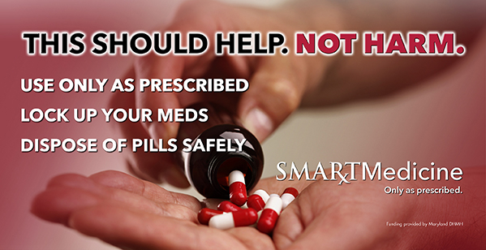
What has been developed
Highway Billboard

Slide 10

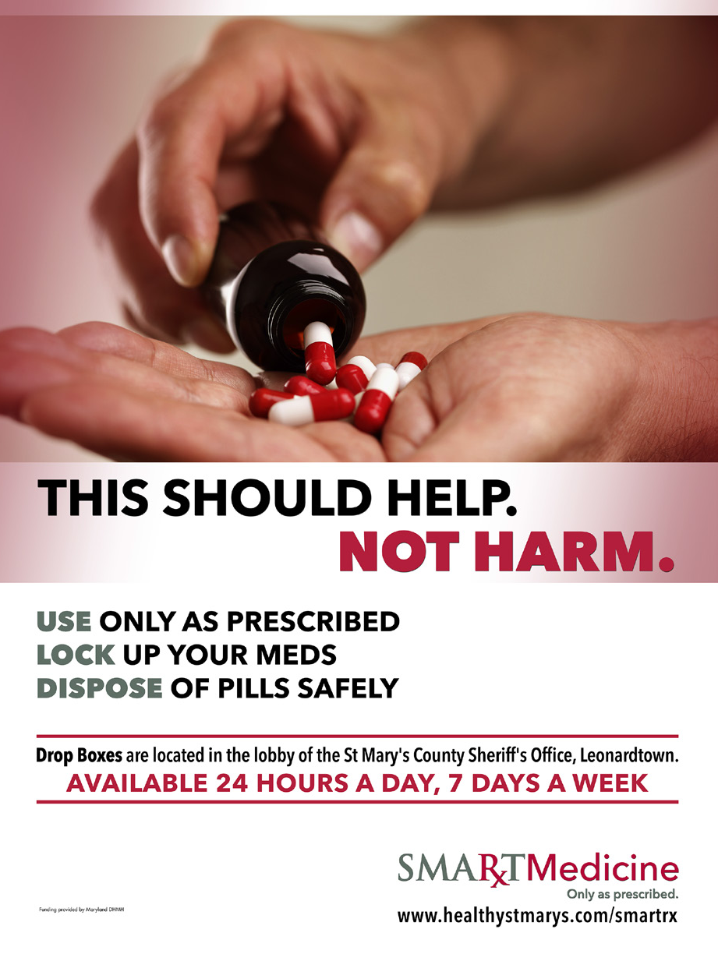

Flyer template for announcements, information and
education efforts, etc.
Poster that includes Prescription Drop box information

Slide 11
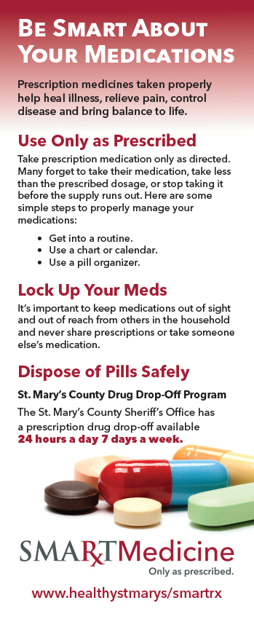
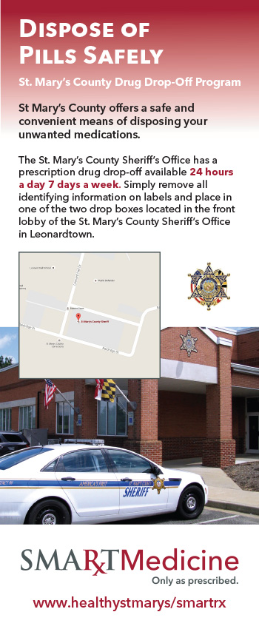
Pharmacy Insert Card
Front Side Back Side

Slide 12
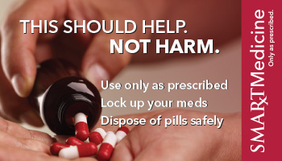

Share Cards
Front Side Back Side

Slide 13
How Can I Get Involved?
Provide feedback on materials
Help distribute educational materials to the local physician offices, pharmacies, and places out in the community
  Display educational and SmartMedinice materials if you are a prescriber, dispensers and/or concerned community member
  Write letters to the editor on the topic of opioid misuse and prevention
Help identify and invite local prescribers for the enrollment sessions
  Enroll if you are not enrolled and are eligible to do so
Help identify community events that Drug Take Backs would be appropriate
Help spread the word about the Overdose Response Program (ORP) or get trained in the ORP.
Notes:
Implementation cannot be successful without support and capacity! This means mobilizing resources within our community by convening key stakeholders, coalitions, and service providers to implement the strategies.

Slide 14
Ongoing Evaluation
Monitor
Evaluate
Sustain
Improve
Notes:
Evaluation involves measuring the overall impact of the SPF and the specific programs, policies, and practices implemented on the selected outcomes, as well as an assessment of the actual implementation of strategies.

Slide 15
Contact Information
OMPP Team
  OMPP Coordinator: Kendall Wood Kendall.E.Wood@medstar.net
  Local Health Improvement Coordinator: Jenna Mulliken Jenna.Mulliken@maryland.gov
  Prevention Coordinator: Maryellen Kraese Maryellen.Kraese@stmarysmd.com
  OMPP Evaluator: Marge Rosensweig Marjorierosensweig@gmail.com
  OMPP Marketing: Katherine Stormont & Bill LeWarne Fullstridecom@me.com & Bill@blackcatdesigninc.com

