Slide 1
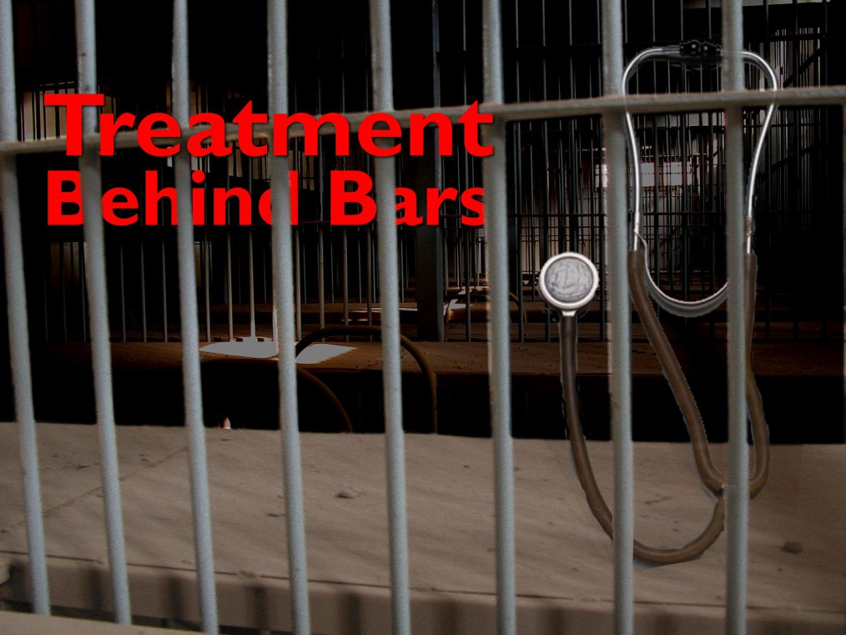
Office of the Sheriff
St. Mary’s County, Maryland
Behavioral Health Action Team Meeting
March 10, 2017

Slide 2
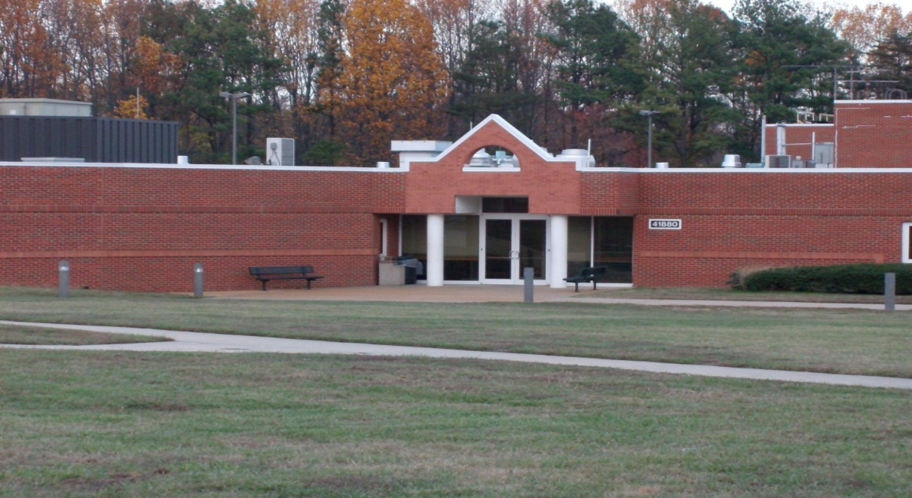
Office of the Sheriff
St. Mary’s County, Maryland

Slide 3
Population Demographics

Slide 4
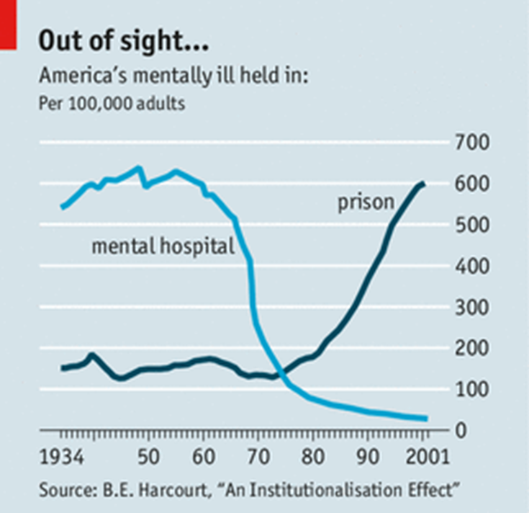
Deinstitutionalization

Slide 5
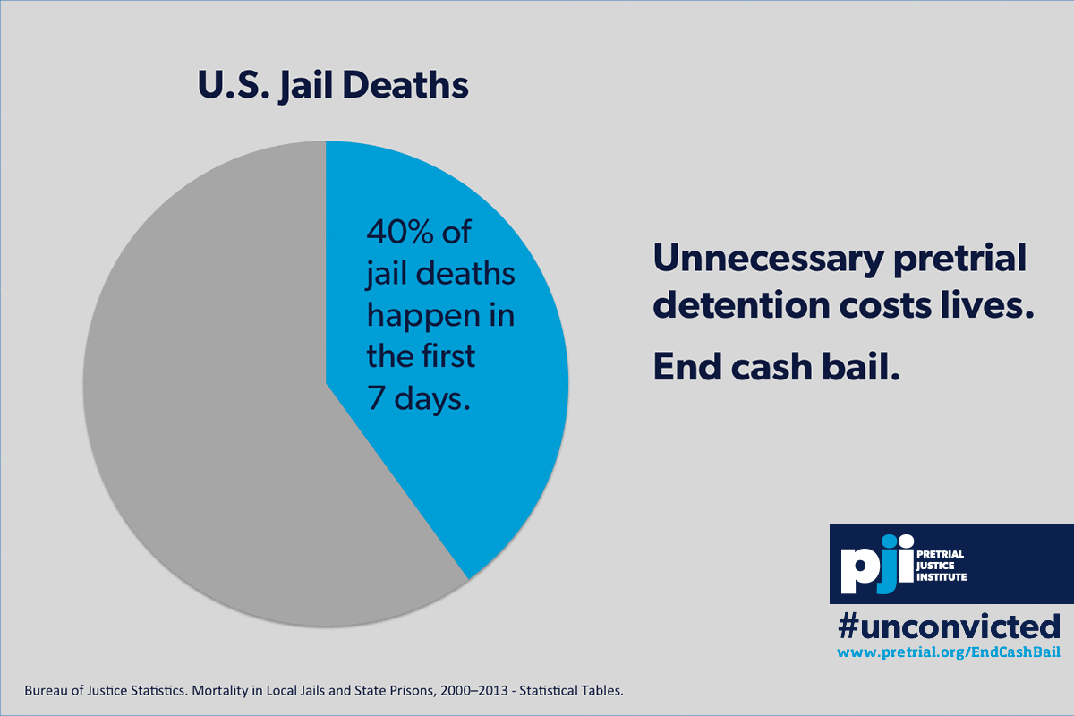
Pretrial Facts & Information

Slide 6
Mental Health Inmates
*Snapshot of Jail Population *
Total Inmates | General Population | Mental Health Population
243 | 129 | 114
Total Inmates | General Population | Mental Health Population
215 | 118 | 97

Slide 7
Mental Health with
Co-Occurring Disorder
*Snapshot of Jail Population*
Total Mental Health Inmates 2014 | Co-Occurring 2014
90 | 24
Total Mental Health Inmates 2017 | Co-Occurring 2017
94 | 3

Slide 8
St. Mary’s County Detention Center

Slide 9
St. Mary’s County Detention Center

Slide 10
St. Mary’s County Detention Center
* Snapshot - 3/6/2017 *
* Snapshot - 3/6/2017 *

Slide 11
St. Mary’s County Detention Center
* Snapshot - 3/6/2017 *

Slide 12
St. Mary’s County Detention Center
* Snapshot - 3/6/2017 *

Slide 13
Recidivism Demographics

Slide 14
St. Mary’s County Detention Center

Slide 15

Health Care Referrals
Demographic (Nov. 2015 – Nov. 2016)

Slide 16

Demographic
(Nov. 2015 – Nov. 2016)

Slide 17
Substance Abuse Demographic
Pretrial Community
(Nov. 2015 – Nov. 2016)

Slide 18
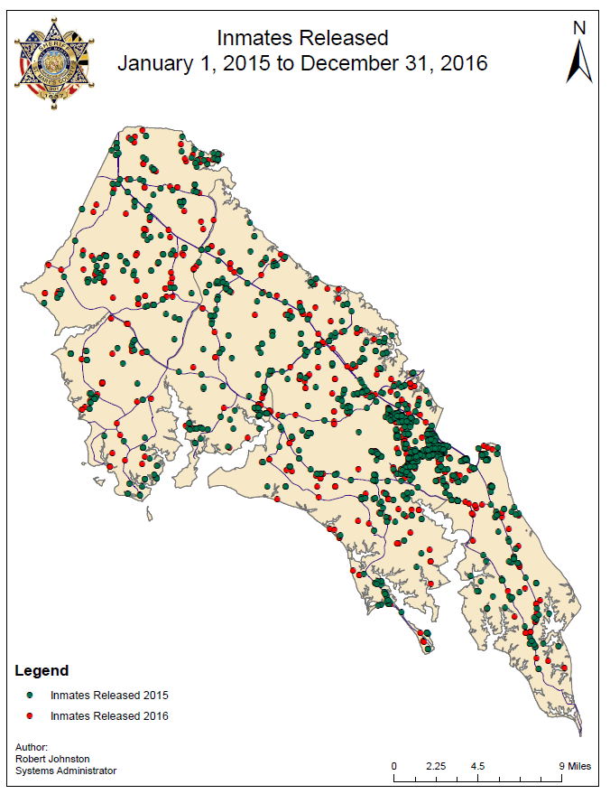

Slide 19
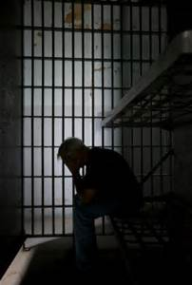
Mental Health
Services & Barriers

Slide 20
St. Mary’s County Detention Center
Mental Health Services:
Assessment
Crisis intervention
Psychiatric evaluation
Medication management
Supportive counseling
Therapeutic groups to include Anger Mgmt, Men’s/Women’s Issues, Life Skills, Parenting, and PC Issues Group.
Aftercare referral
St. Mary’s County Sheriff’s Office

Slide 21
St. Mary’s County Detention Center
  Barriers to treatment/services in the jail:
  Lack of space to provide additional groups
  Insufficient suicide watch cell for overflow
  Very limited residential type placements for seriously mentally ill
  Jail becoming the dumping ground for those with multiple issues struggling in the community
  Not enough sober or other housing for those homeless individuals

Slide 22

St. Mary’s County Detention Center

Slide 23
St. Mary’s County Detention Center
  Ideal program would include:
  Re-entry program with more available resources
  Soft hand turn overs to those being linked with community resources
  Multi-disciplinary team meetings for key players in the community to attempt to meet the needs of those individuals with multiple needs

Slide 24
St. Mary’s County Detention Center
  Contact Information:
  Captain Deborah L. Diedrich, Acting Commander
  41880 Baldridge Street
  Leonardtown, Maryland 20650
  301-475-4200 Ext 2242
  Deborah.Diedrich@stmarysmd.com

