Slide 1

RU ok? Prevention Campaign
Presentation to St. Mary’s County Public Schools

Slide 2
Focus
Addressing behavioral health concerns in SMCPS
Awareness/education Campaign
Mechanism/resources for students to report or assist

Slide 3
Facts
YRBS Data 2016 for Mental Health Issues
2,091 Students grades 9-12 participated
29.9% were sad or hopeless in the past year for a period of 2 or more weeks
19.3% seriously considered suicide
14.8% made a plan

Slide 4
More Facts
YRBS Data 2016 for Substance Use Issues
32.6% of High School students reported current use of alcohol
17.7% used 5+ drinks in one sitting
61.2% have used during their lifetime
All of the alcohol data exceeds the state averages
30.6% have used marijuana in their lifetime
Cocaine and injected drug users increased since 2014 data

Slide 5
RU ok? Concept
R U ok? is a media campaign designed to bring awareness, education and information to the community on how to identify, approach and interact with someone who may be suffering from a behavioral health crisis.

Slide 6
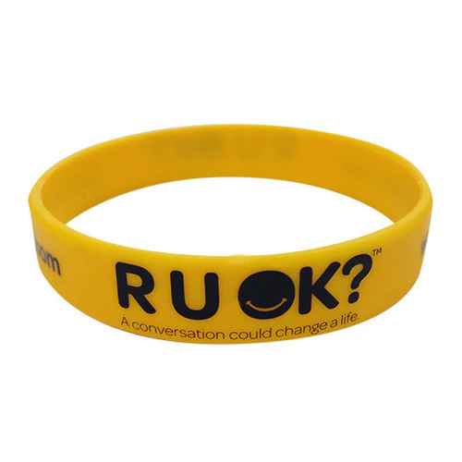

Similar Programs
https://www.ruok.org.au/
https://seizetheawkward.org/

Slide 7
R U ok? in the Community
Billboards
Comcast
Community Outreach
Promotional products

Slide 8
R U ok? in SMCPS
Geo-fencing
Robo callout
The Peach Jar
SMCPS – Twitter, Webpage, Facebook
Posters
Videos
Kick off event/ongoing events
Curriculum

Slide 9

Logo

Slide 10
Poster Sample 1

Slide 11
Poster Sample 2

Slide 12
Next Steps
Select logo
Complete program description
Include SMCSO – who?
Set timeline – Suggested Oct – Nov-Dec
Present to Board of Education for approval- Aug – Sept
Present to School Principals (A & S)- Sept
Present to Secondary School Counselors- Sept
Implement Campaign

Slide 13

Questions

