Slide 1
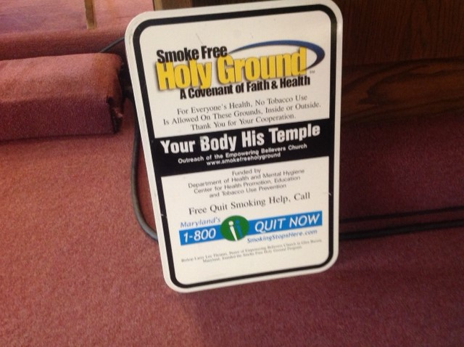
Smoke Free Holy Ground
A Covenant of Faith and Health
Apostle Larry Lee Thomas Sr., Founder
Empowering Believers Church of the Apostolic Faith
EBC International Network

Slide 2
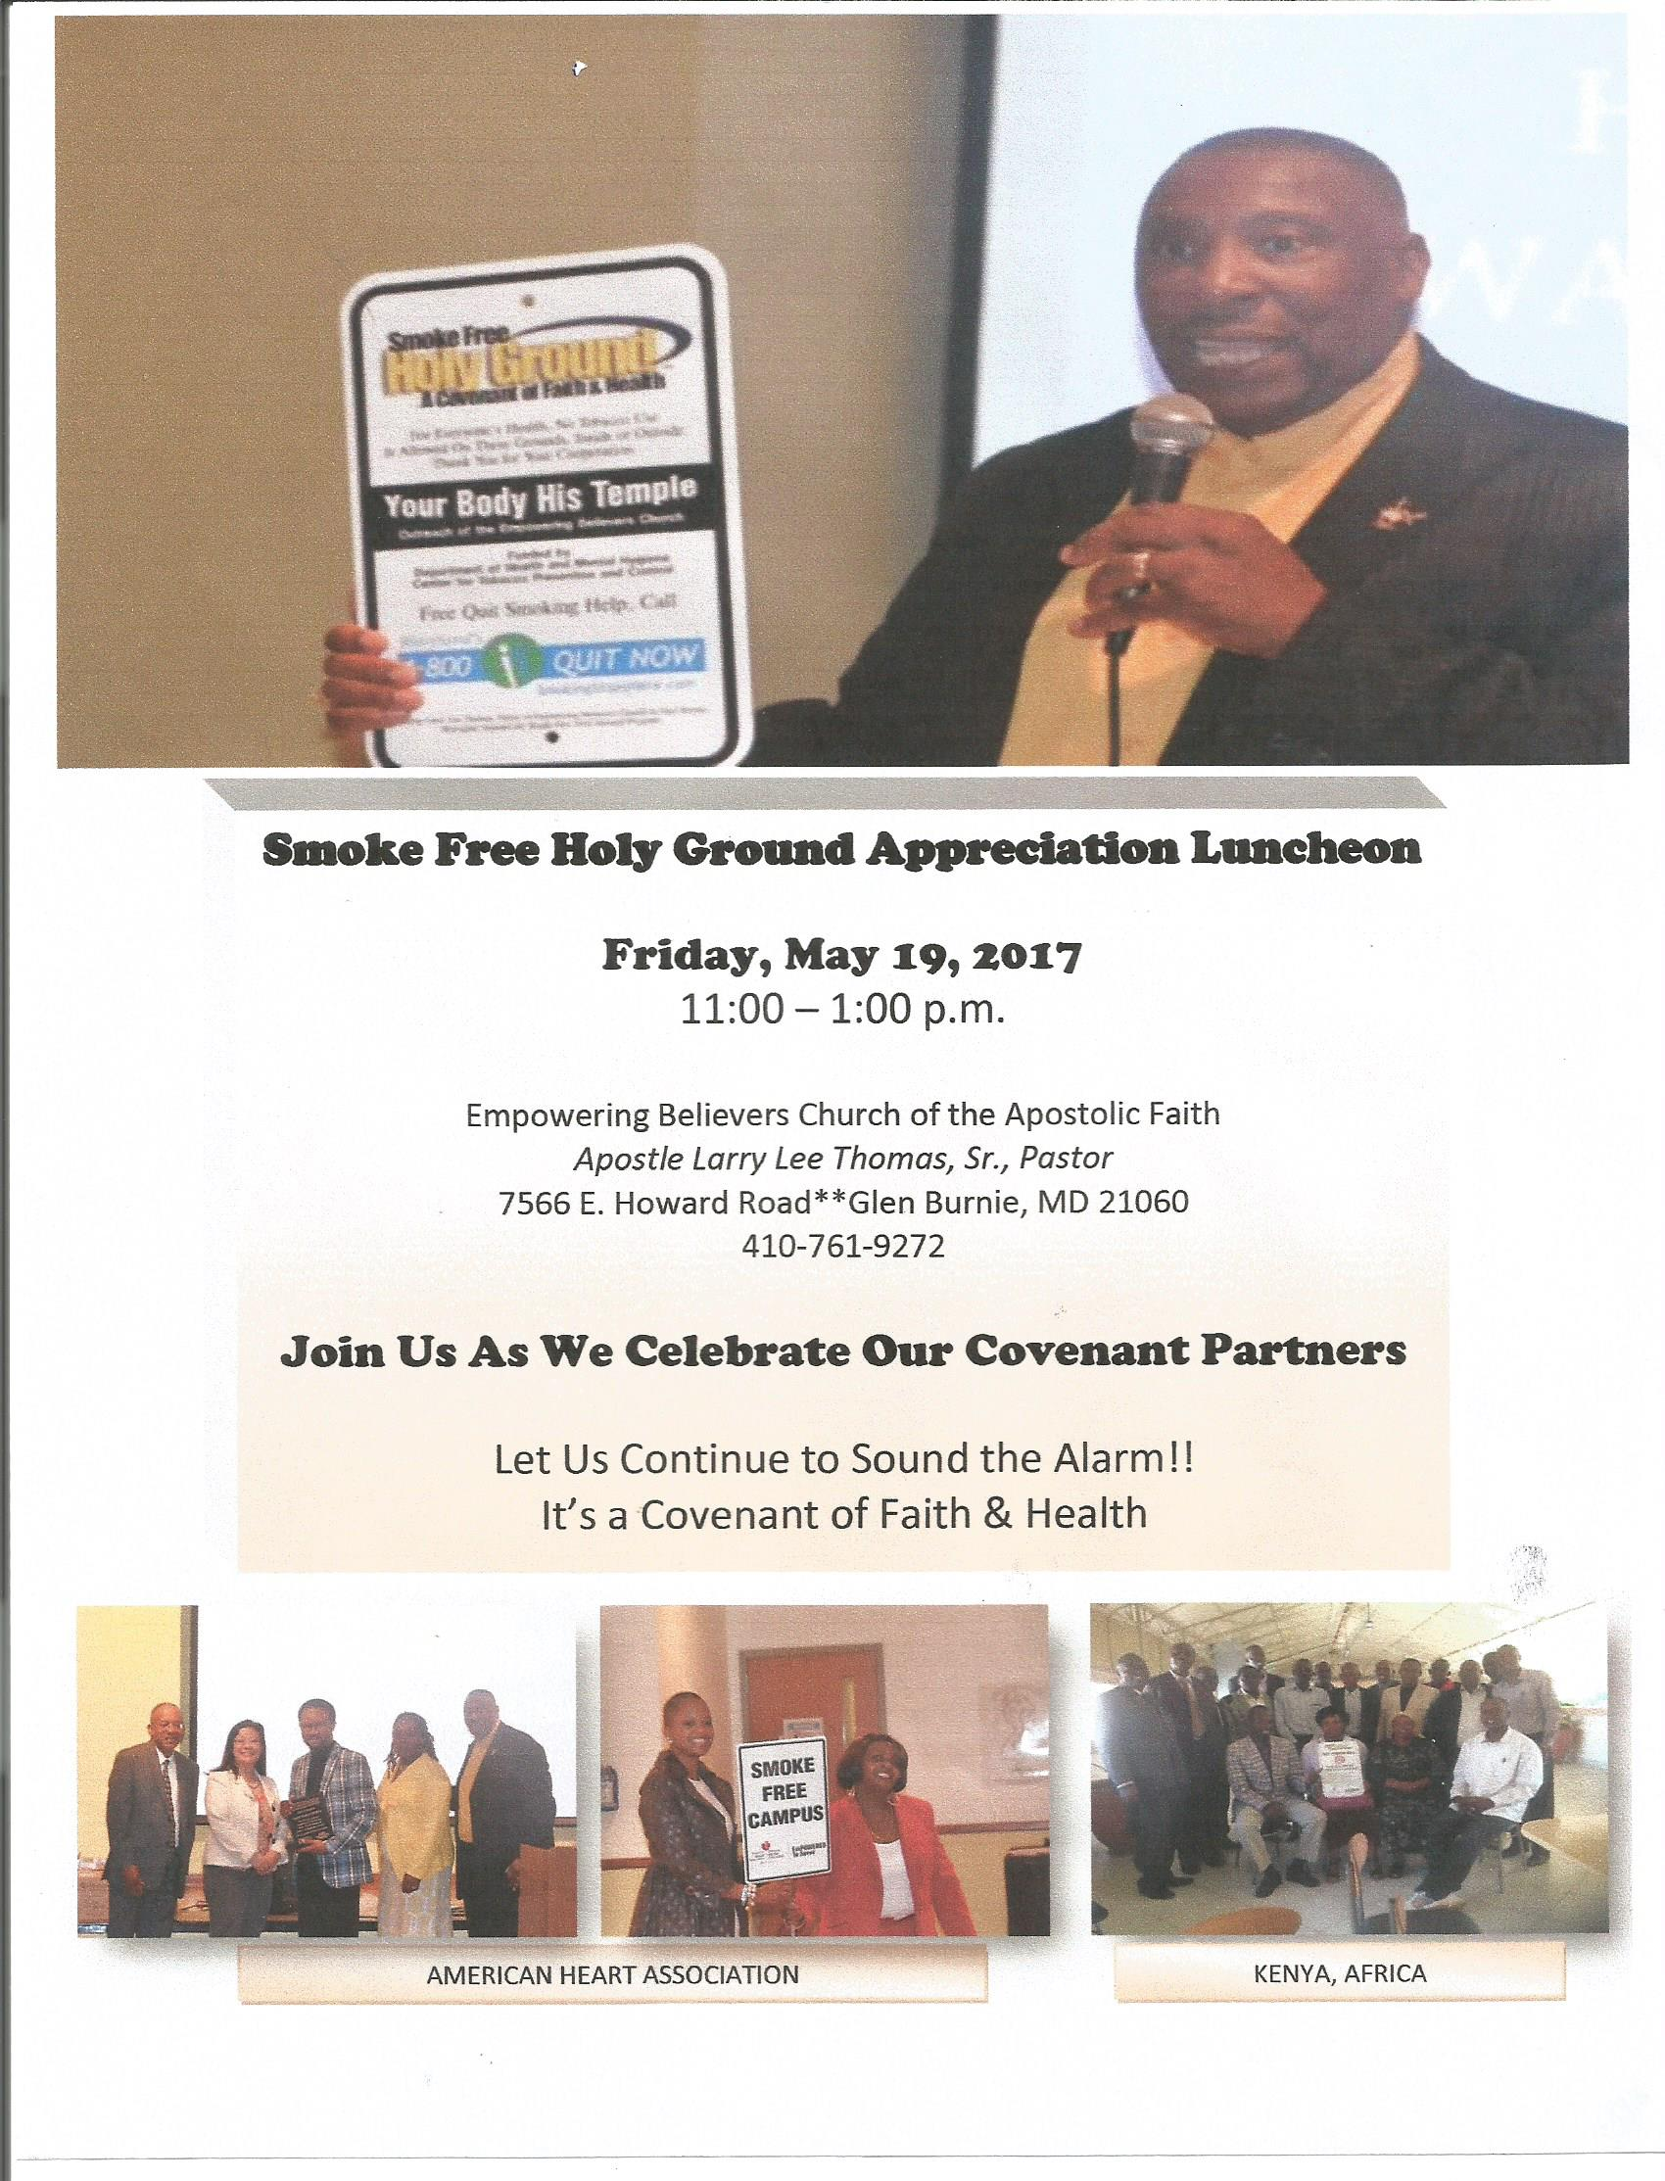
Apostle Larry Lee Thomas, Sr.
Apostle Larry Lee Thomas, Sr. is the Senior Pastor of the Empowering Believers Church located in Glen Burnie, Maryland and the presiding prelate of the Empowering Believers Church Apostolic International Network where he oversees churches and ministries in the USA, Africa, Caribbean, and the Philippines.
He is the founder of The Smoke Free Holy Ground Initiative which began in 2001 with a grant from The Department of Health and Mental Hygiene (DHMH) to educate churches and the faith community about the dangers of tobacco and secondhand smoke.
The Lord has allowed this initiative to have over 800 covenant partners in Maryland, Virginia, West Virginia, New Jersey, Pennsylvania, Alabama, Tennessee, California and Indiana. They began spreading the message to sound the alarm in Barbados and in Kenya, Tanzania, Uganda, Nigeria, Rwanda and Burundi, Africa.
They have been blessed to partner with DHMH, Anne Arundel County, Allegany, Cecil, Baltimore, Kent and Queen Anne County’ Health Department; Million Hearts Initiative and The American Heart Association EmPOWERED To Serve Movement, and have been recognized by the CDC as one of the ten best practices in the faith community.
To God be the Glory for the great things He has done. Let us continue to “Sound the Alarm”, let us remember “It is A Covenant of Faith and Health,” and please don't forget “It is your Body but His Temple.”

Slide 3


Slide 4
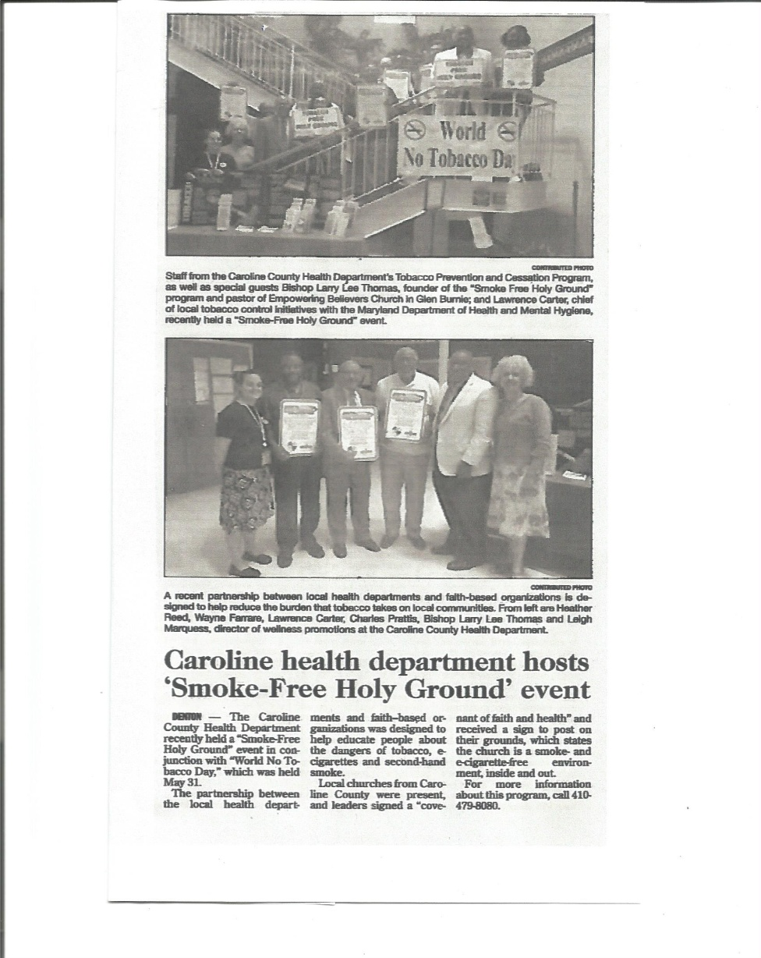
Caroline County

Slide 5
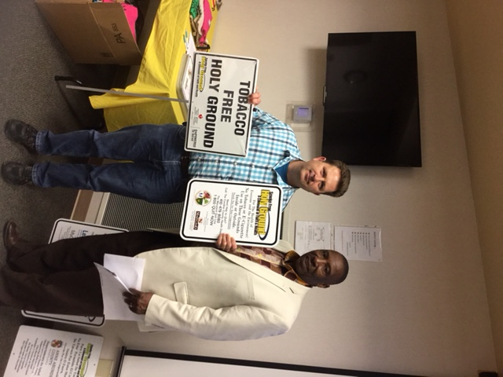
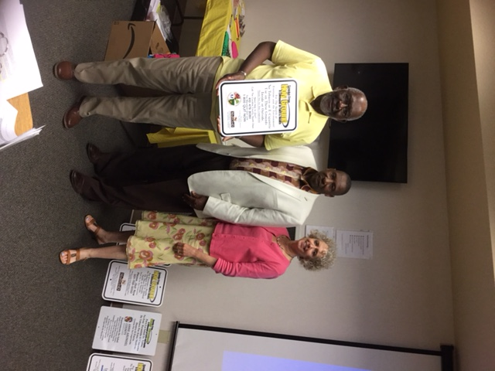
Caroline County Health Department Host “Smoke Free” Event

Slide 6
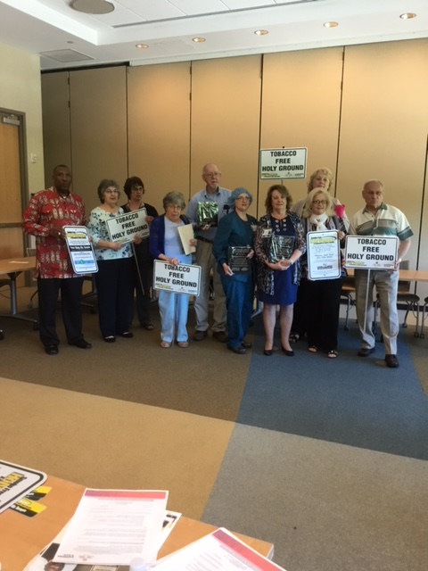
Smoke Free Holy Ground
Allegany County

Slide 7
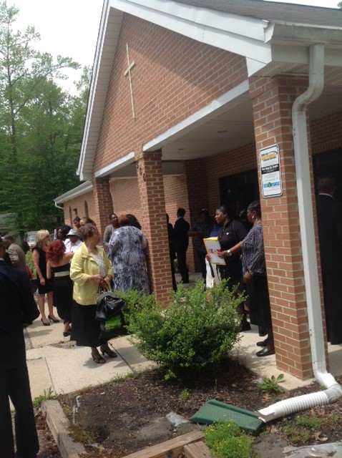
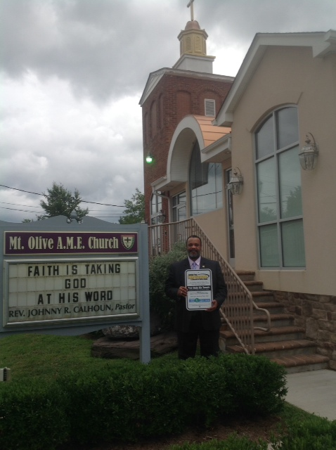
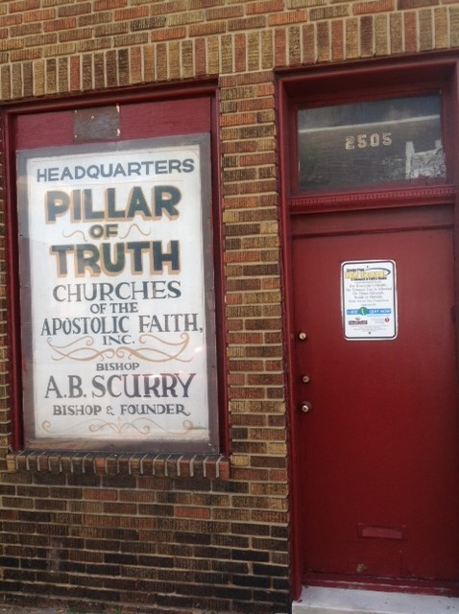
Churches Establishing Smoke Free
Holy Ground

Slide 8
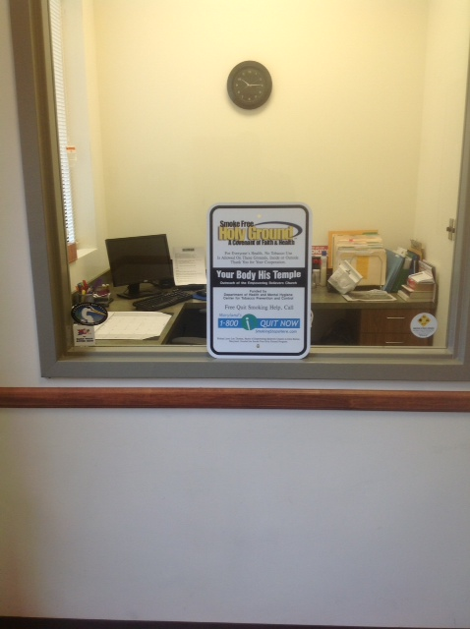
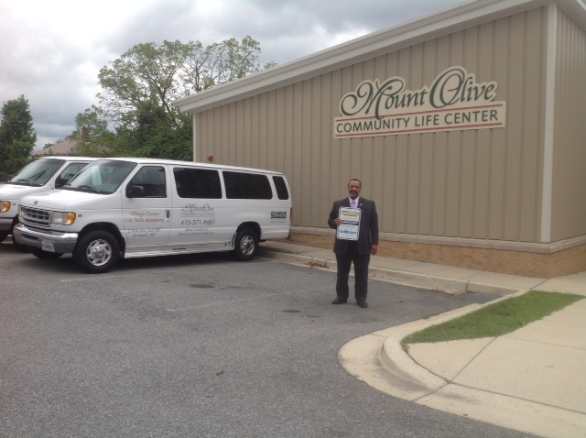
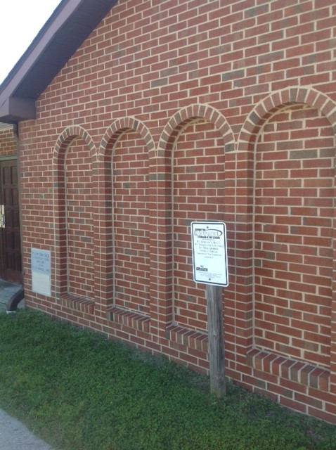
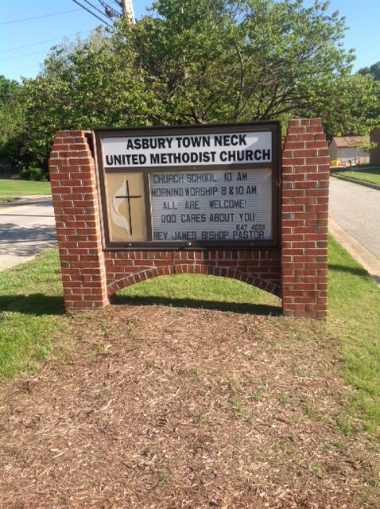

Slide 9

Million Hearts® is a national initiative launched by the Department of Health and Human Services to prevent 1 million heart attacks and strokes in the U.S. over the next 5 years.
100 Congregations for Million Hearts® is a faith-based program designed to help guide members toward a heart-healthy lifestyle.
The Centers for Disease Control and Prevention (CDC) and the Centers for Medicare & Medicaid Services (CMS) are co-leaders working alongside other federal agencies and private-sector organizations to make a lasting impact against cardiovascular disease.

Slide 10


Slide 11
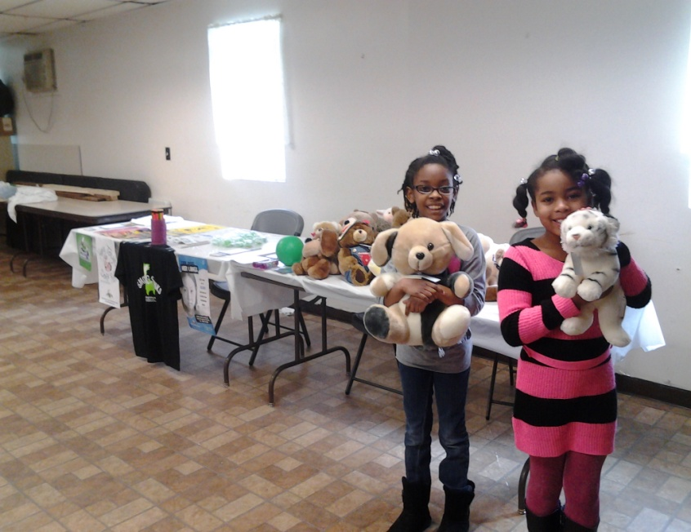
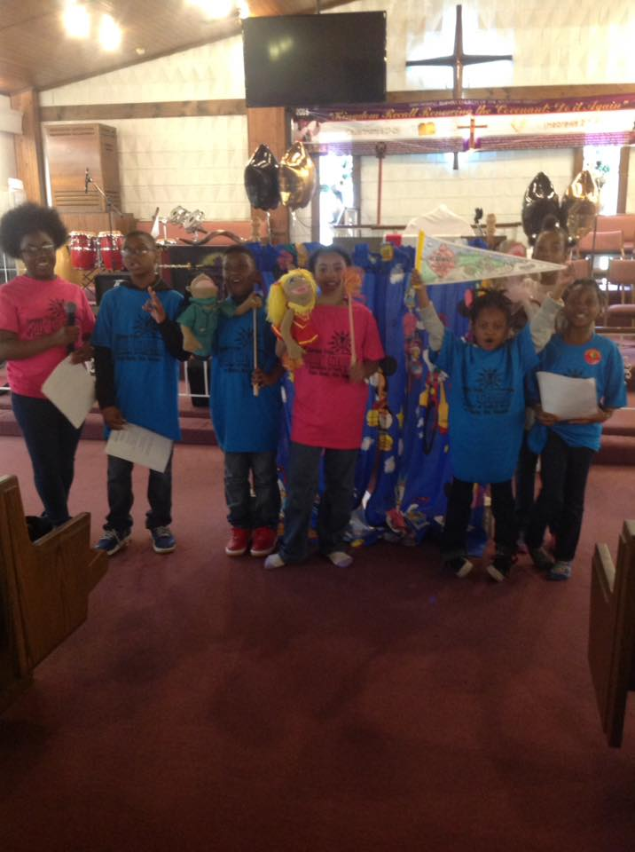
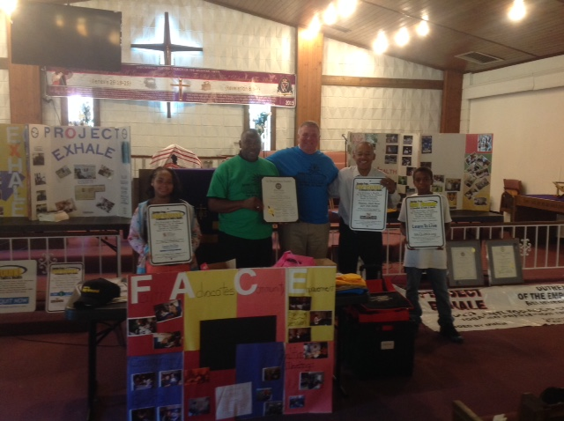
SFHG – Empowering Believers Church
17 years strong!!

Slide 12
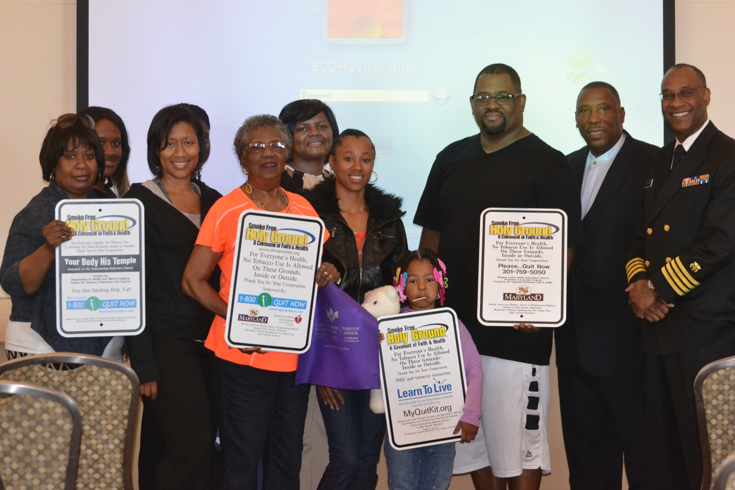

Slide 13
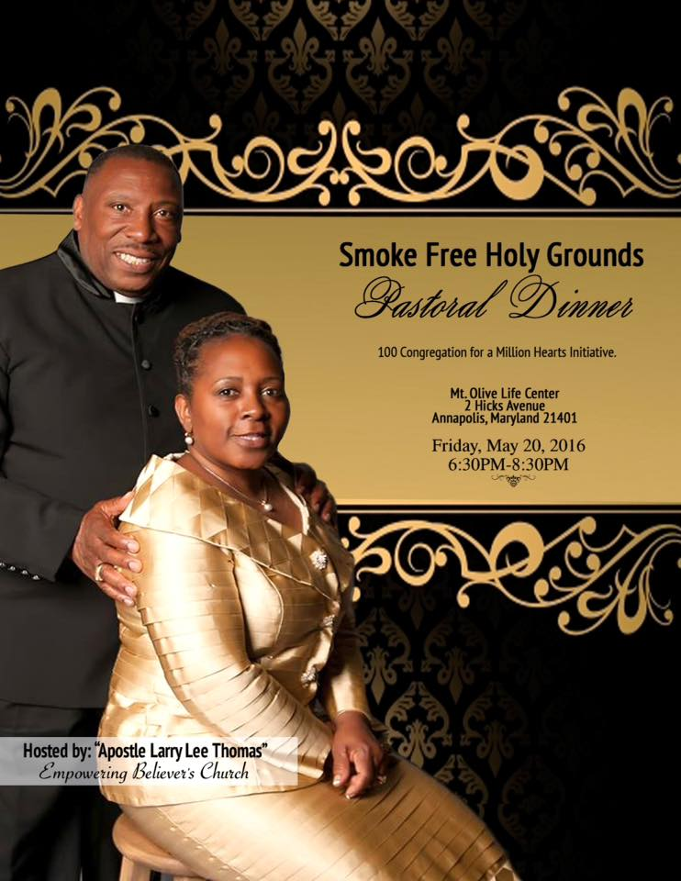

Slide 14
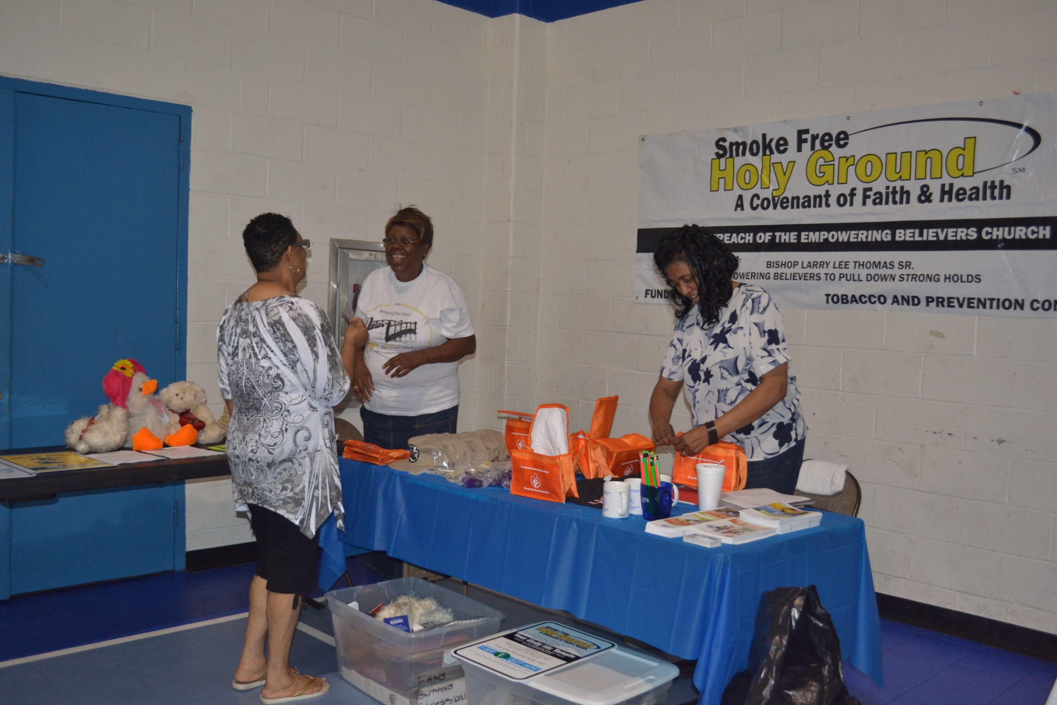

Slide 15

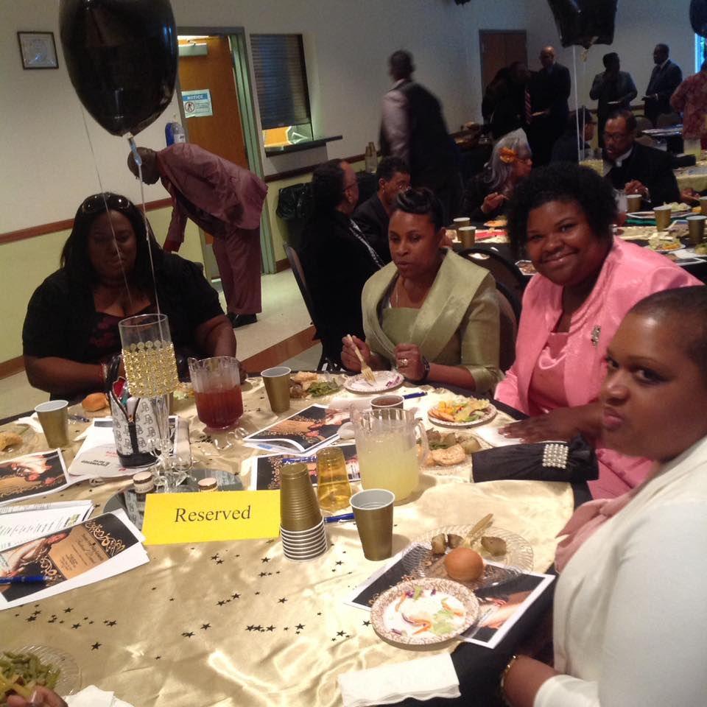
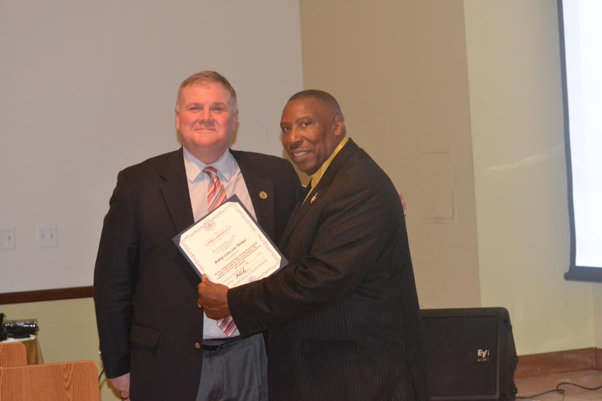
100 Congregations for a Million Hearts

Slide 16
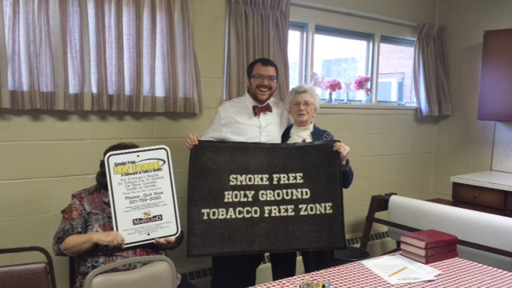

Slide 17
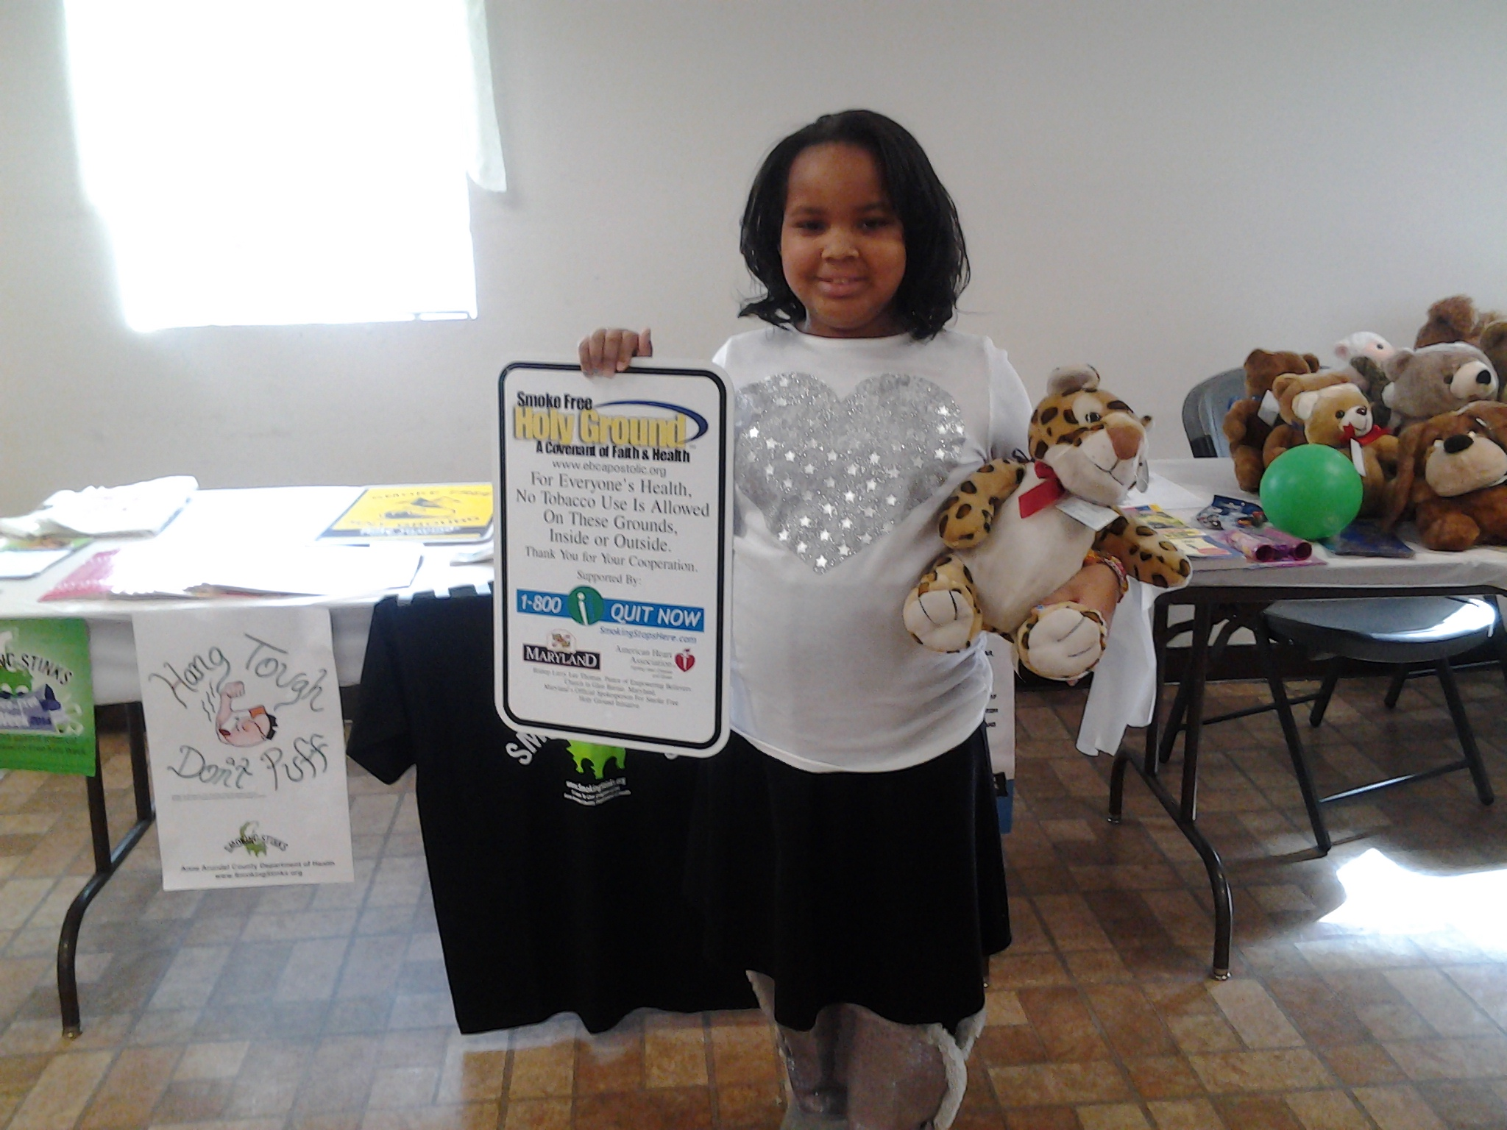

Slide 18
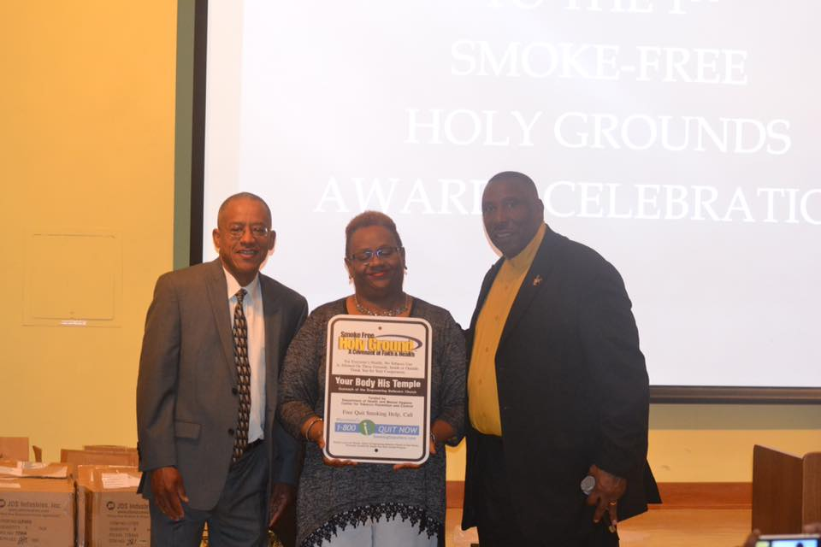
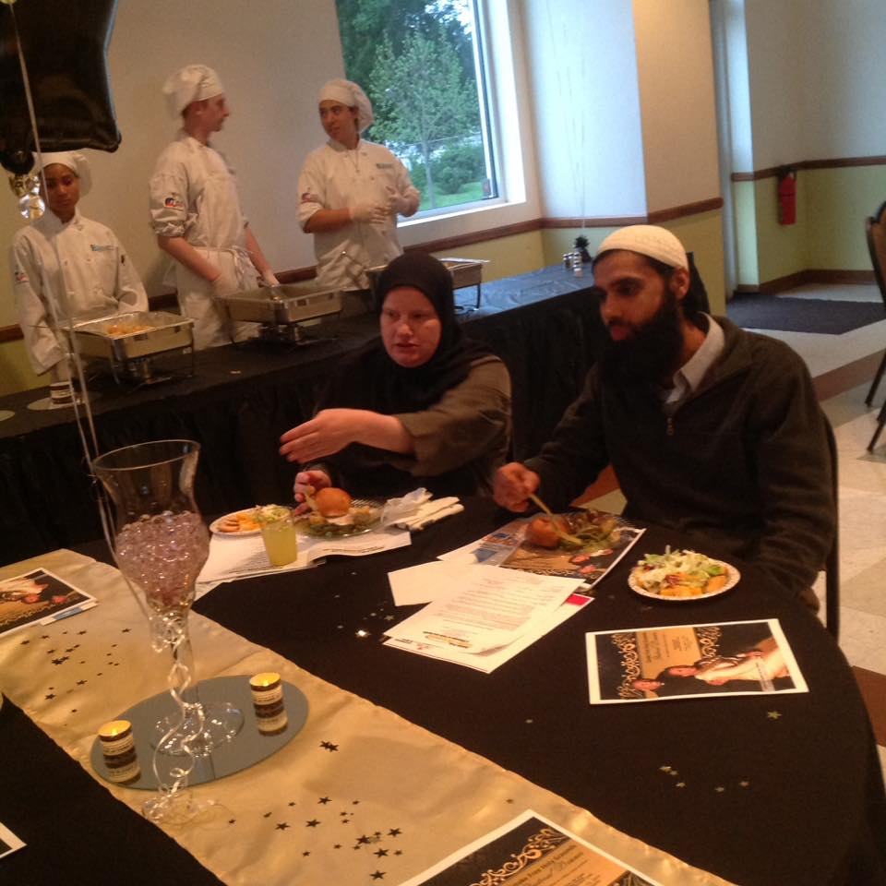

Slide 19

Partners

Slide 20
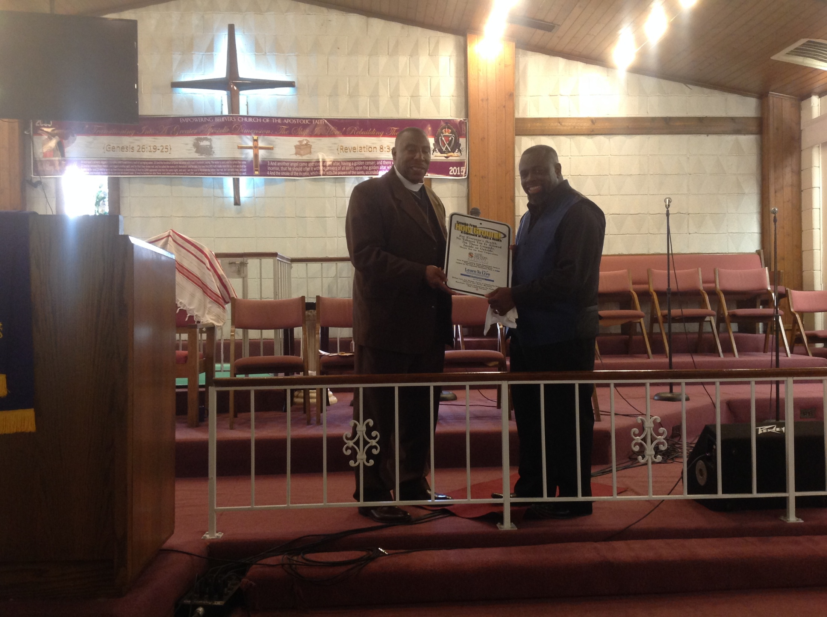

Slide 21
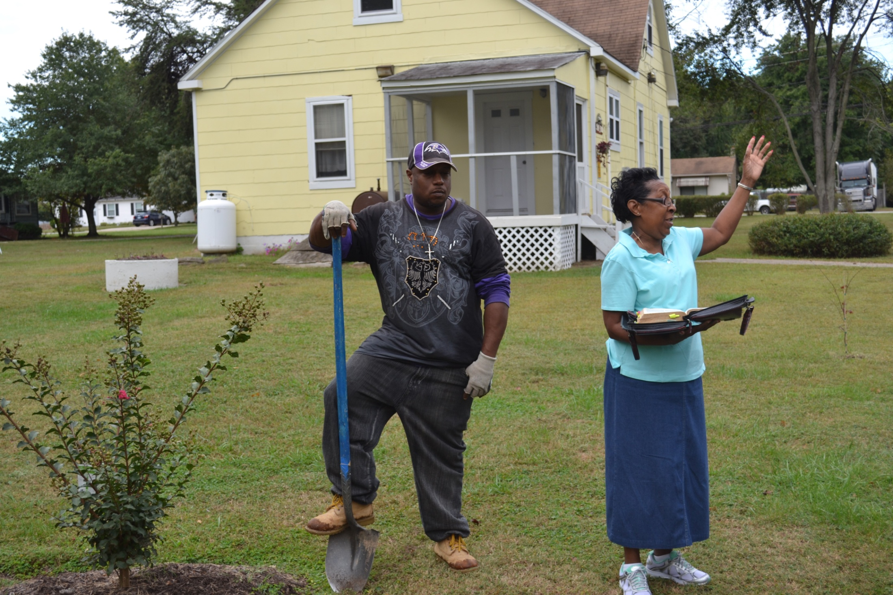

Slide 22
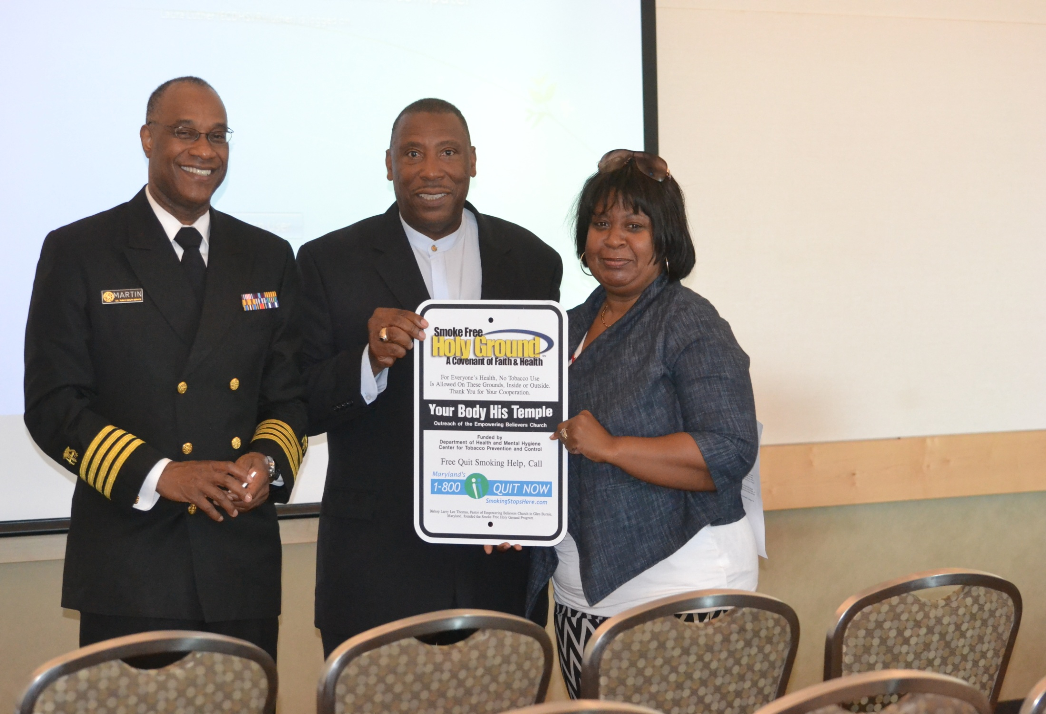

Slide 23
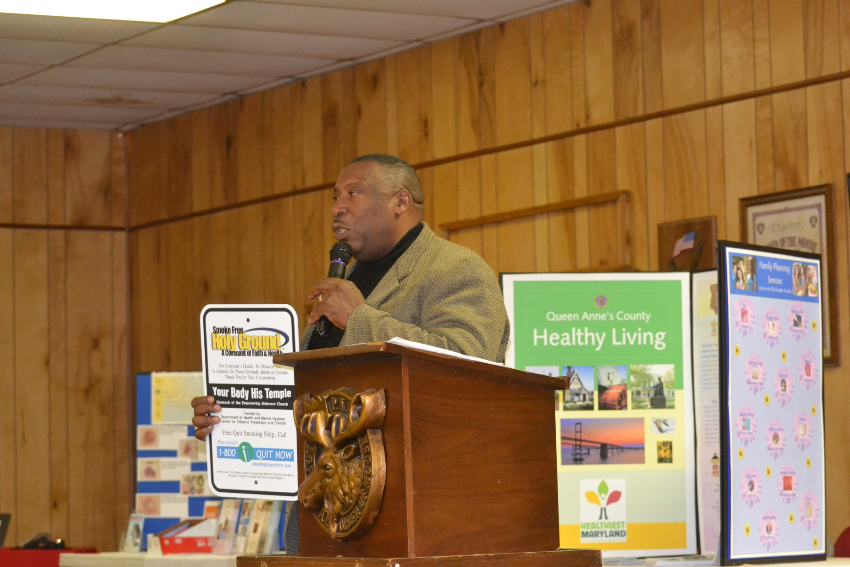

Slide 24
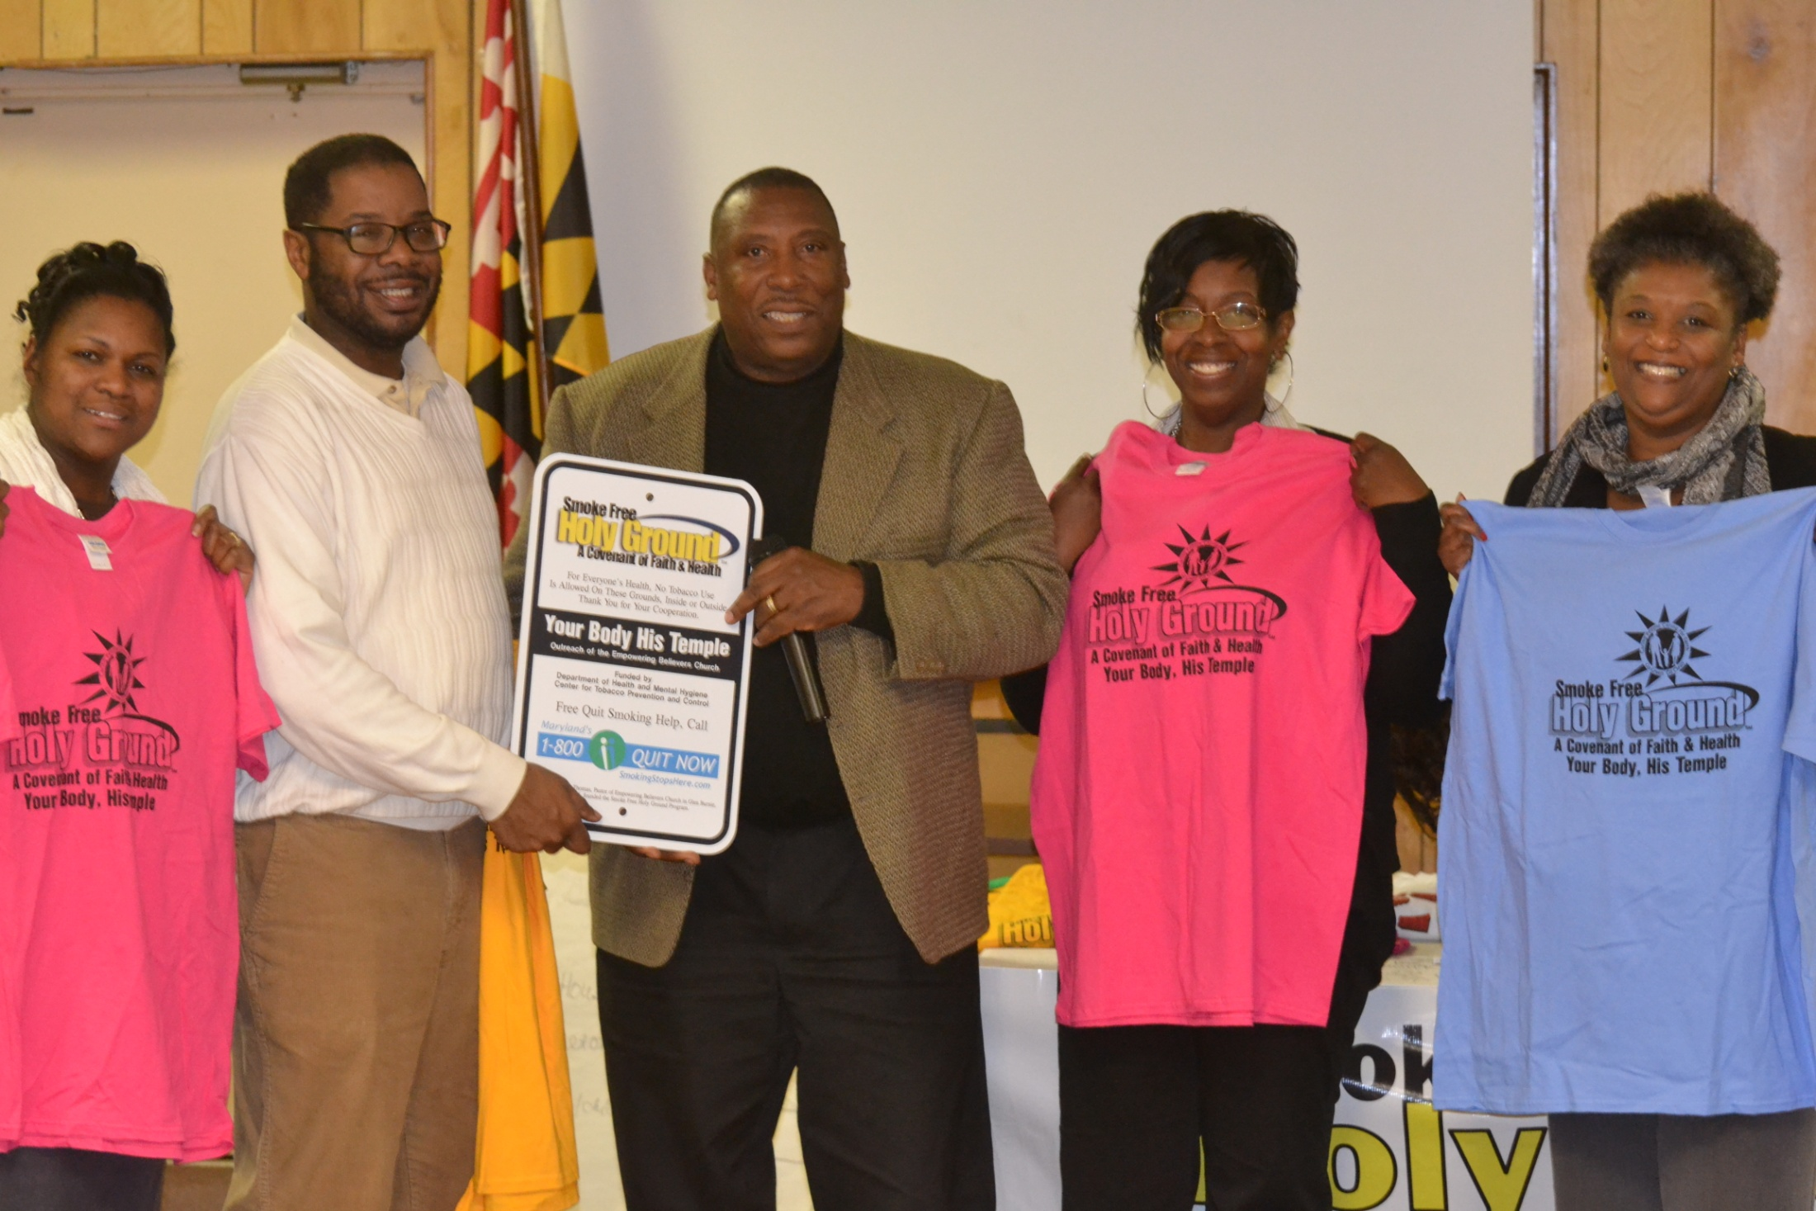

Slide 25
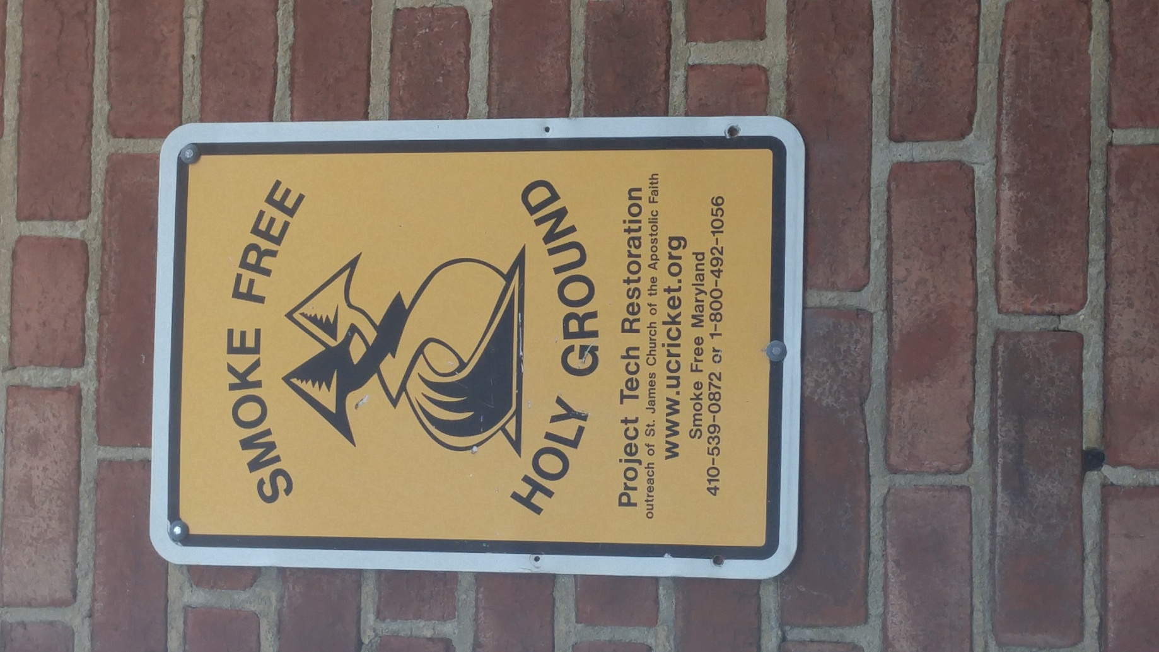

Slide 26
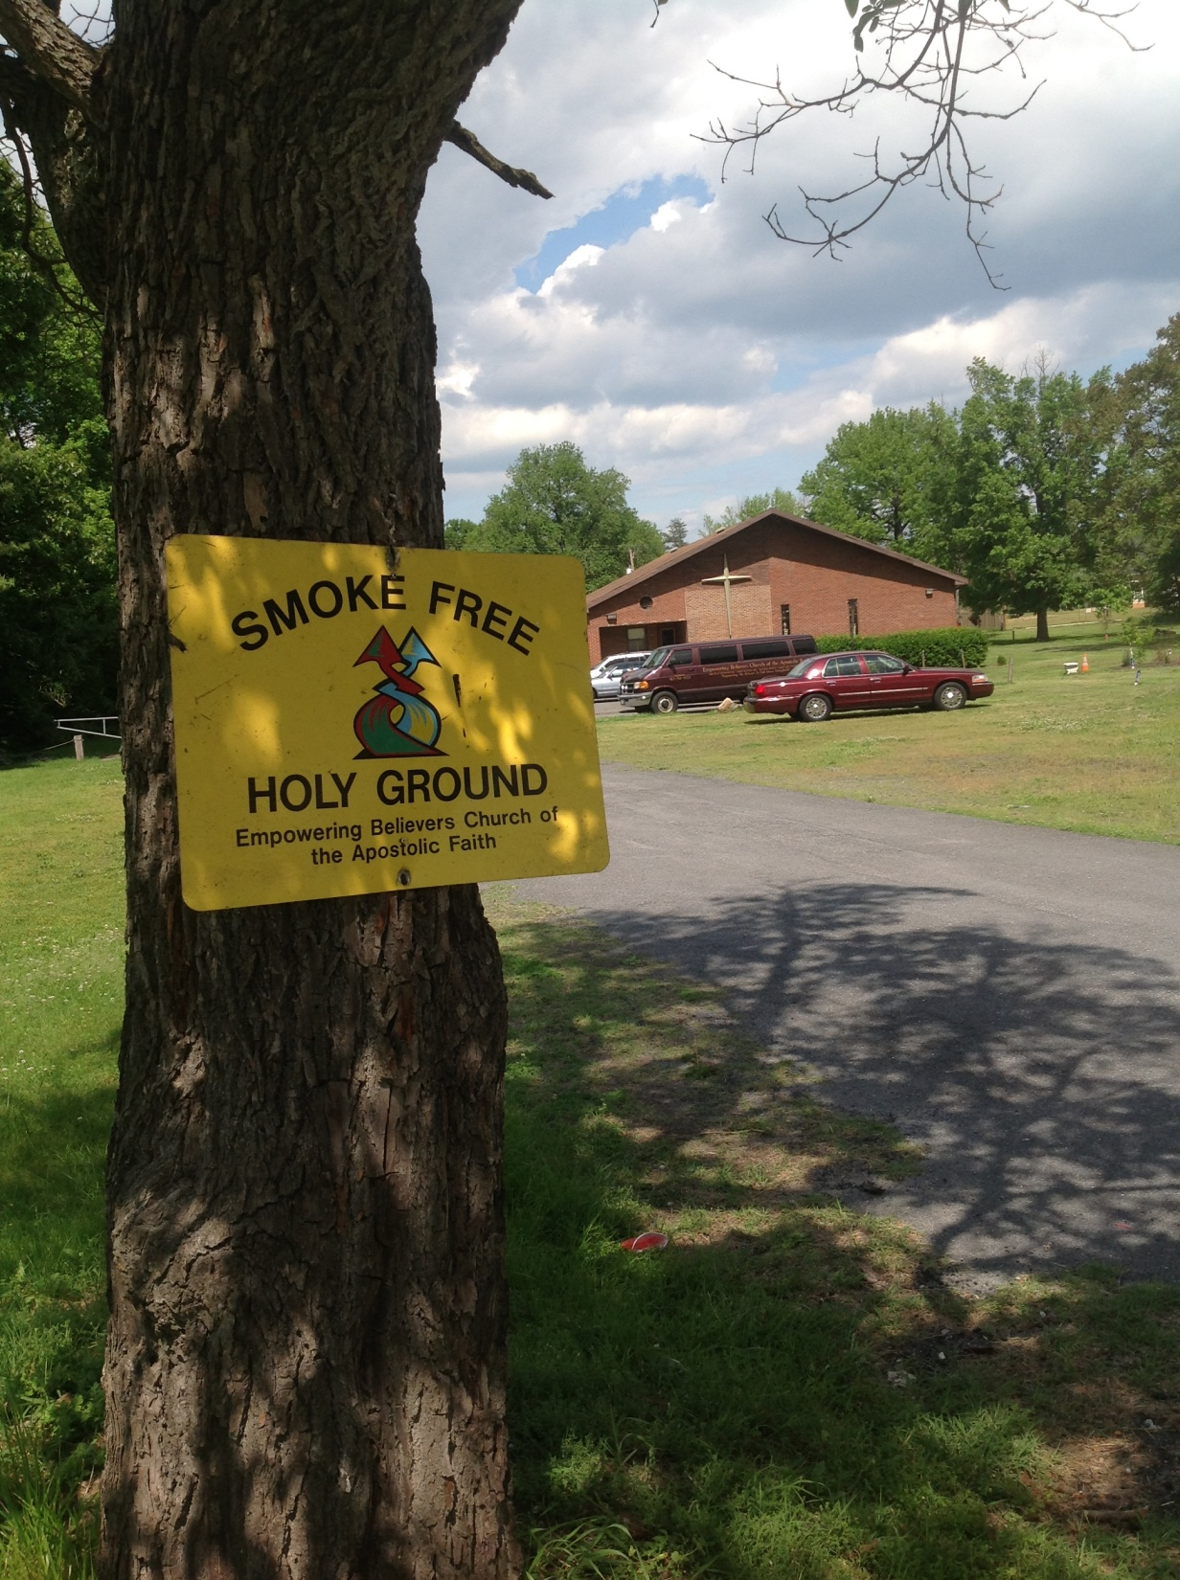

Slide 27
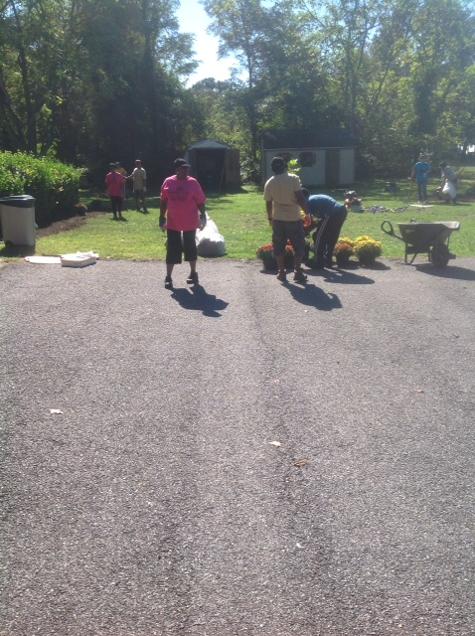

Slide 28
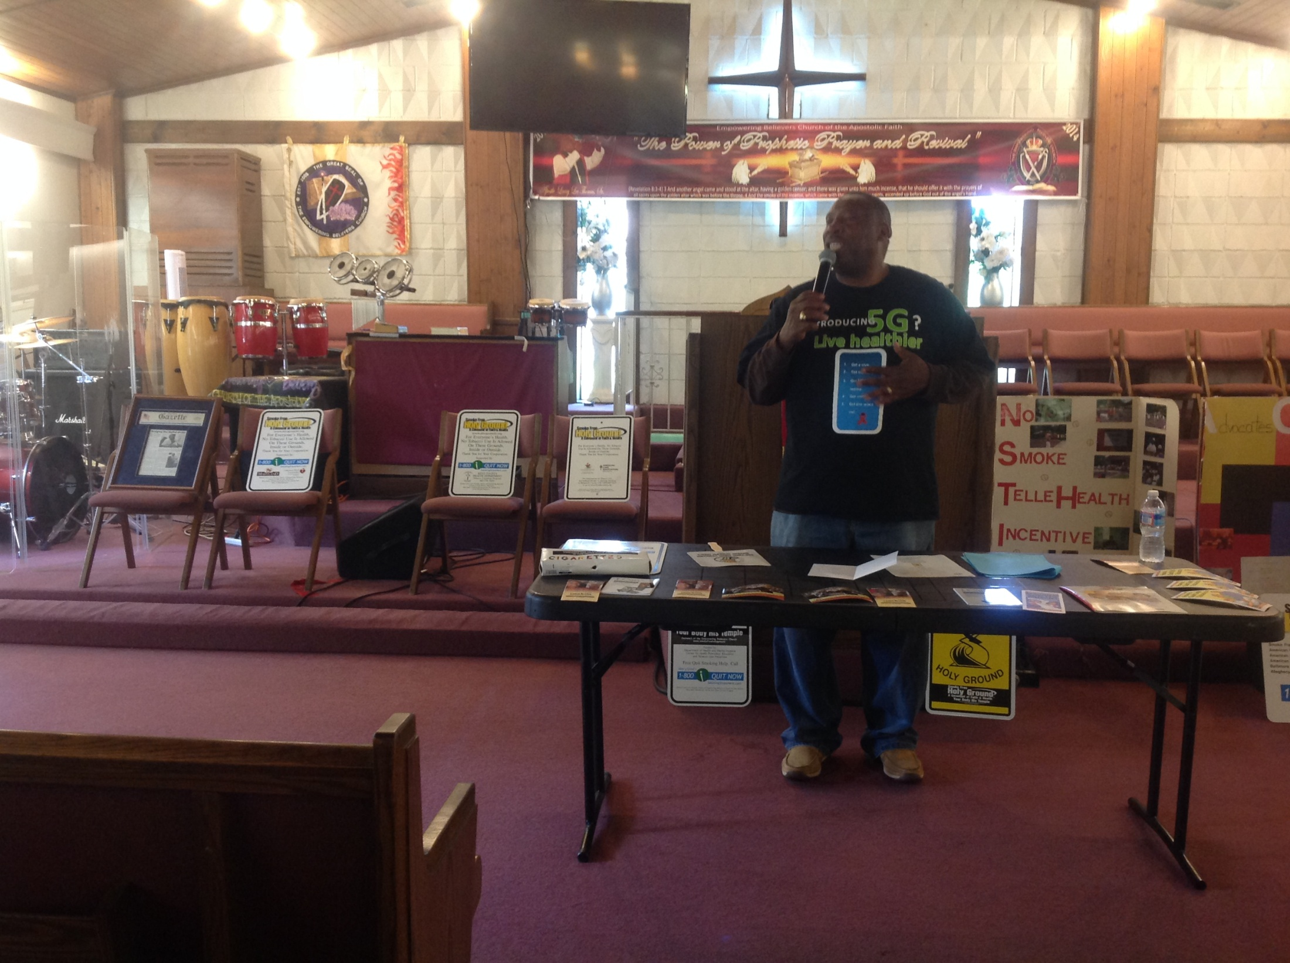

Slide 29
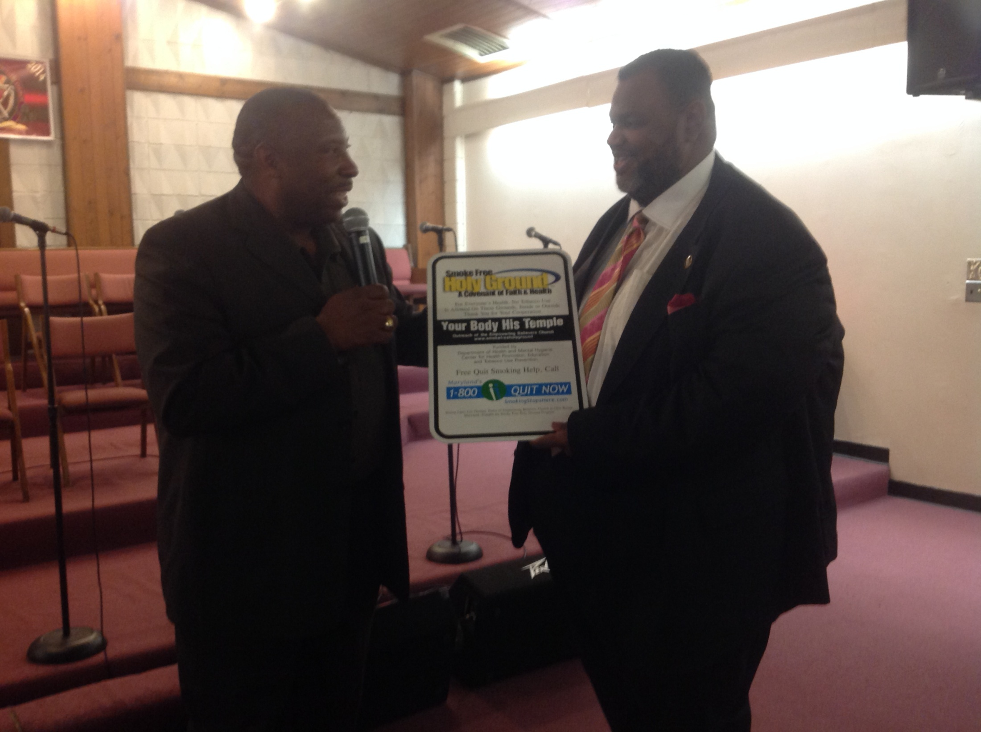

Slide 30
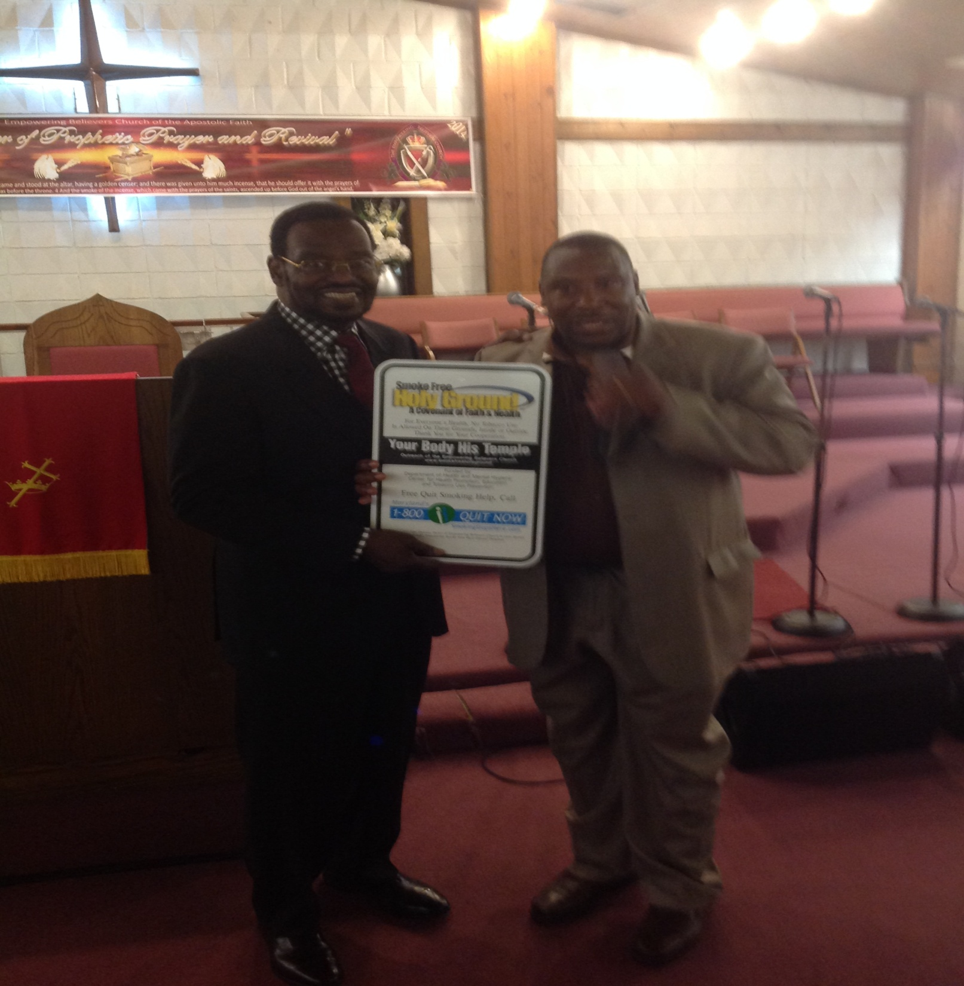

Slide 31
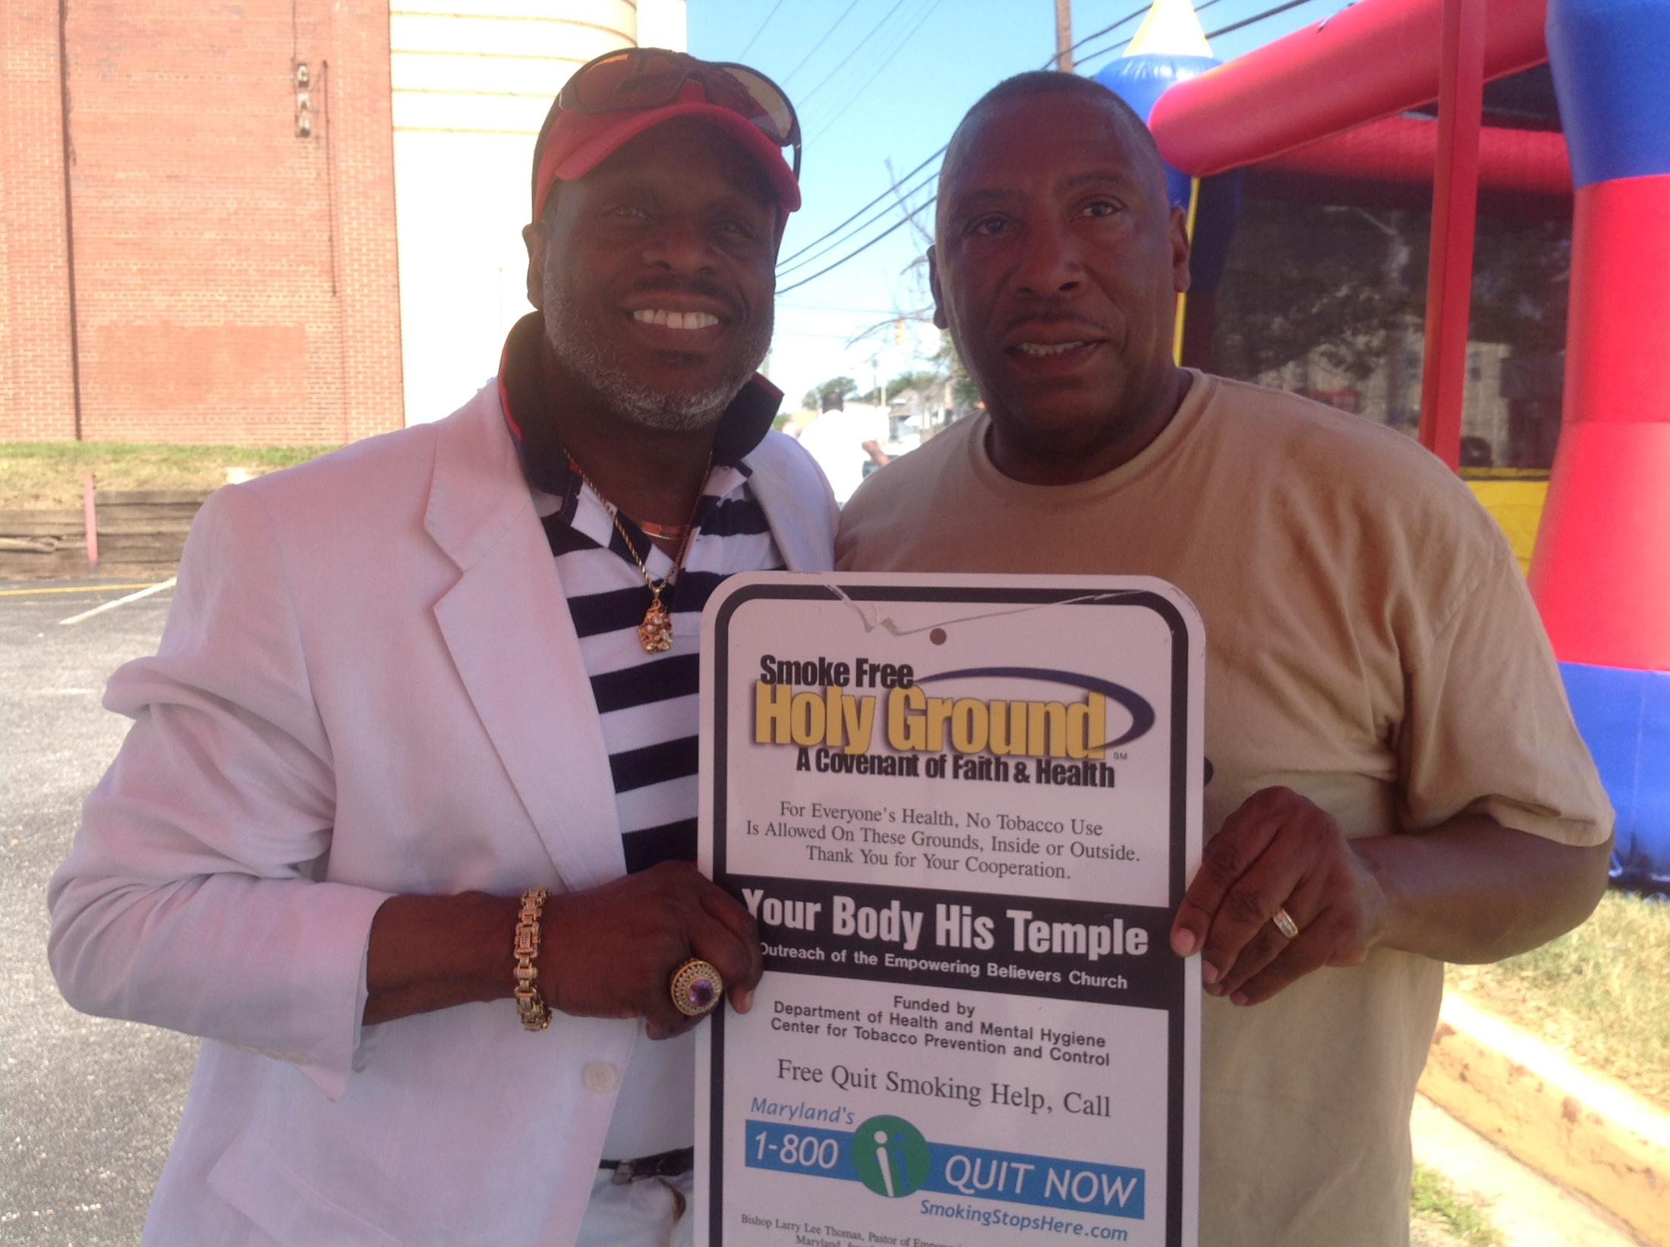

Slide 32
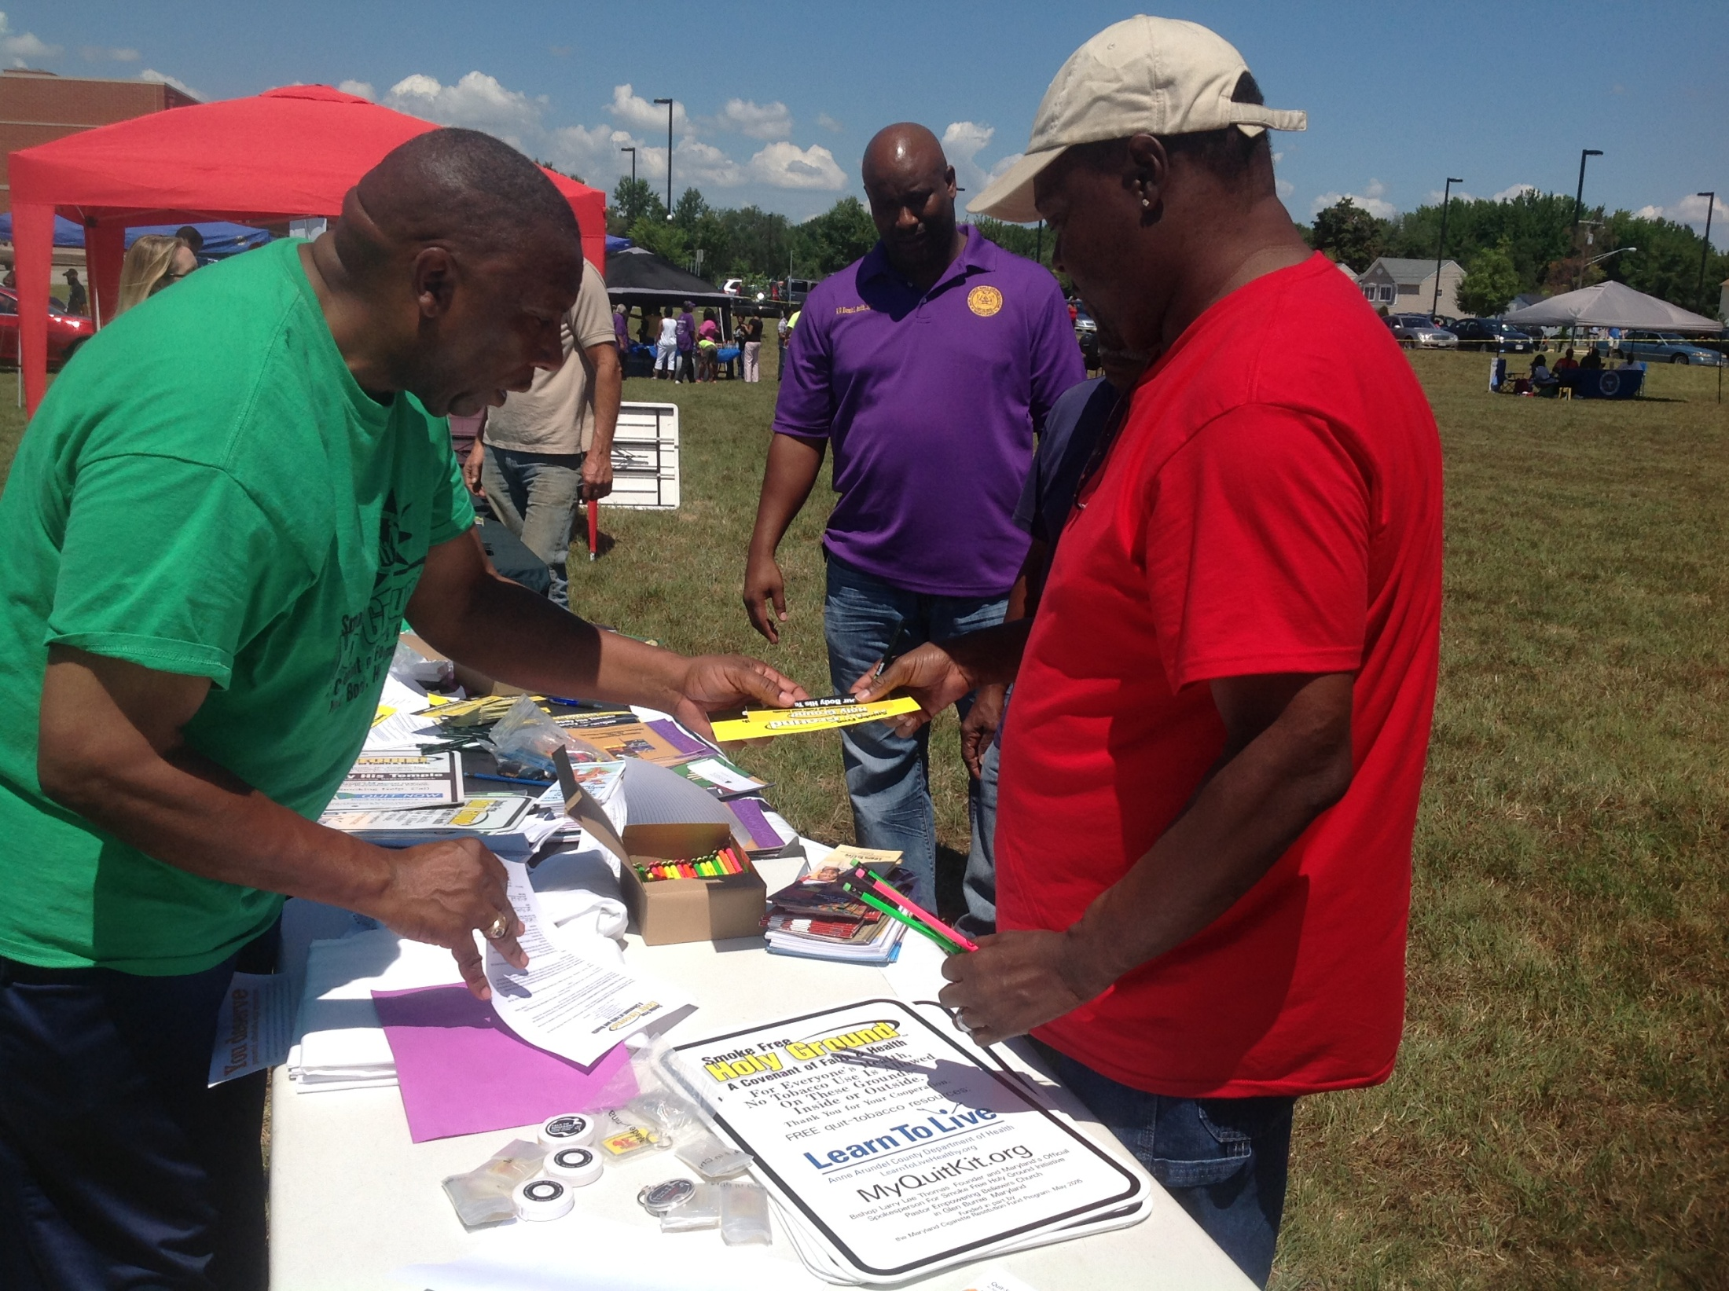

Slide 33
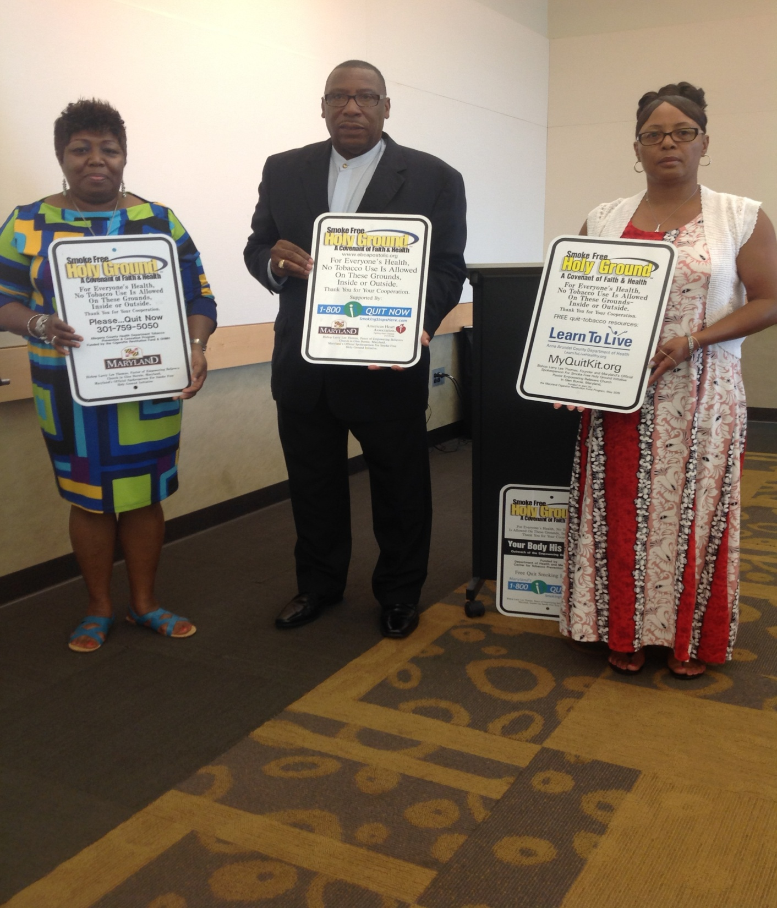

Slide 34
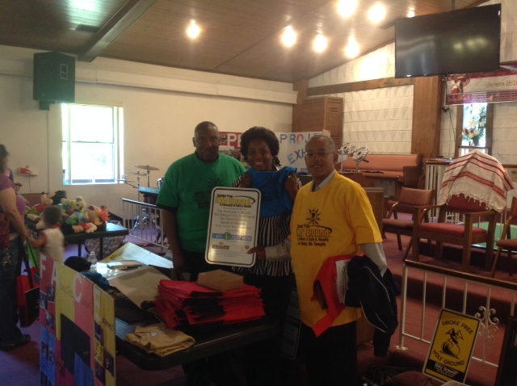

Slide 35
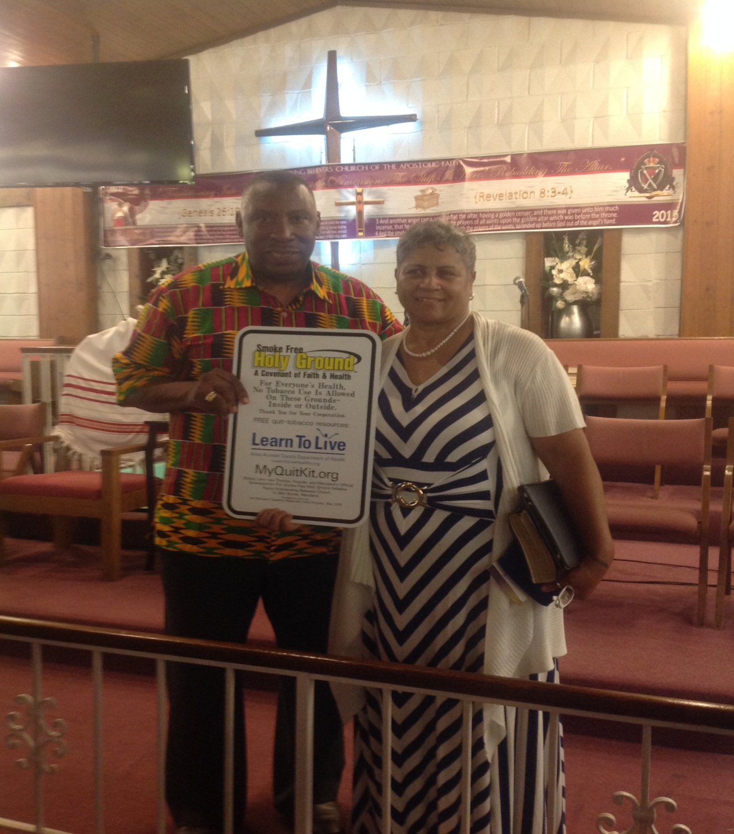

Slide 36
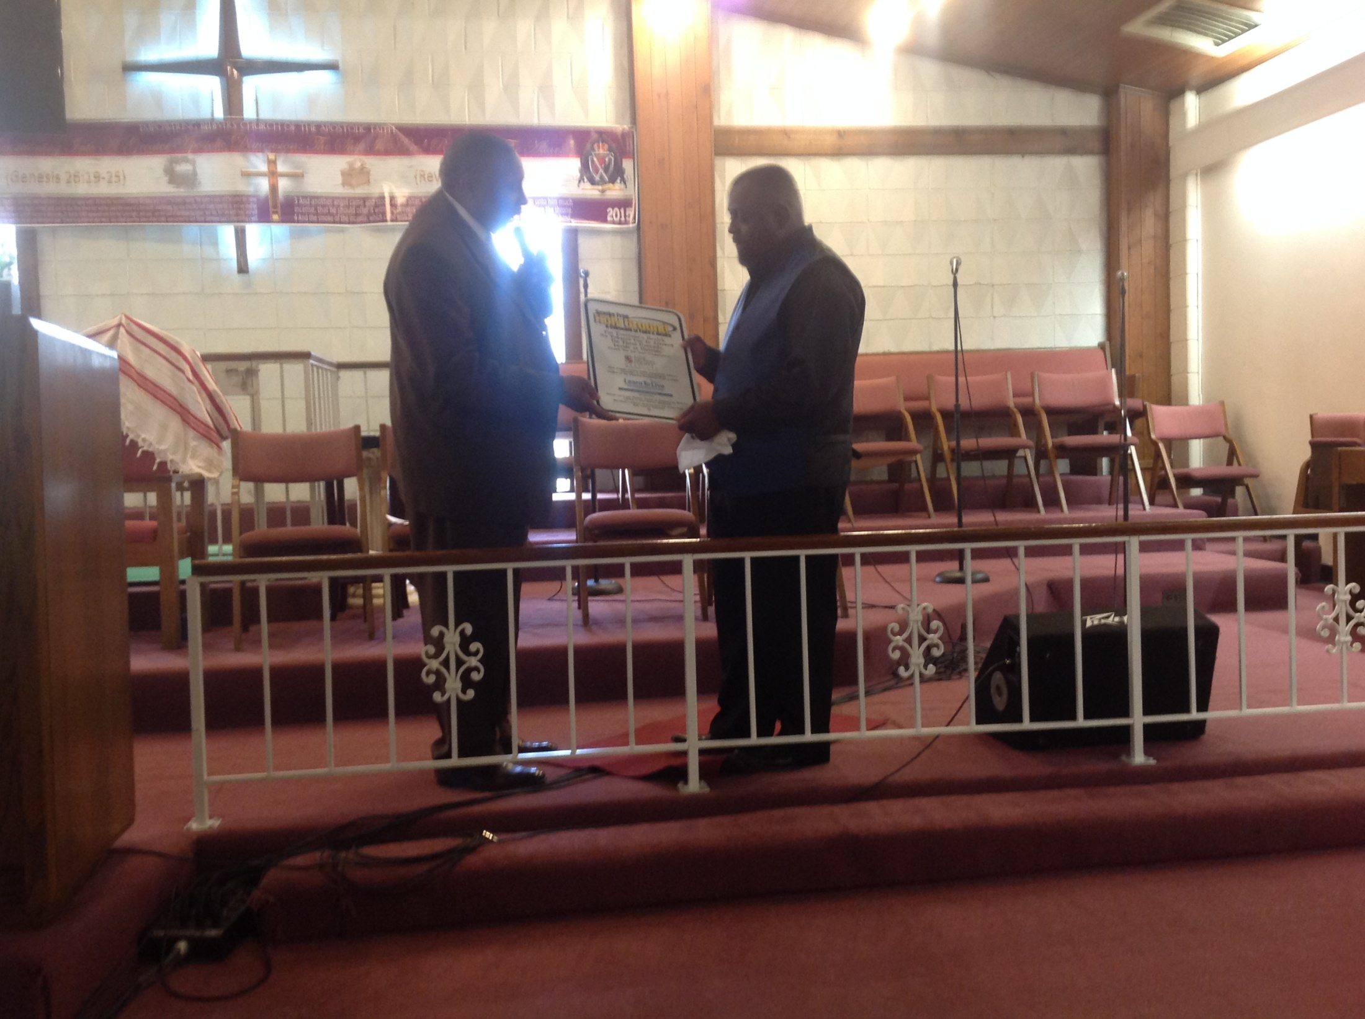

Slide 37
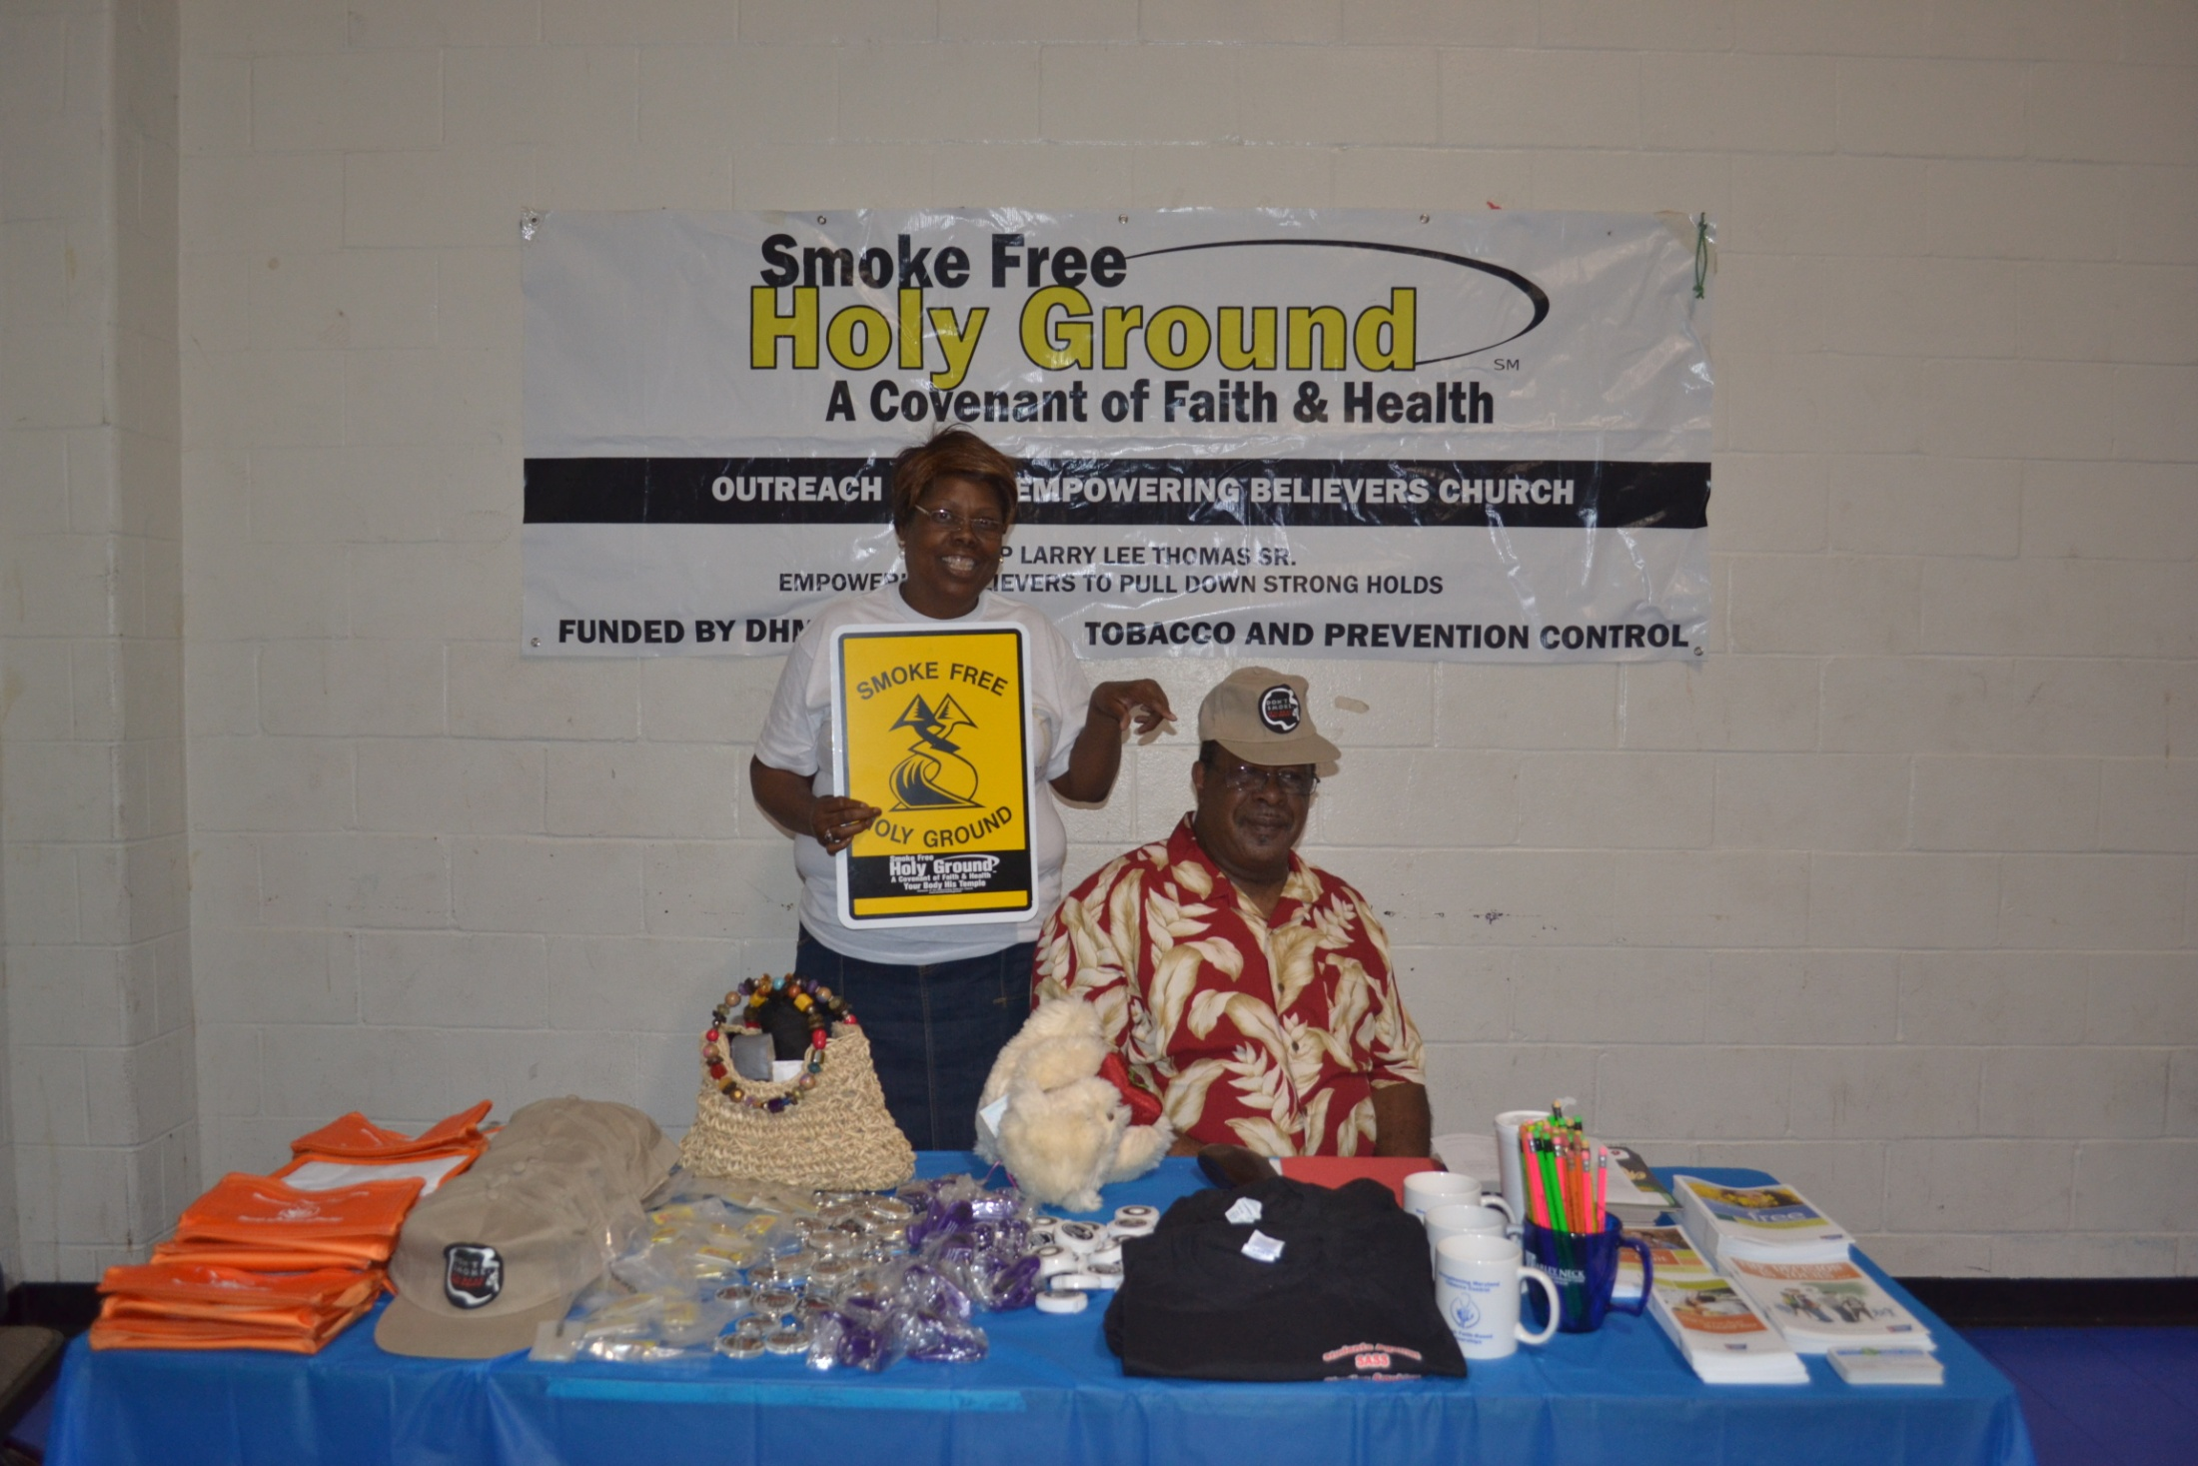

Slide 38
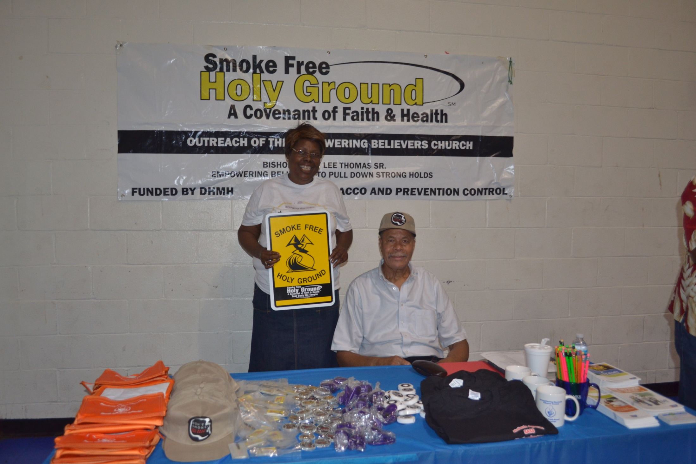

Slide 39
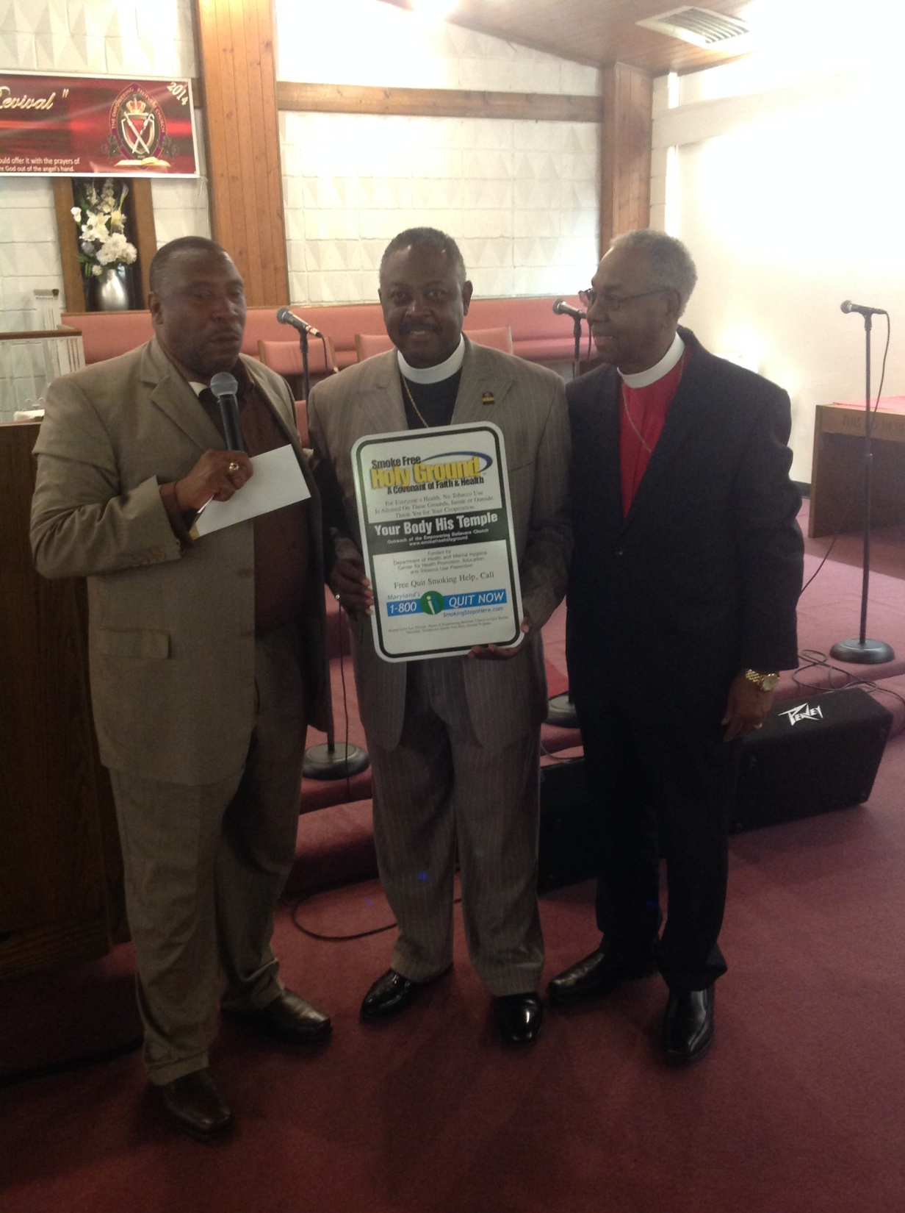

Slide 40
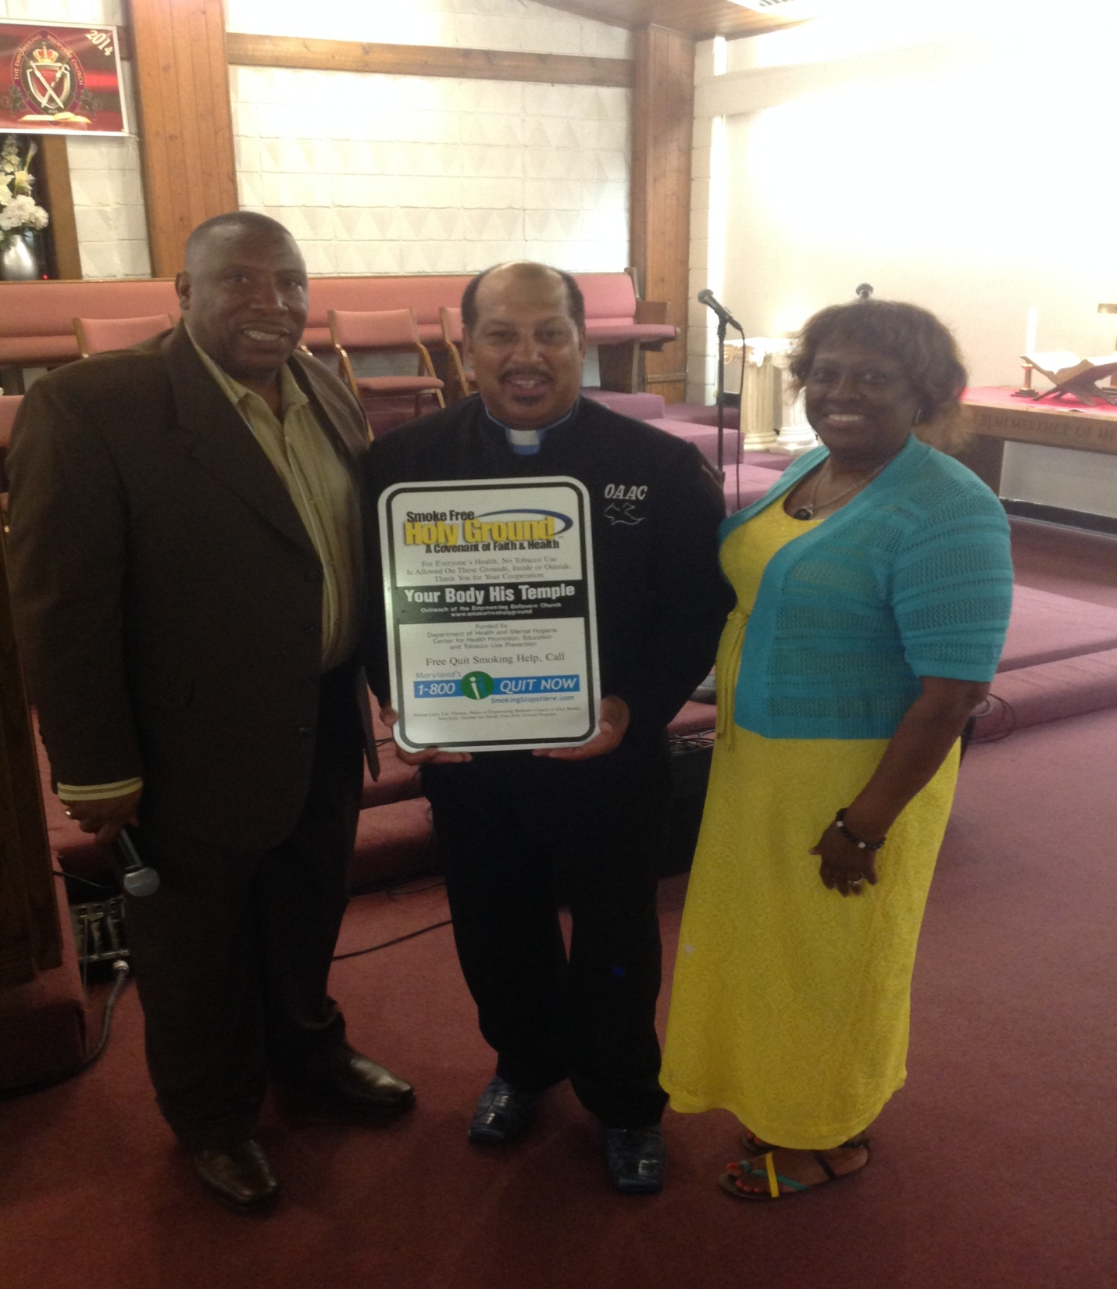

Slide 41
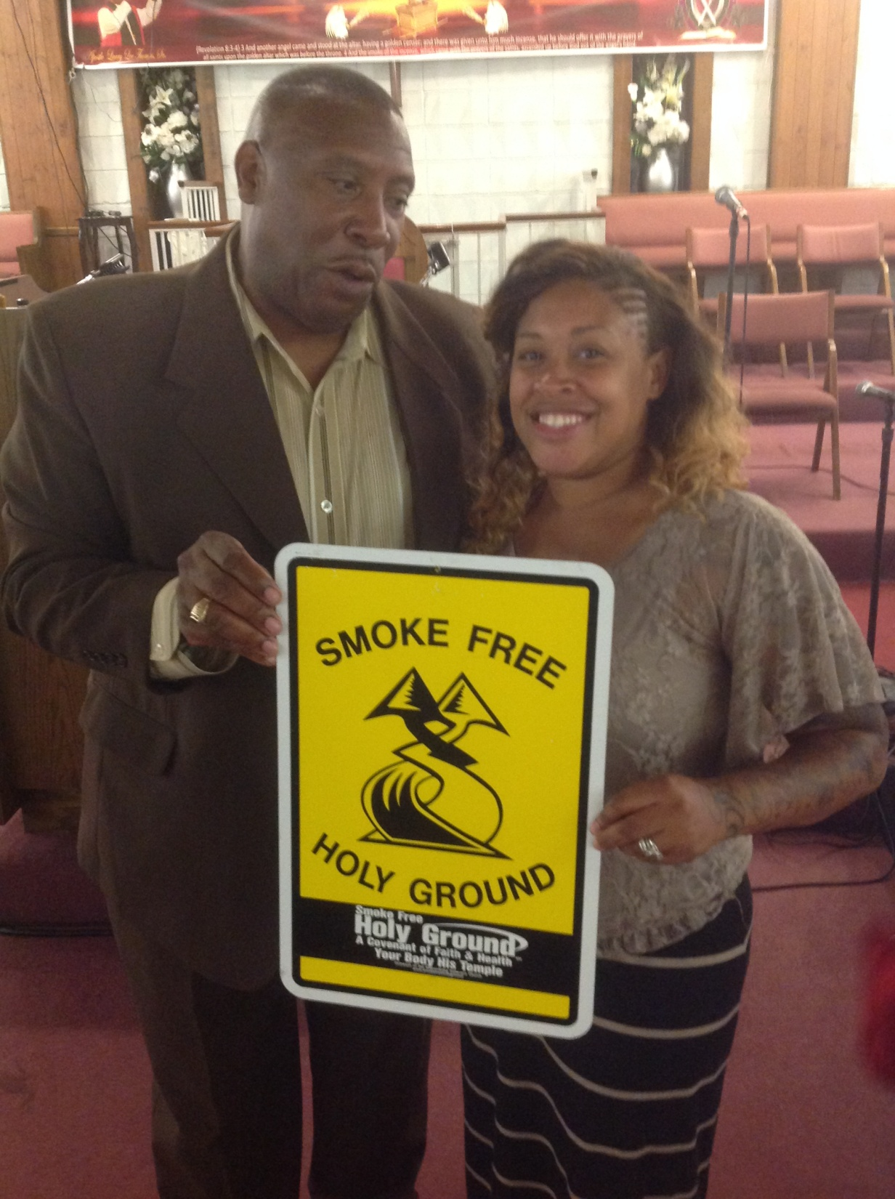

Slide 42
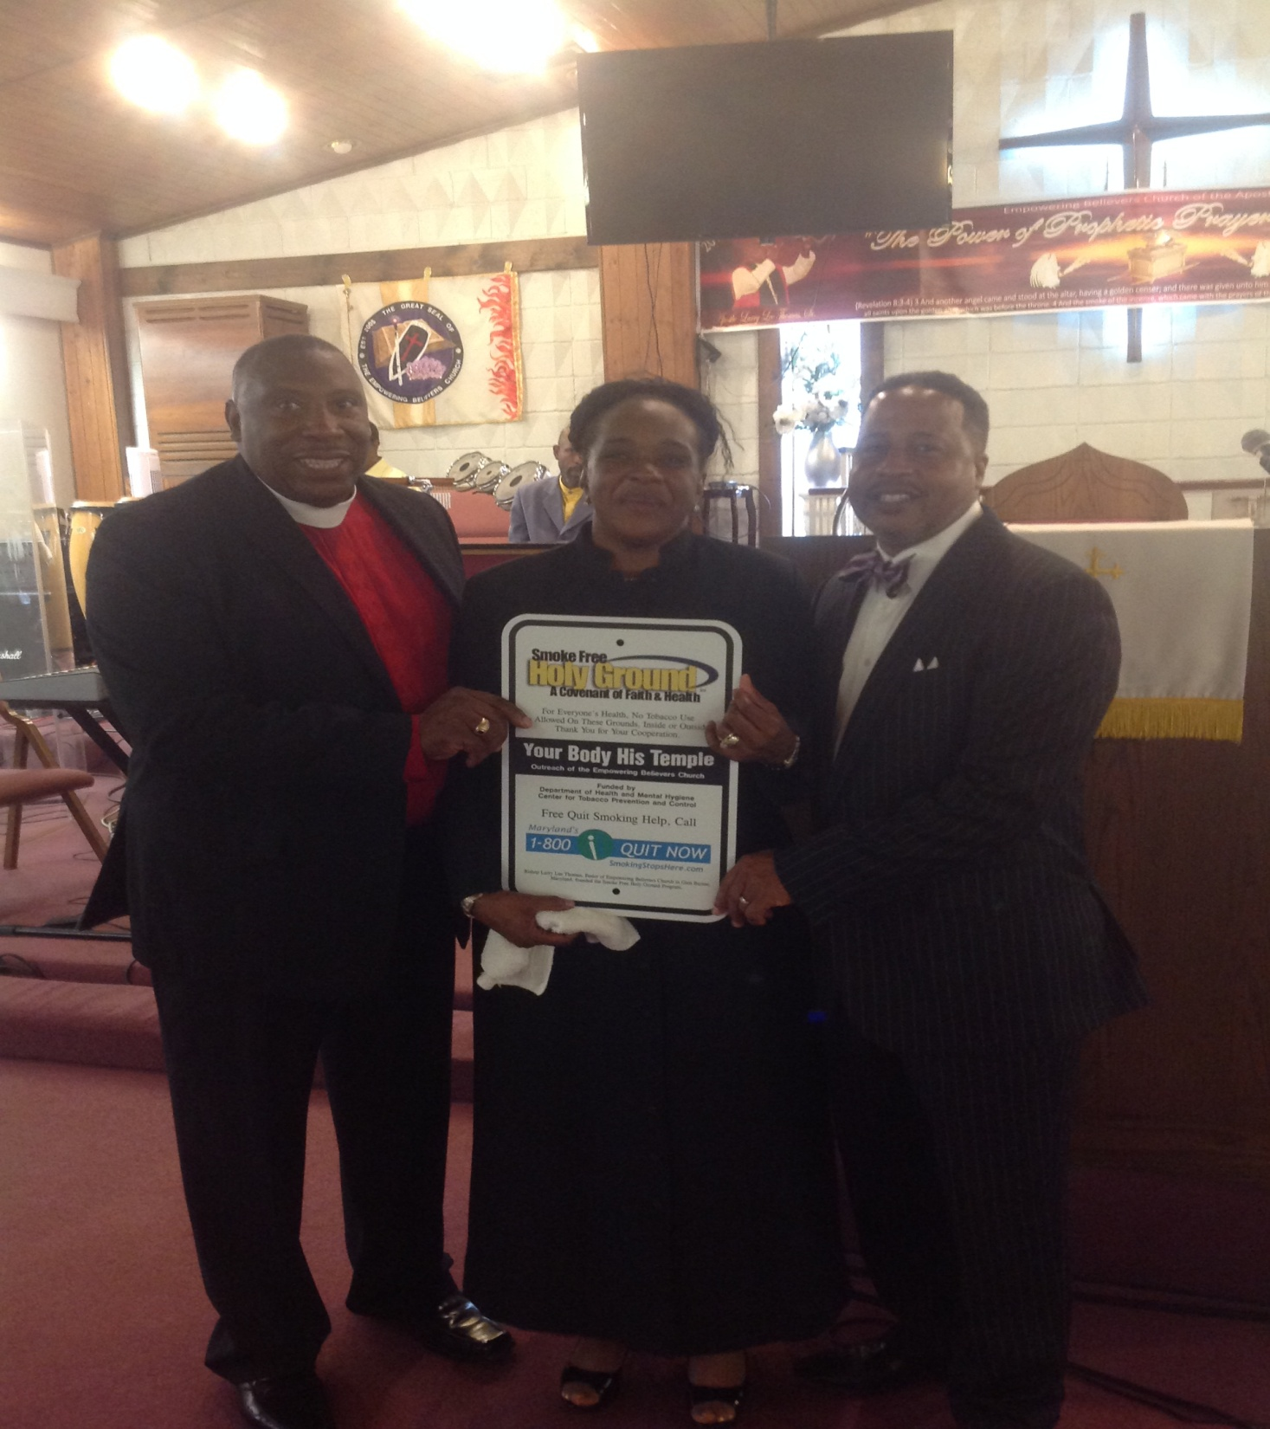

Slide 43
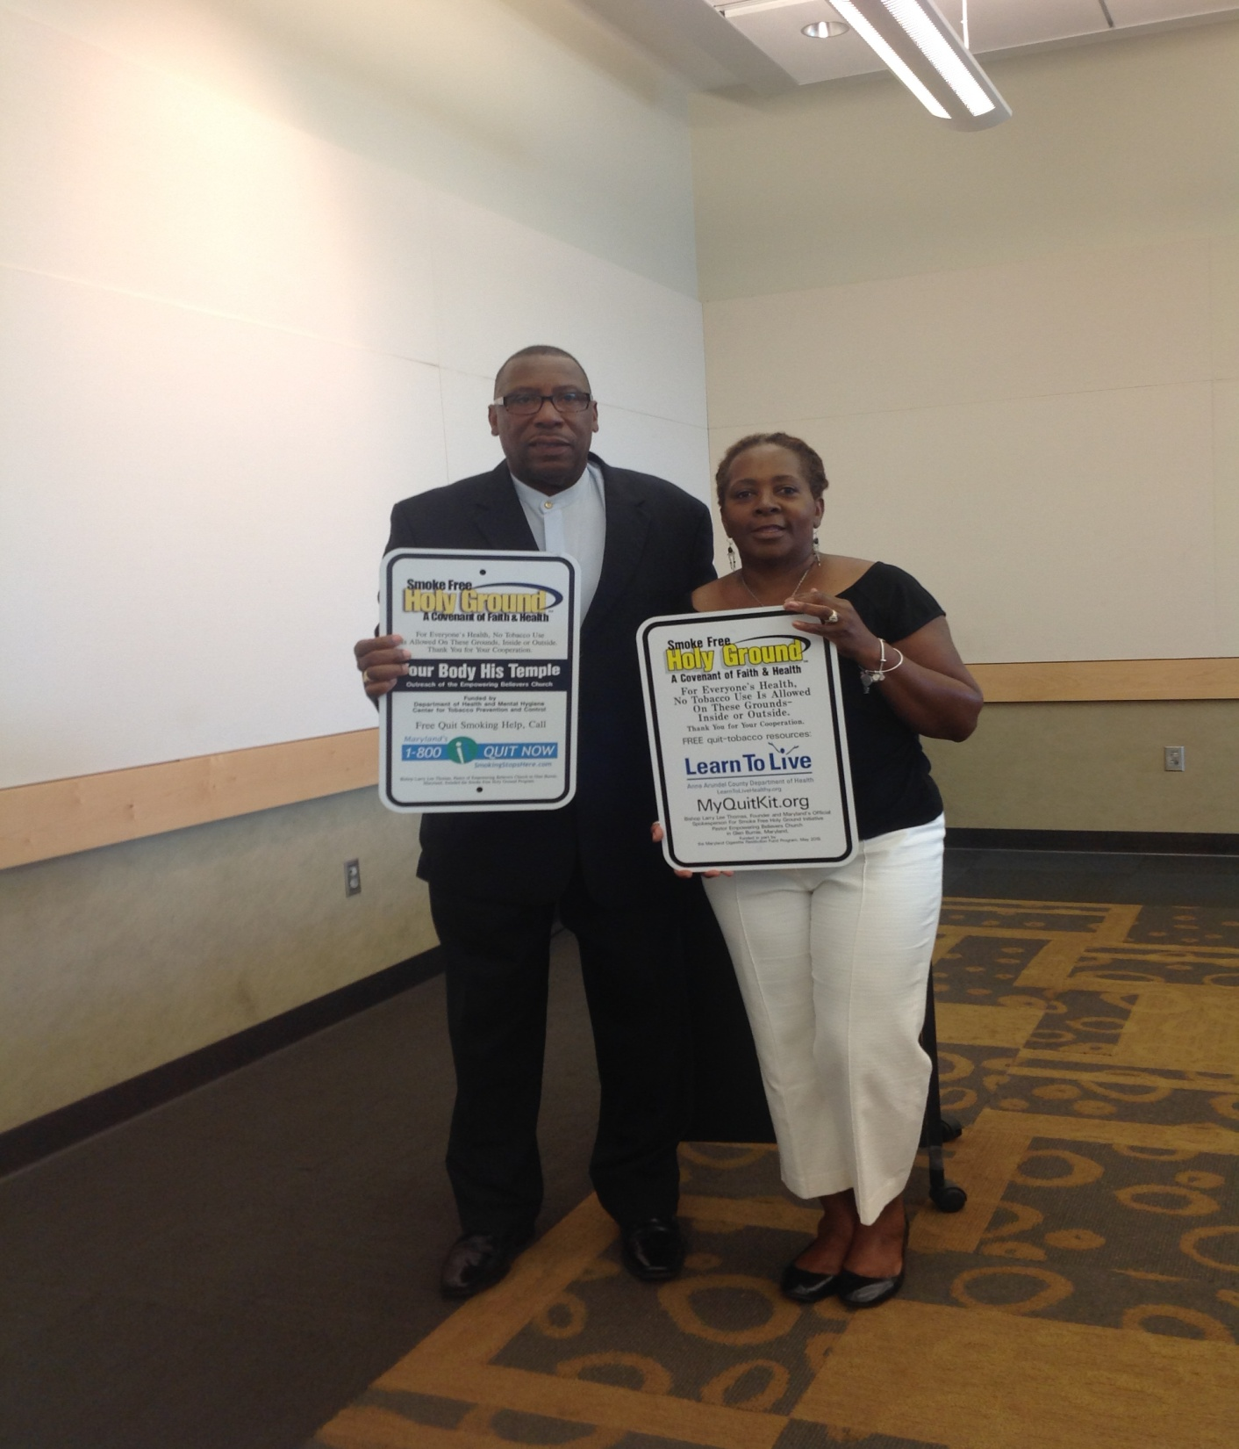

Slide 44
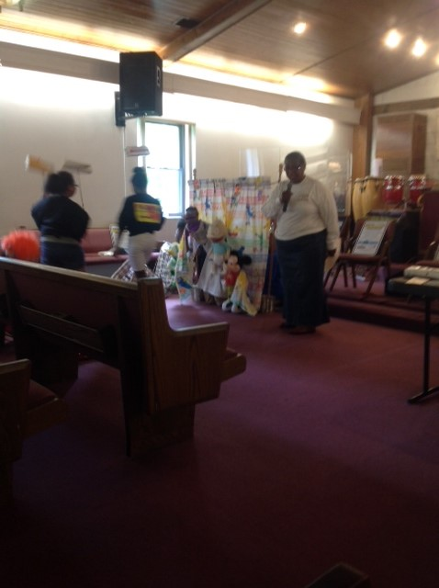

Slide 45


Slide 46


Slide 47


EBC Apostolic International Network
Africa Missions Trip
Smoke Free Holy Ground
Tanzania
Kenya

Slide 48

Smoke Free Holy Ground - Expansion to Rwanda and Mwanza Tanzania

Slide 49

Smoke Free Holy Ground - NIGERIA

Slide 50

Smoke Free Holy Ground - KENYA

Slide 51

Smoke Free Holy Ground - KENYA

Slide 52

Smoke Free Holy Ground

Slide 53

Smoke Free Holy Ground

Slide 54


Slide 55


Slide 56


Slide 57


Slide 58

Smoke Free Holy Ground in Uganda
Bishop Joseph Musenze

Slide 59


Slide 60

Smoke Free Holy Ground PRESENTATIONS

Slide 61

Smoke Free Holy Ground PRESENTATIONS

Slide 62

Smoke Free Holy Ground
Western Kenya

Slide 63
Smoke Free Holy Ground
Western Kenya

Slide 64

Smoke Free Holy Ground Rwanda

Slide 65

Smoke Free Holy Ground
Mwanza Tanzania

Slide 66

Smoke Free Holy Ground PRESENTATIONS

Slide 67

SFHG - RWANDA

Slide 68

SFHG - RWANDA

Slide 69


Slide 70
Tools to Succeed & Grow
Educational Events
Increased Partnerships
Community Awareness
Continued Partnership Support
Promotional items (signs, tee shirts, bumper stickers, books, etc.
Sounding the Alarm!

Slide 71



