Slide 1

American Foundation for Suicide Prevention (AFSP)
Healthy St. Mary’s Partnership

Slide 2
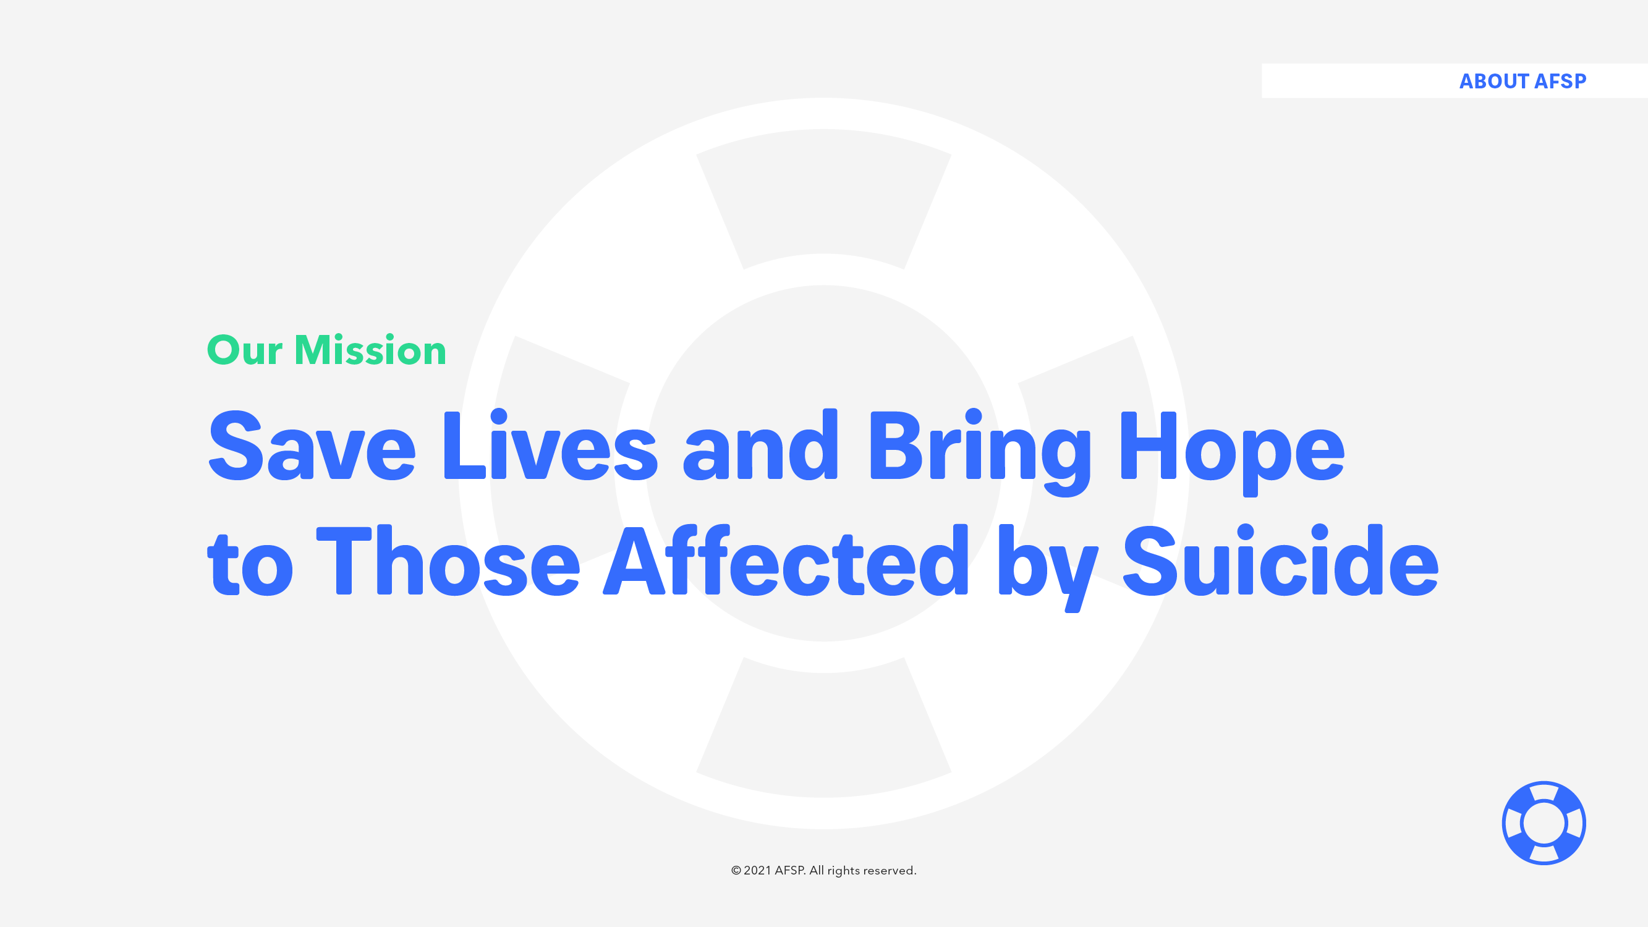

Slide 3
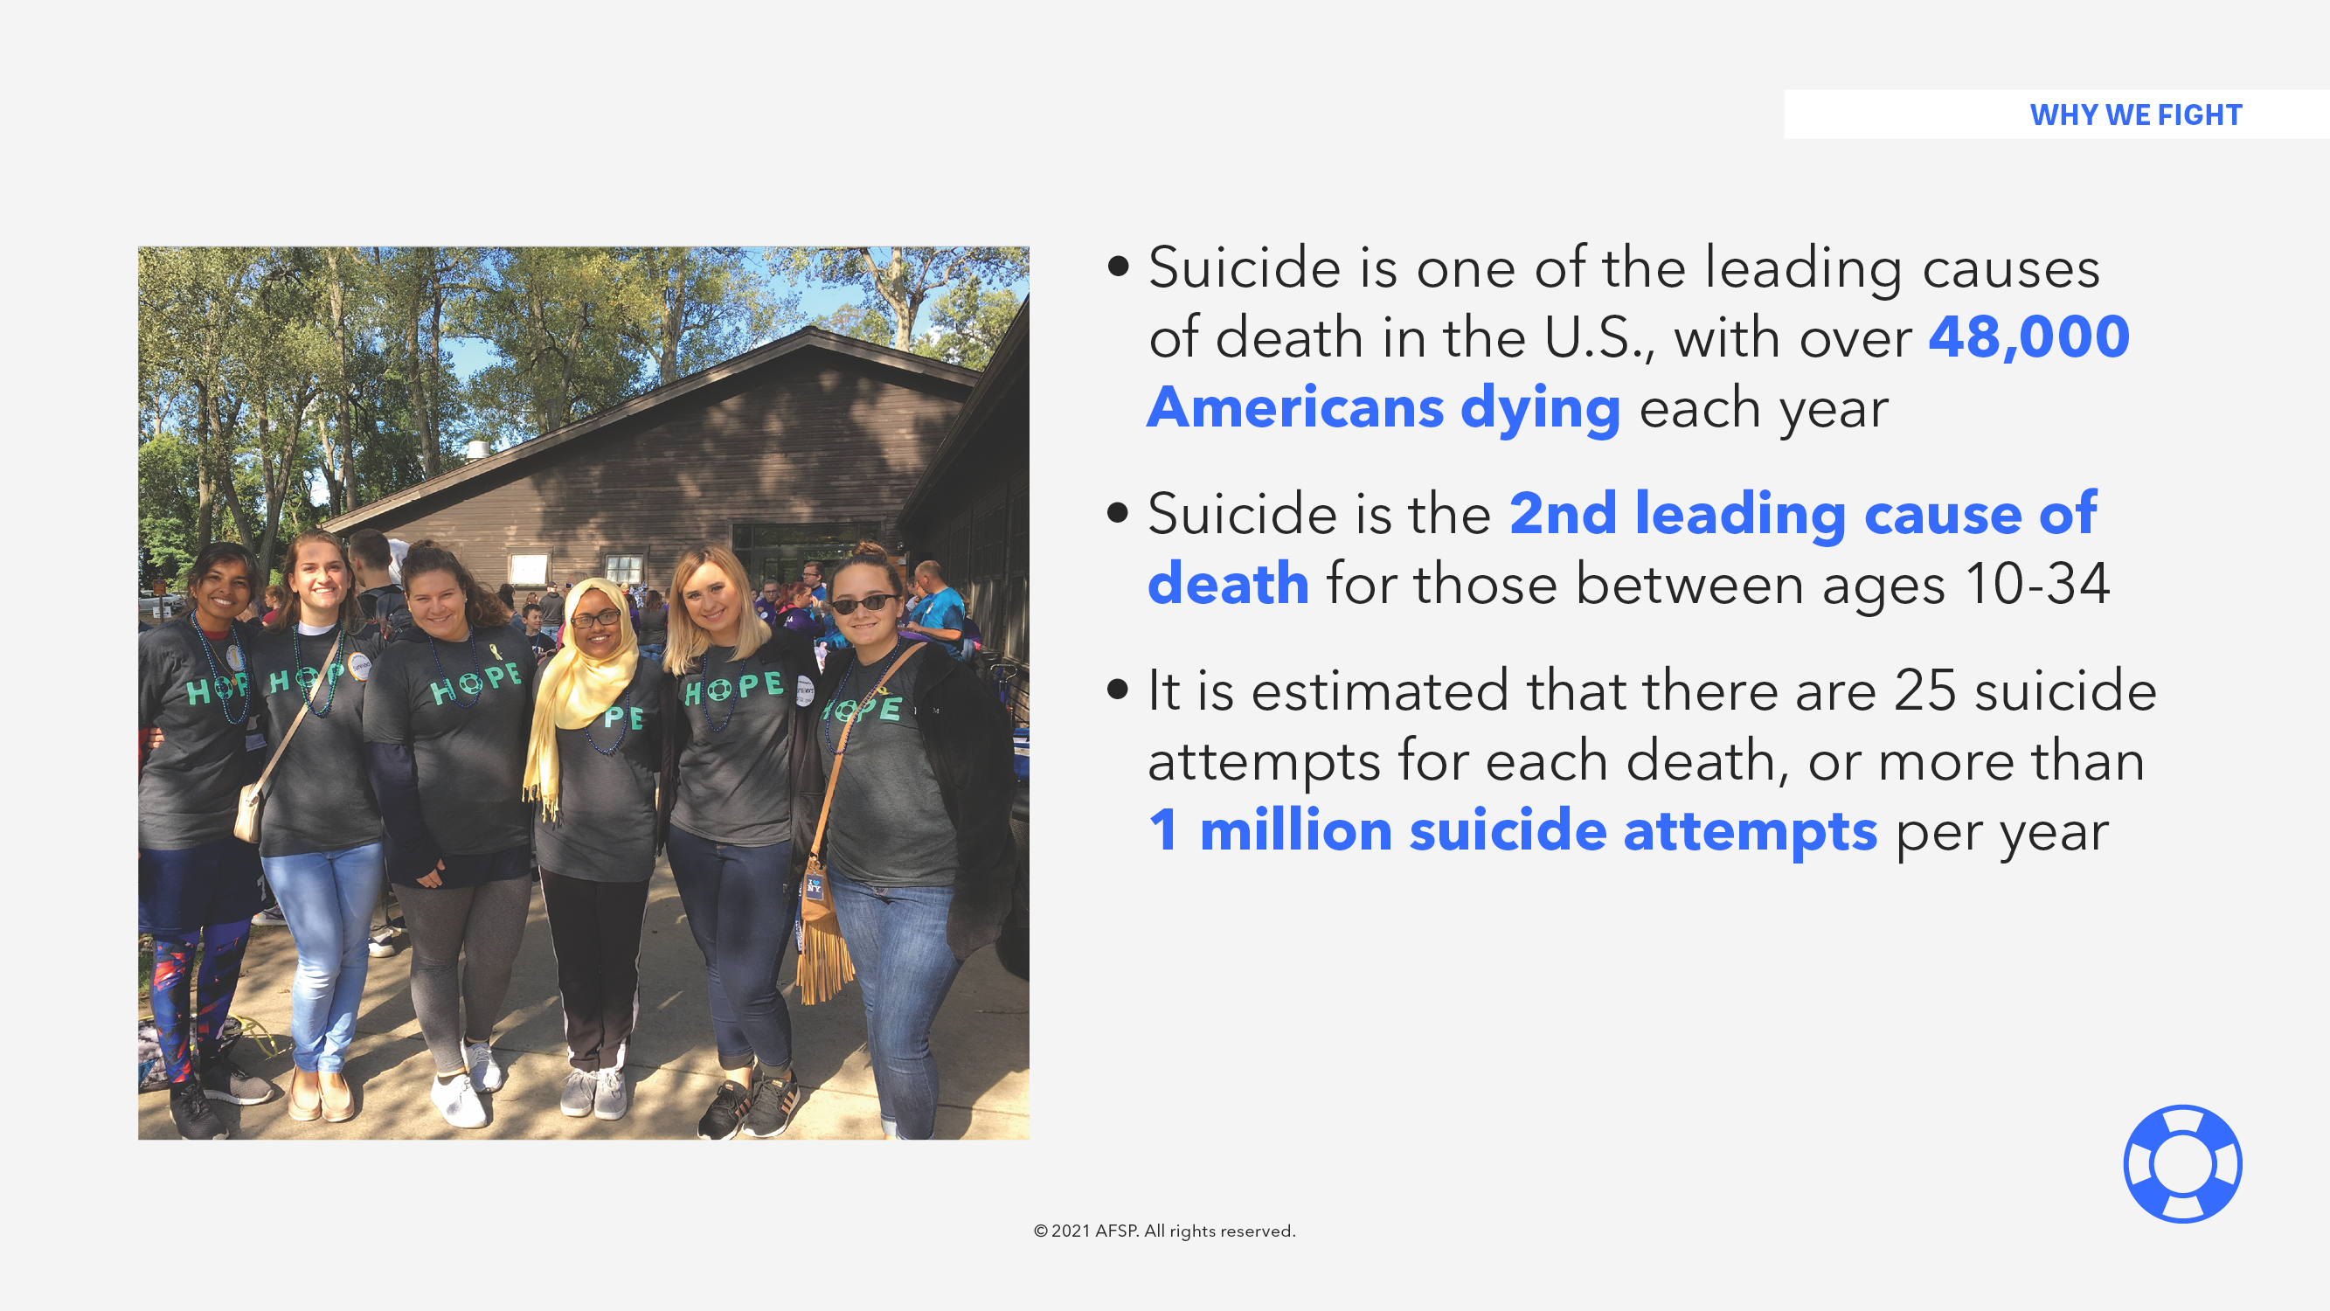

Slide 4
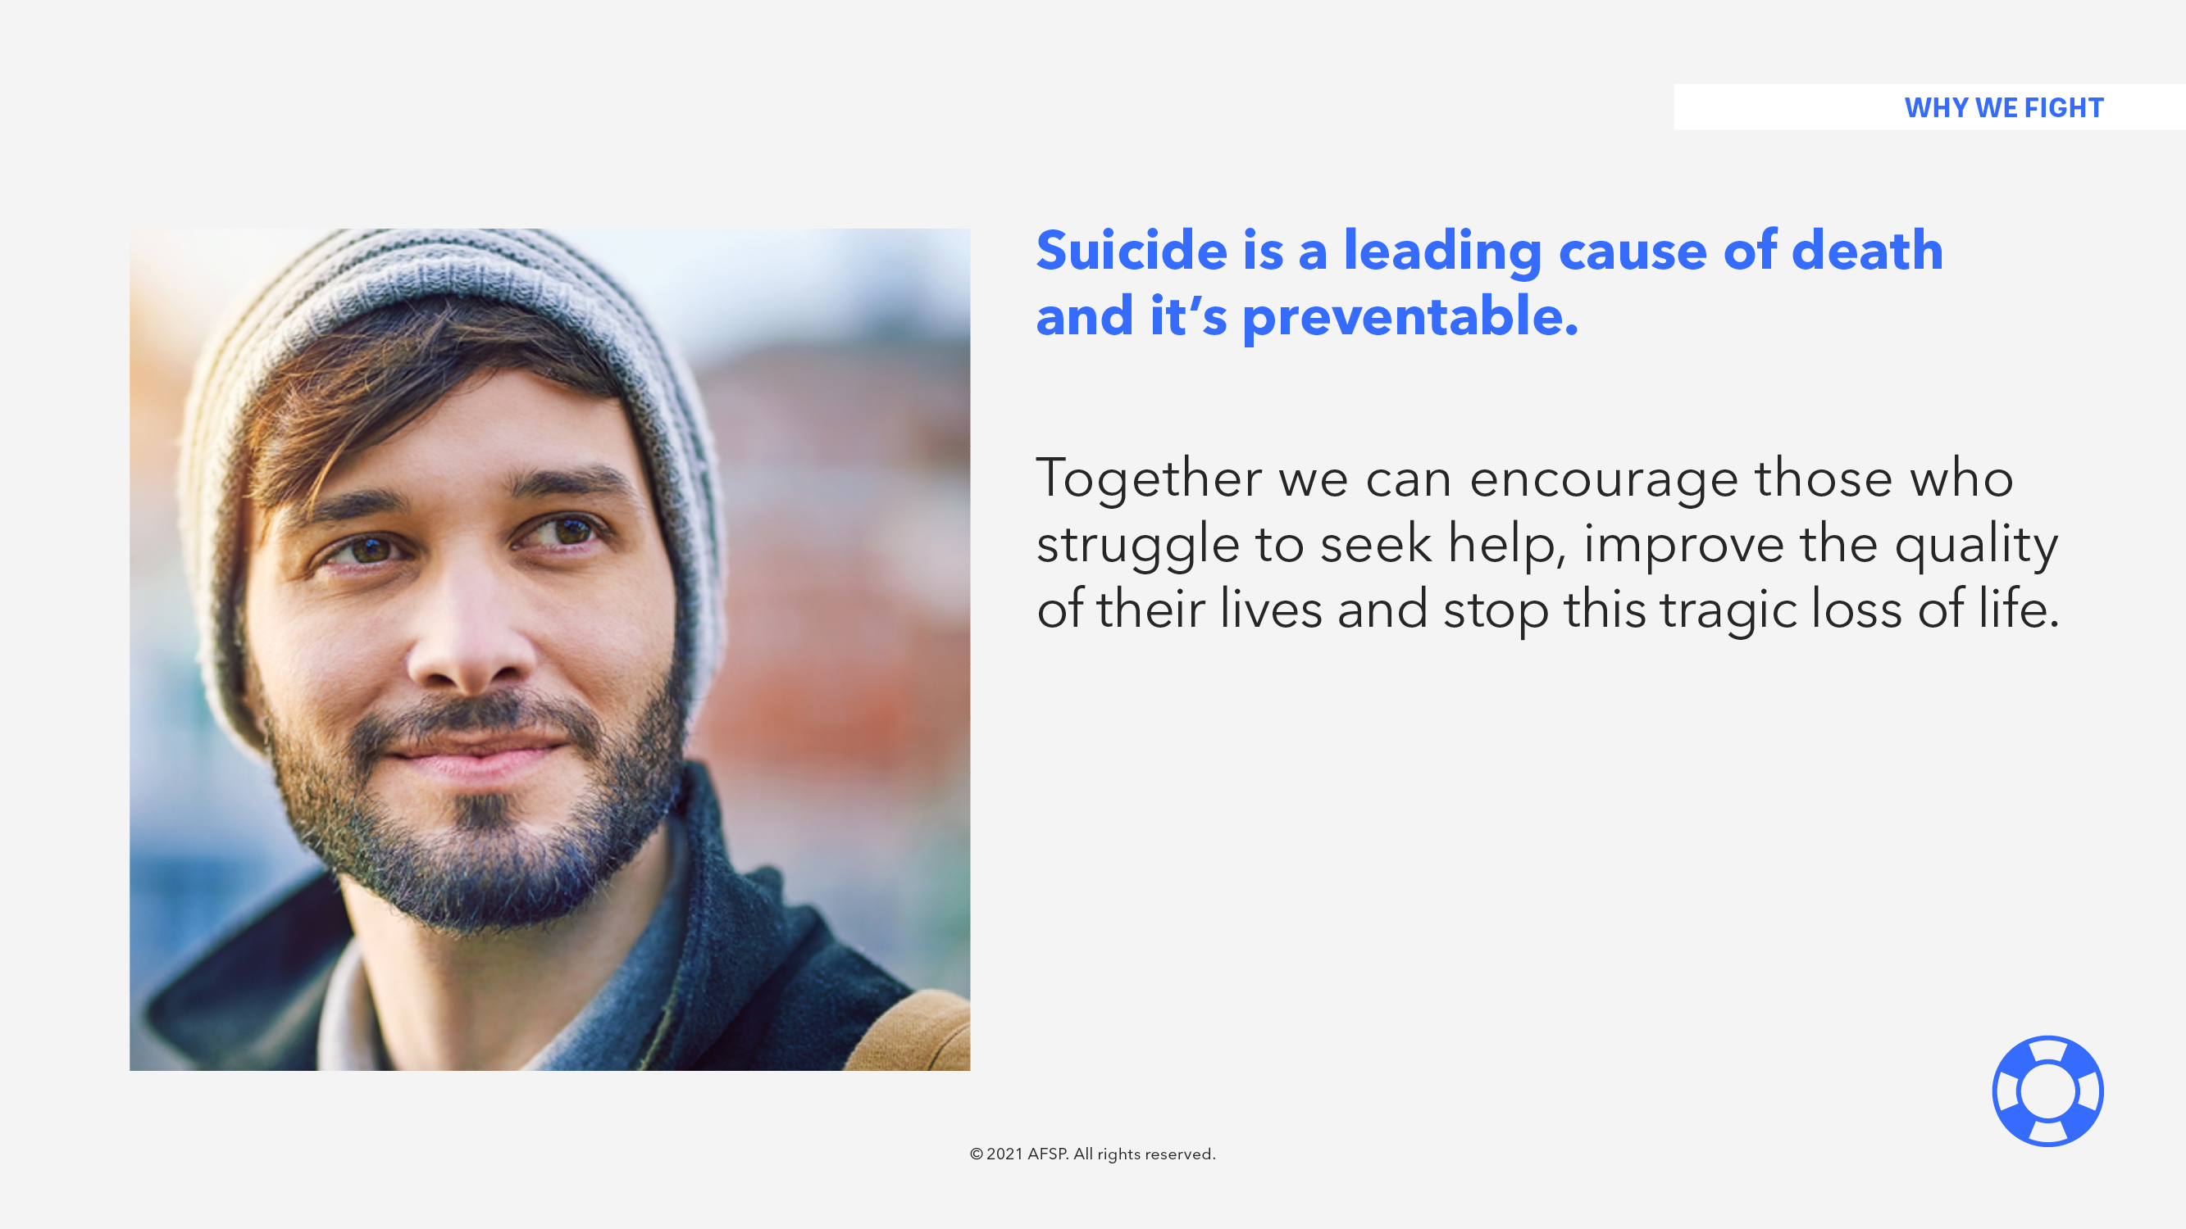

Slide 5
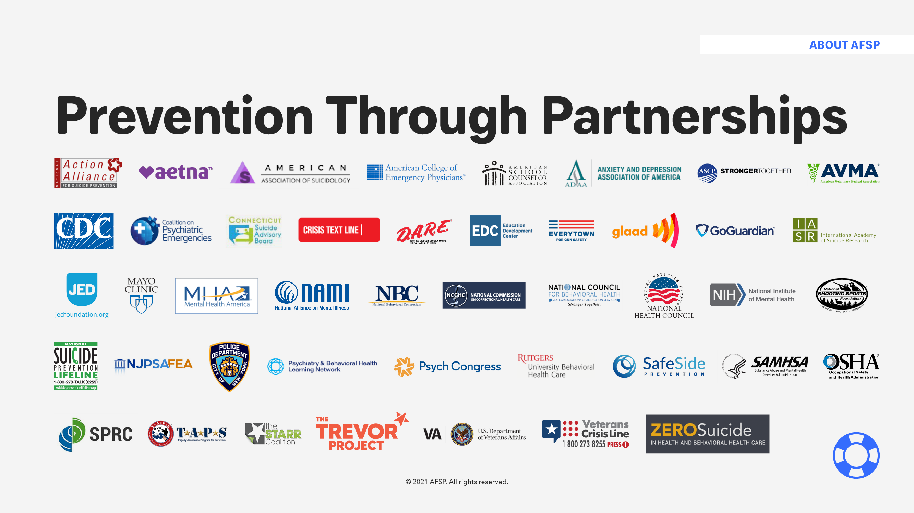

Slide 6
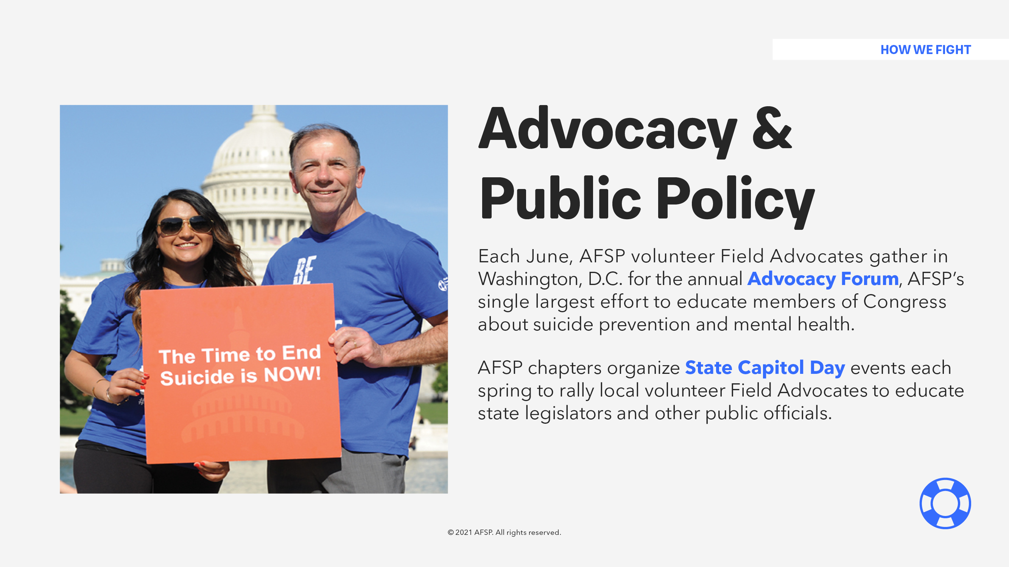

Slide 7
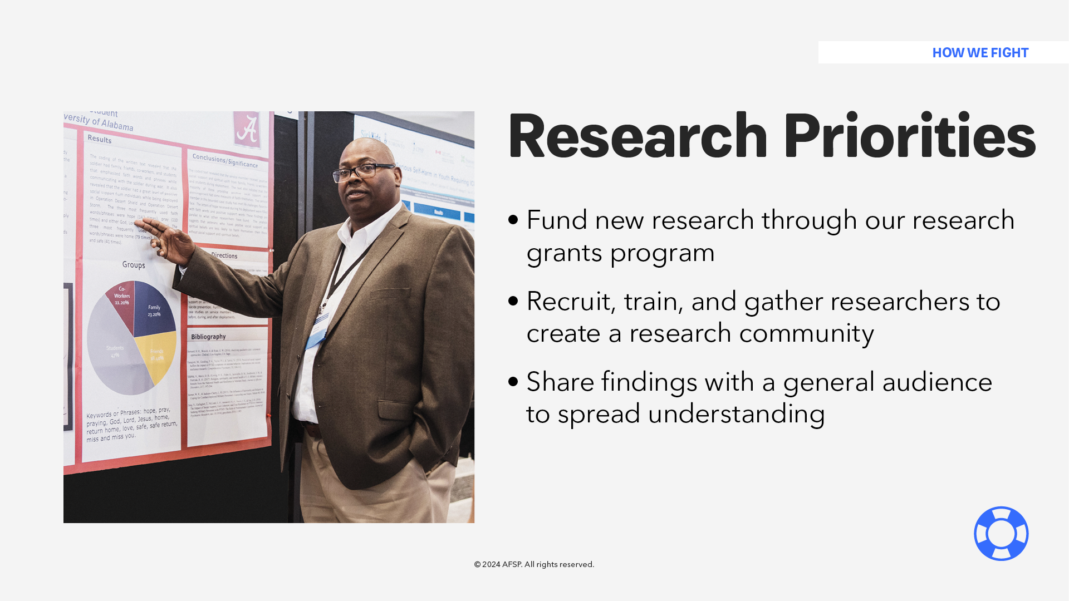
Notes:
One key way we fight is through research. Our current research priorities include: Funding new research through our grants program, Creating a research community by recruiting, training and gathering researchers. And finally, by Sharing the research findings to improve understanding and spread awareness.

Slide 8
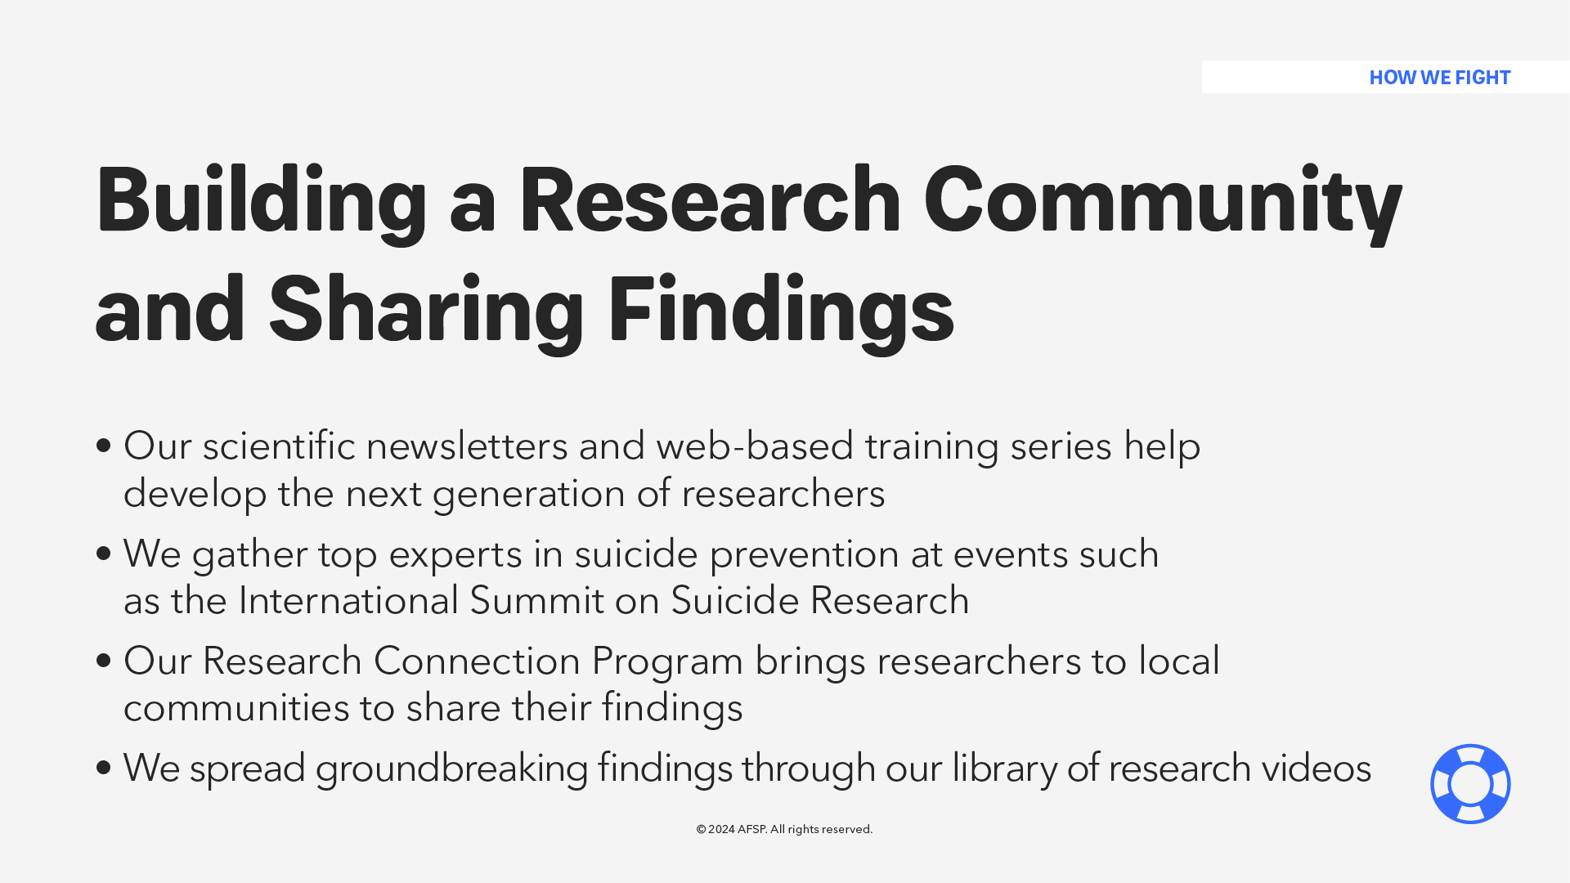

Slide 9
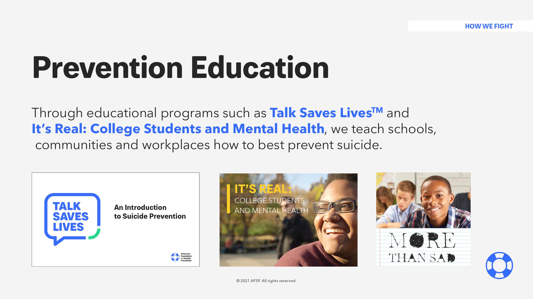

Slide 10
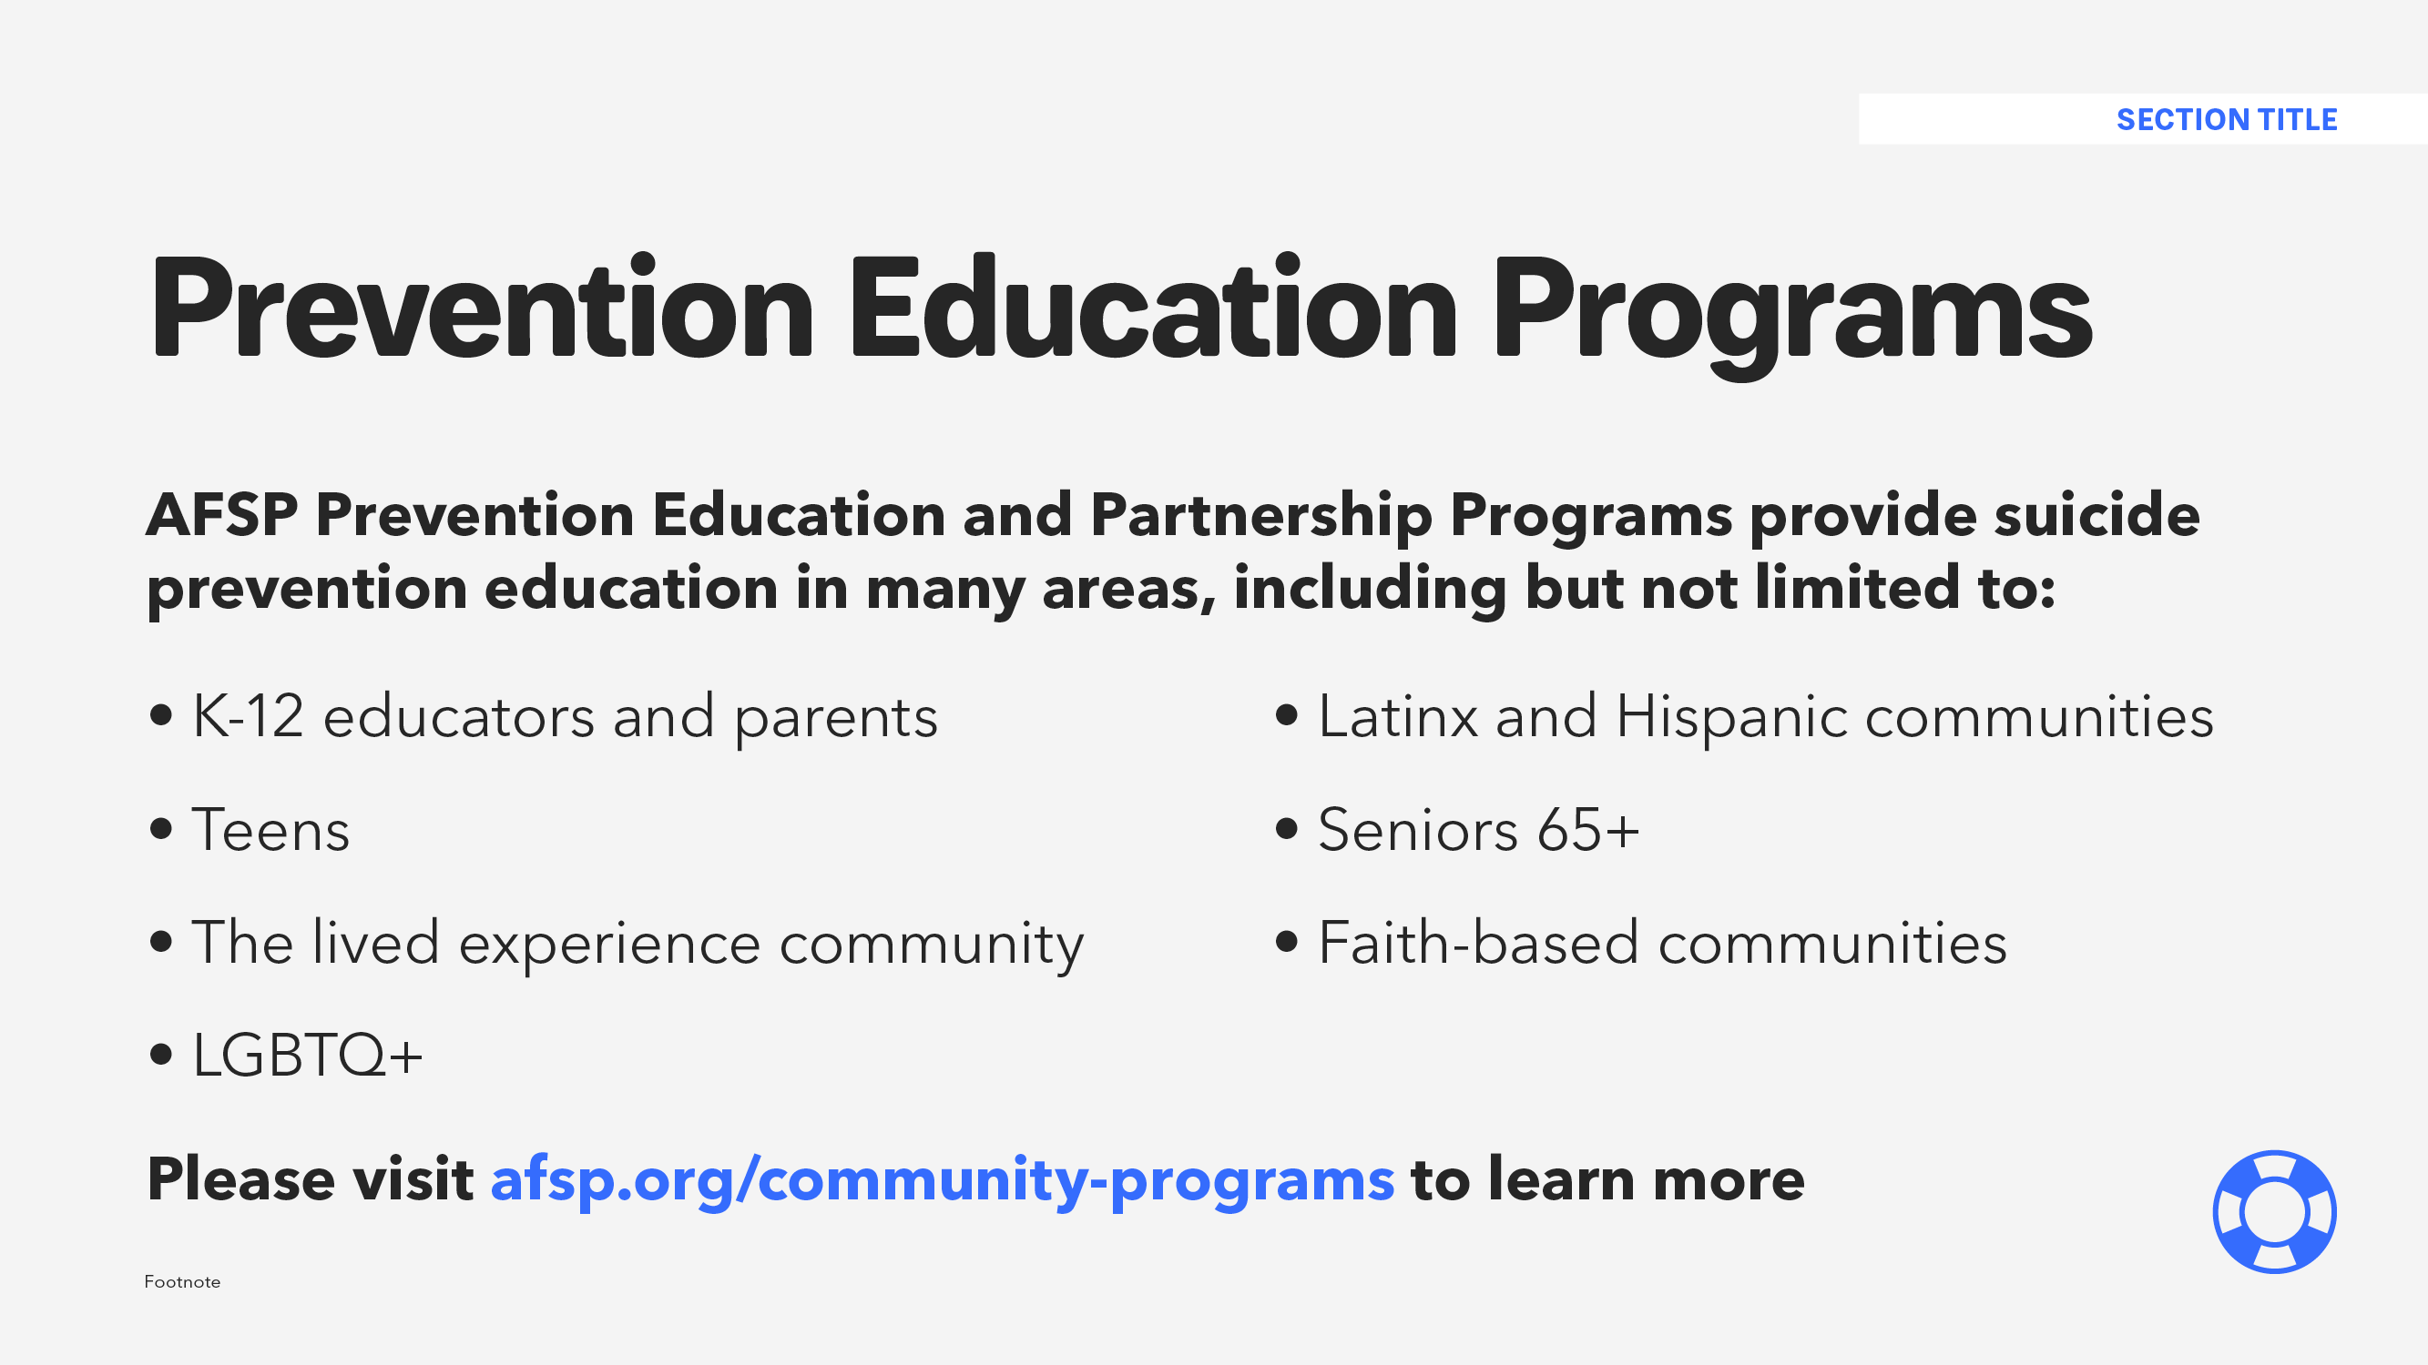

Slide 13
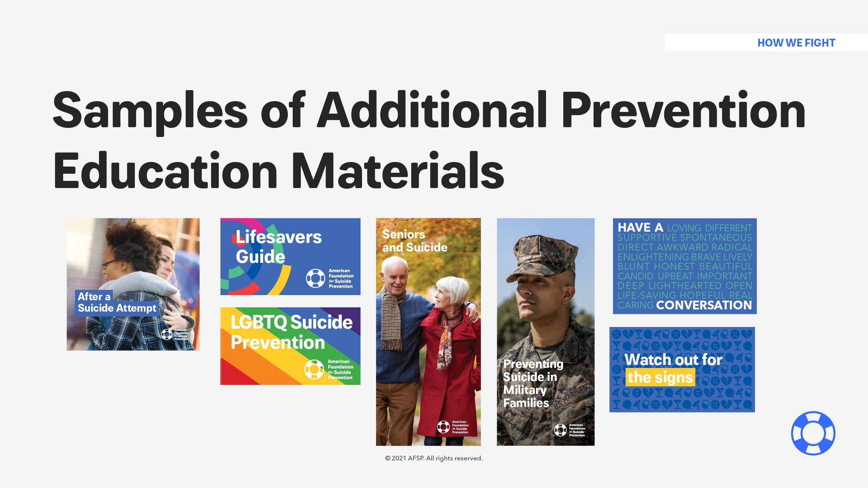

Slide 14
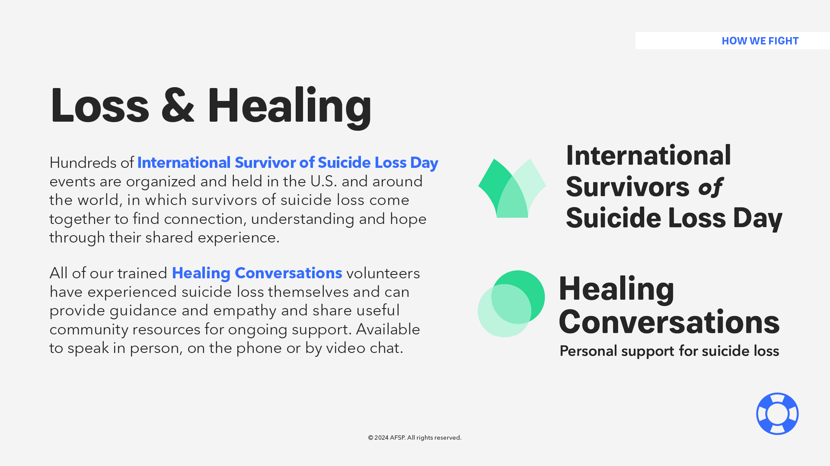
Notes:
Through our International Survivors of Suicide Loss Day and Healing Conversations program, AFSP provides support year-round to those who have been affected by suicide.
International Survivors of Suicide Loss Day is an annual event in which survivors of suicide loss come together to find connection, understanding, and hope through their shared experience.
Last November New Jersey hosted 6 Survivor Day events across the state with over 150 survivors attending.
Healing Conversations gives those who have lost someone to suicide the opportunity to talk with our experienced volunteers. These AFSP volunteers, who are themselves survivors of suicide loss, offer understanding and guidance in the weeks and months following a suicide death. Available in person, on the phone or by video chat, our volunteers are familiar with the isolation that so often accompanies a death of this kind, and are able to show suicide loss survivors a way forward into a world of support, by creating an opportunity for the newly bereaved to speak openly with someone who has been there, too, and truly gets it.

Slide 15
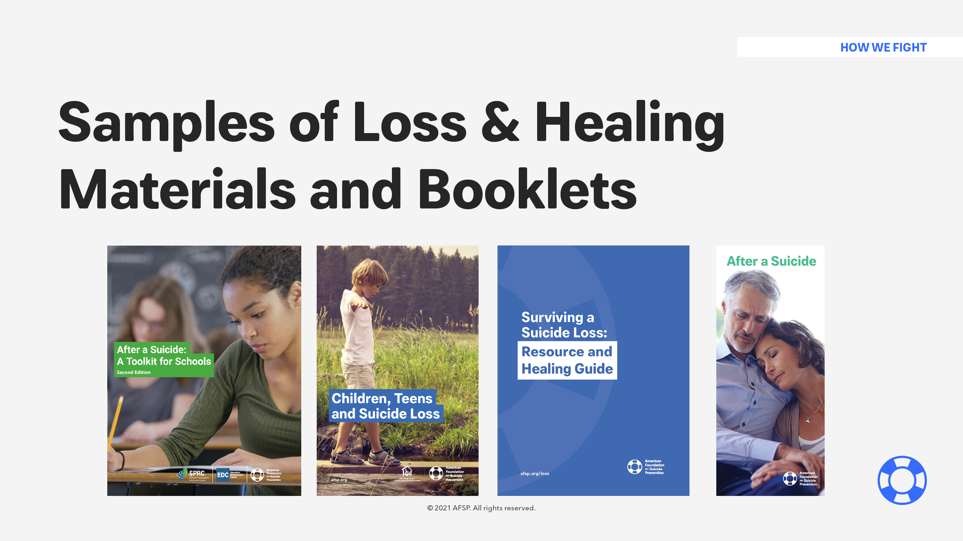

Slide 16
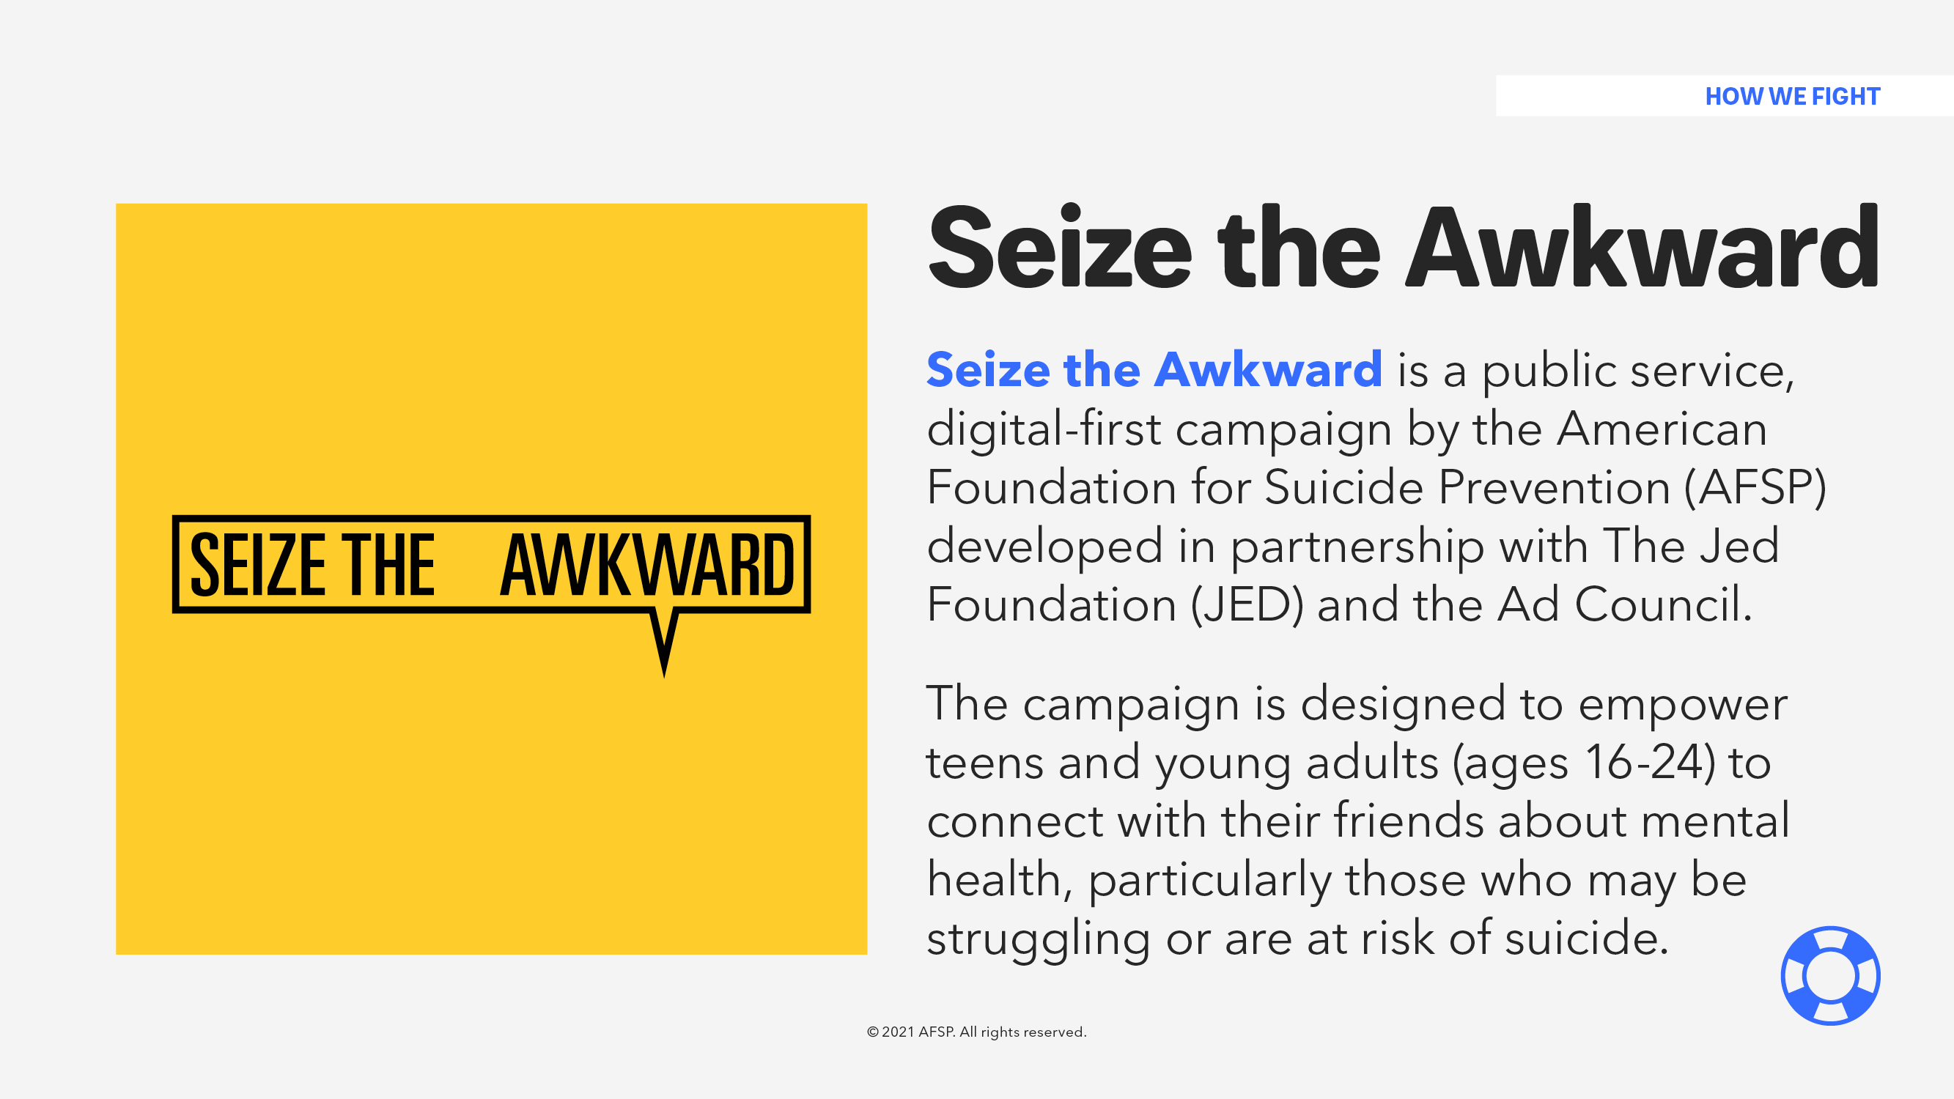

Slide 17
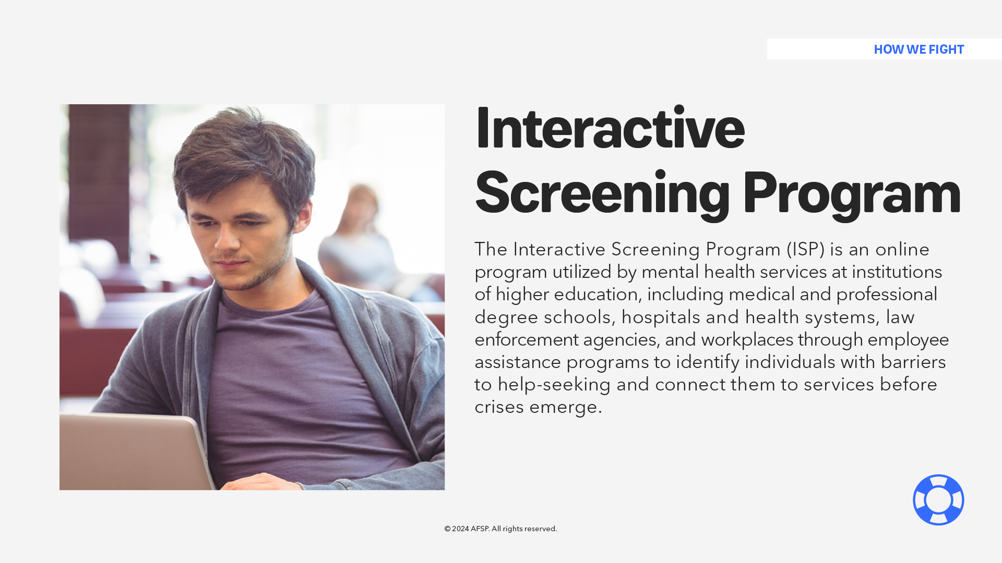
Notes:
The Interactive Screening Program (ISP) connects individuals to mental health services before crises emerge.
ISP is an online program utilized by mental health services at institutions of higher education, including medical and professional degree schools, hospitals and health systems, law enforcement agencies, and organizations and workplaces through their Employee Assistance Programs (EAPs).
Even when people know about available mental health services, shame, fear, and embarrassment often prevent them from seeking help. Through a customized program, ISP provides a safe and confidential way for individuals to take a brief screening for stress, depression, and other mental health conditions, and receive a personal response from a program counselor within the mental health services available to them. Individuals can anonymously communicate with the program counselor to receive recommendations, feedback, and support for connecting to available mental health services.

Slide 18
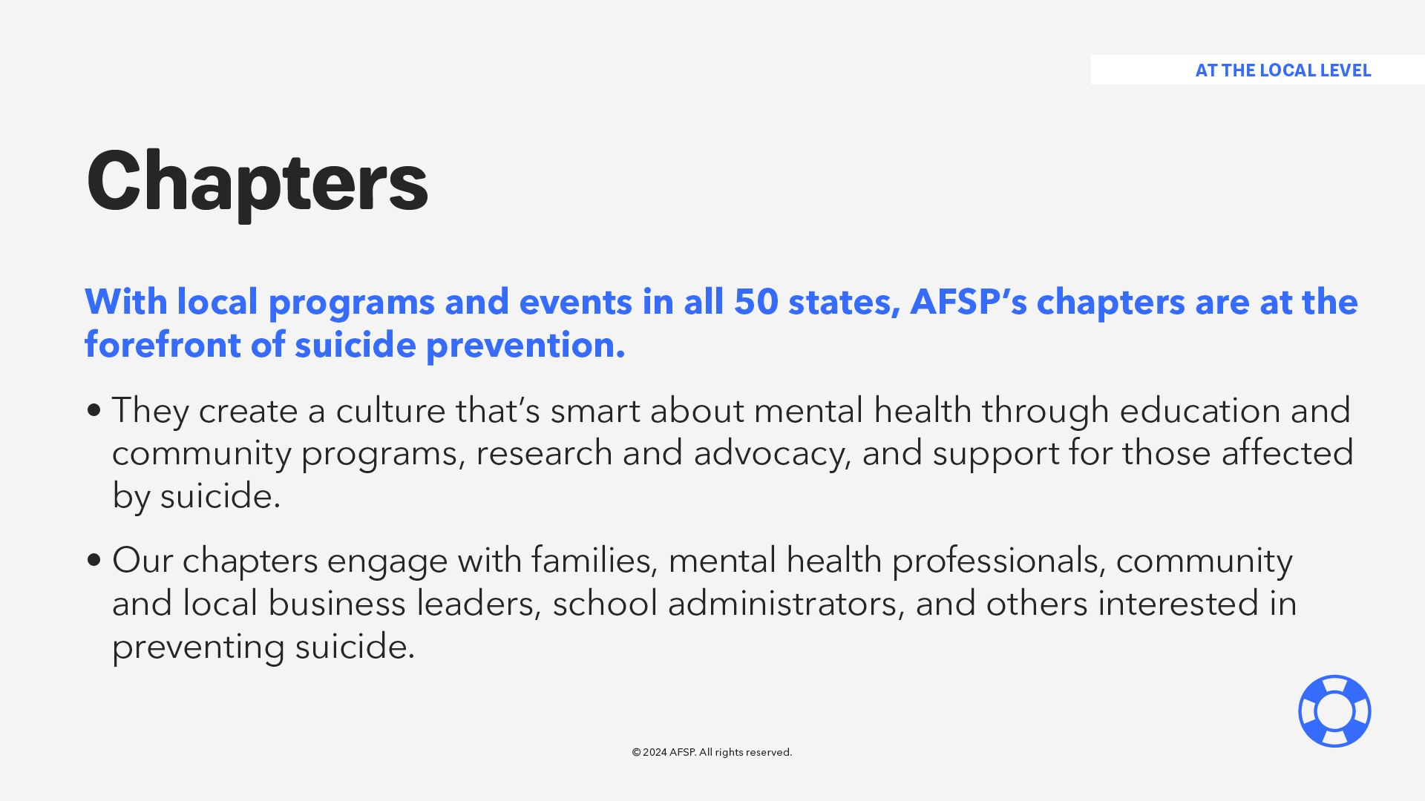

Slide 19
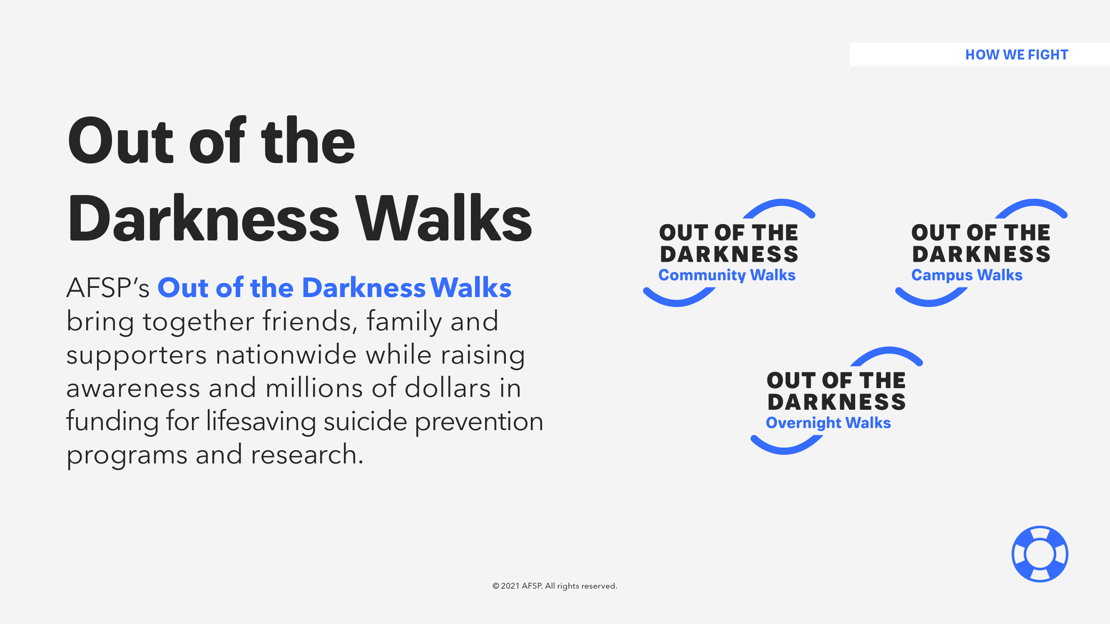

Slide 20
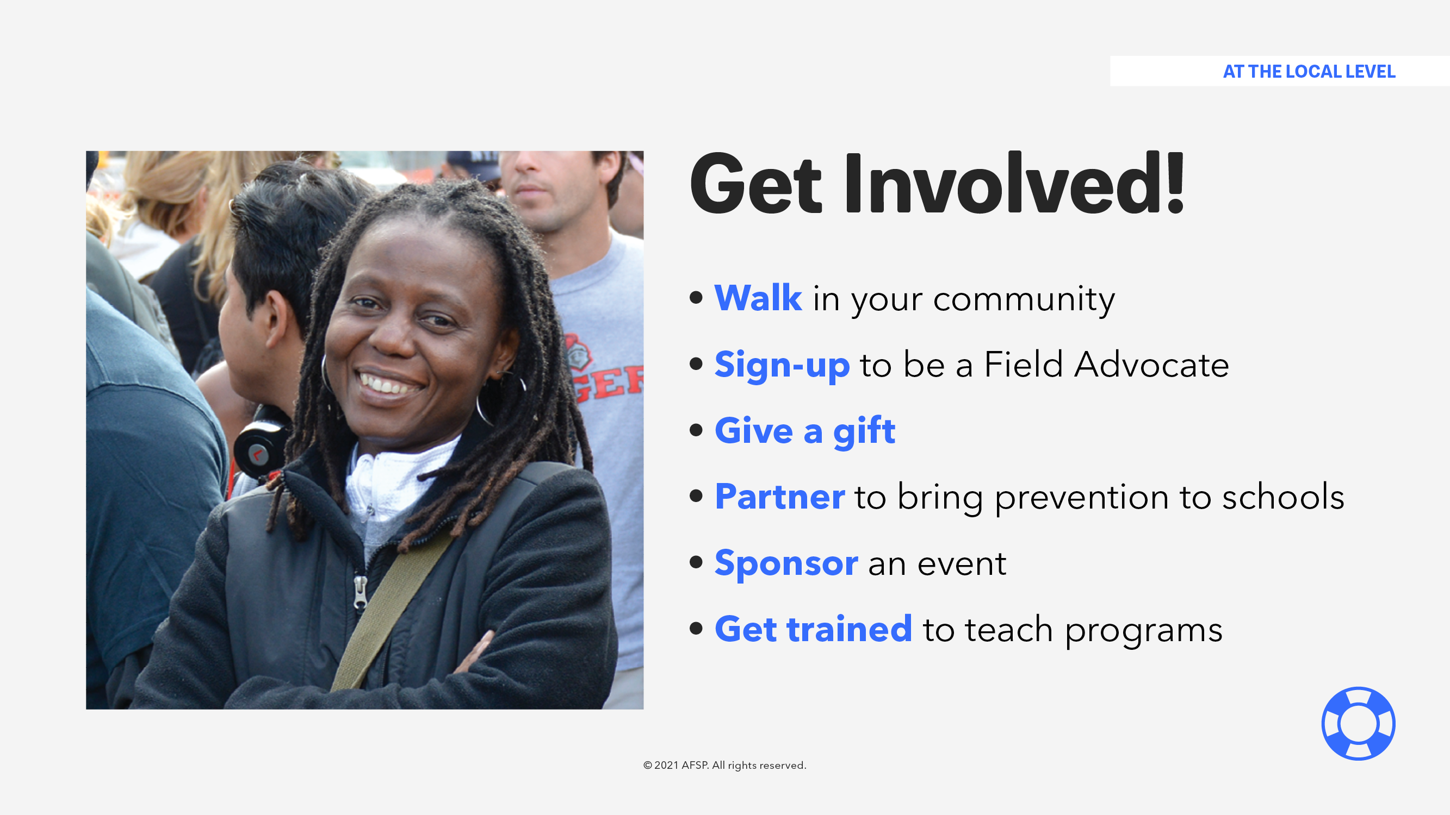

Slide 21
@afspmaryland
Marina Thompson
Maryland Area Director
mthompson@afsp.org

